Slide 1



SoK
Certified Robustness for Deep Neural Networks
Linyi Li (UIUC), Tao Xie (Peking University), Bo Li (UIUC)
UIUC Secure Learning Lab

Slide 2


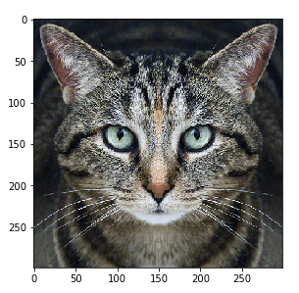
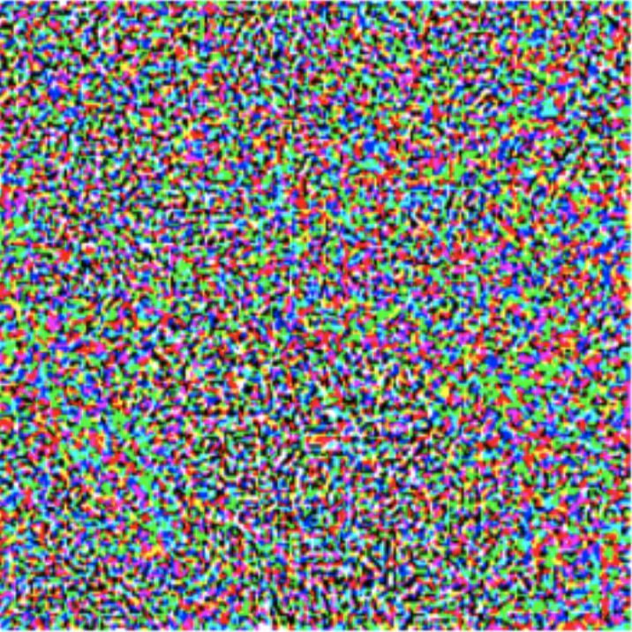

Adversarial Robustness – A Lasting Threat
Deep neural networks (DNNs) can be easily fooled by adversarial examples
  Tiny crafted perturbations can make DNNs give wrong predictions
Cat
Adversarial
Distortion
Dog
Carefully crafted noise

Slide 3
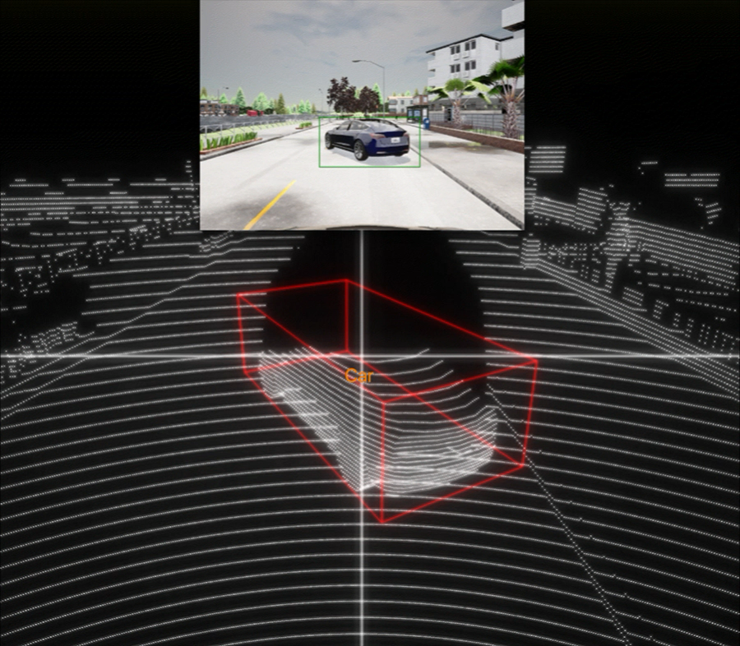
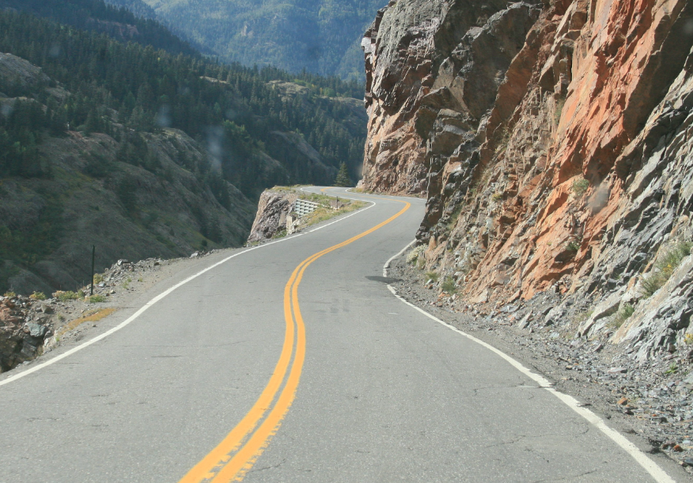
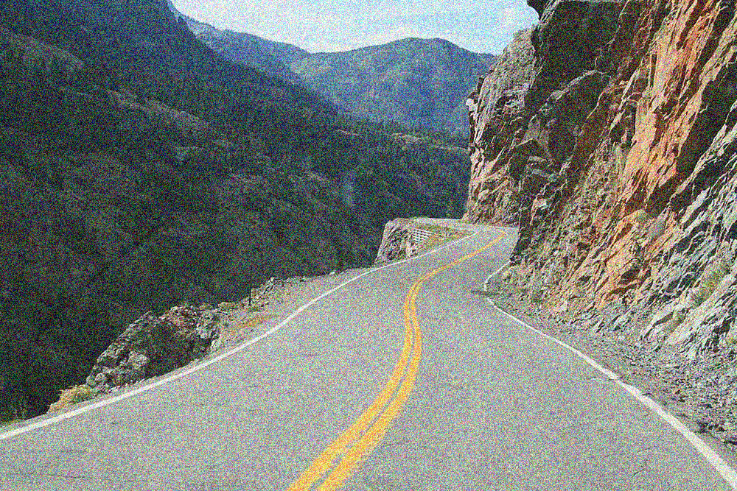
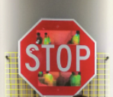

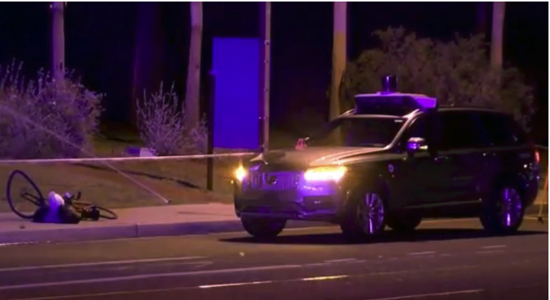
Severe Safety Threats
Example: autonomous driving
Possibly
Fatal Accident

Slide 4
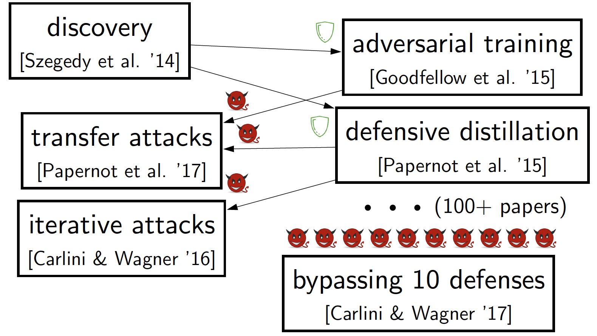
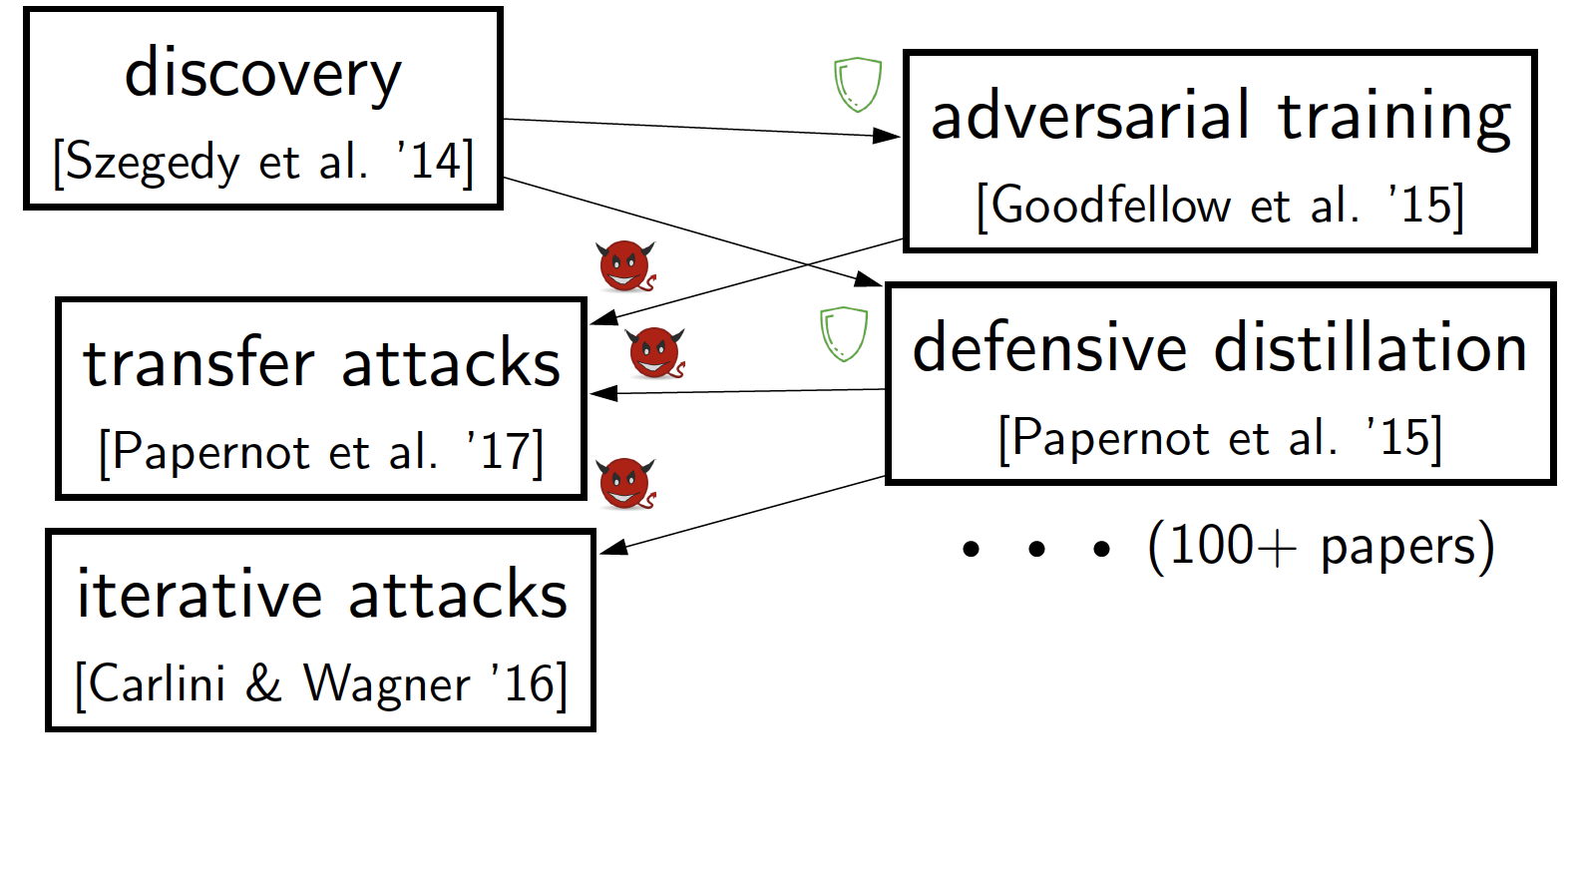
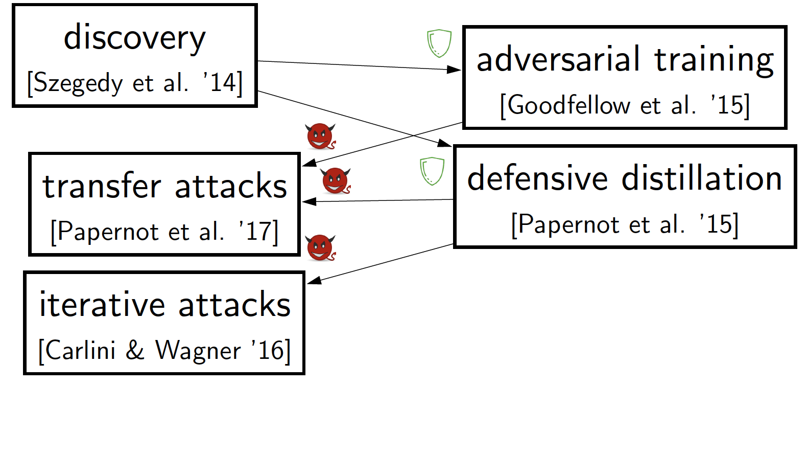
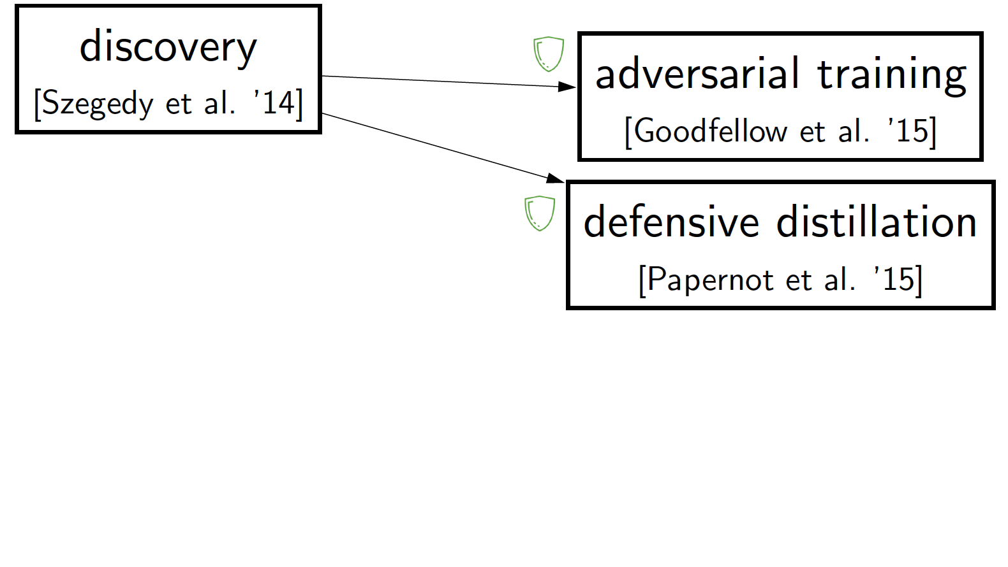
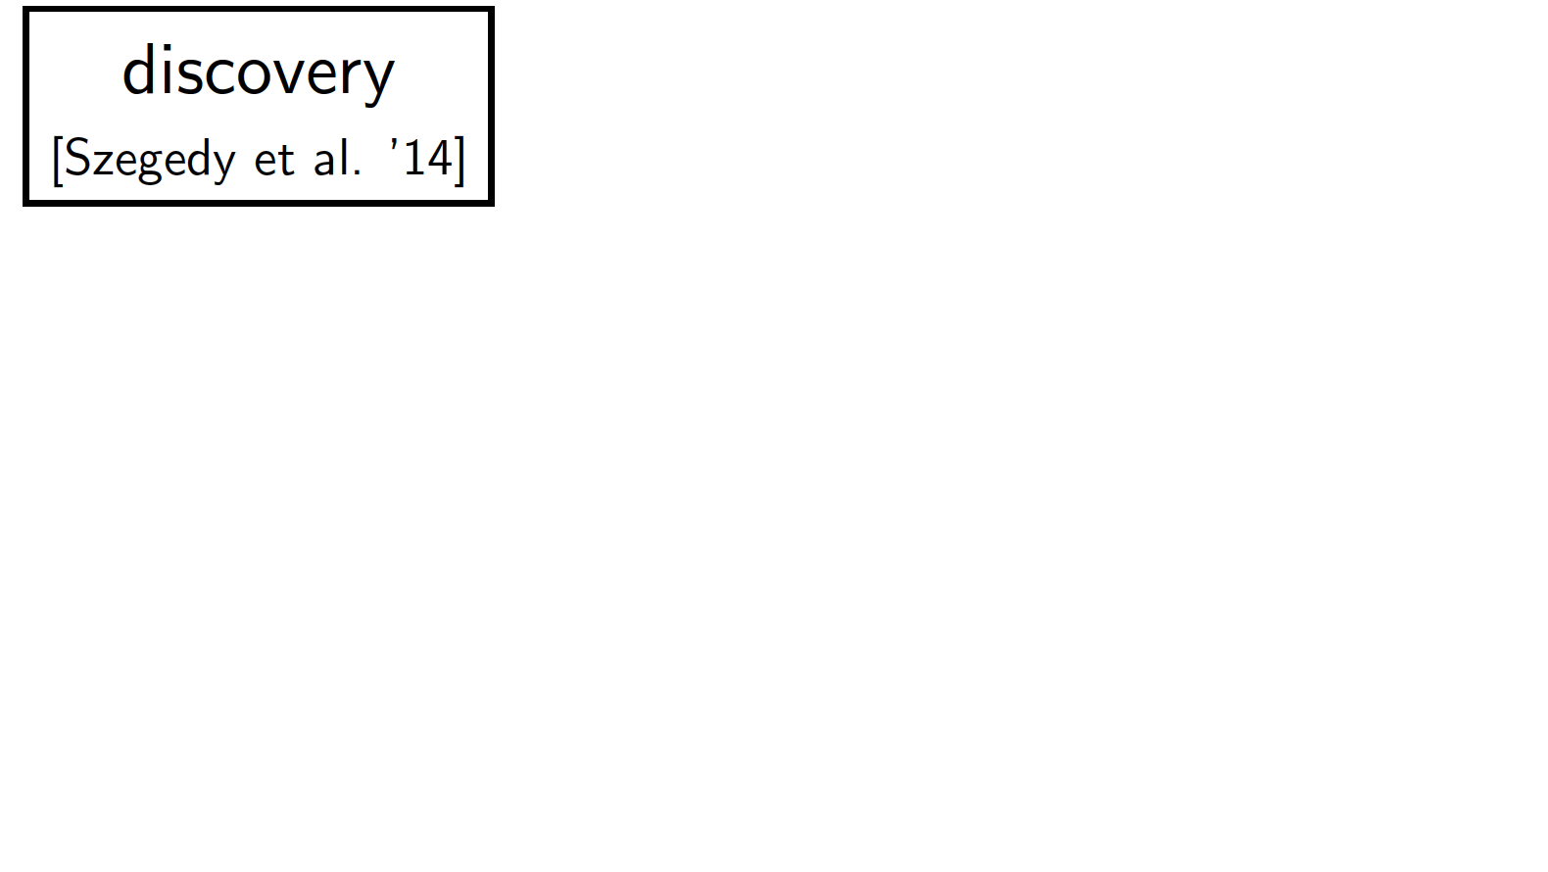
Arm Race
Defenses bypassed by follow-up attacks

Slide 5

Ending Arm Race? Certified Robustness!
Prove adversarial example doesn’t exist
Guarantee of Safety

Slide 6
Ending Arm Race? Certified Robustness!
Prove adversarial example doesn’t exist
Guarantee of Safety
First Systematization of Knowledge on
Certified Robustness for Deep Neural Networks!

Slide 7
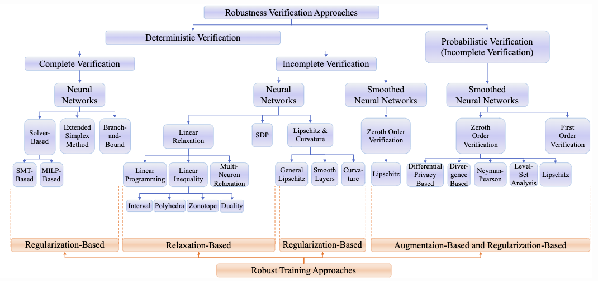
Content
Taxonomy
Summary
Discussion
Benchmark
Characteristics
Strengths
Limitations
Connections
Generalization
…
Current Research
Theoretical Barriers
Main Challenges
Future Directions
…
VeriGauge
Open-source platform for 20+ approaches

Slide 8
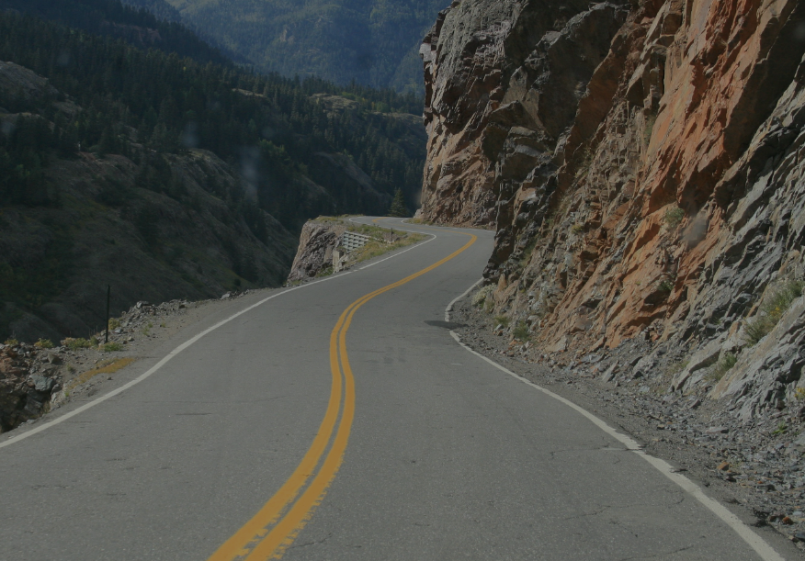
Threat Model
Various types of adversarial examples exist
Tiny Perturbations
Semantic
Transformations
Focus on (p-norm constrained) perturbations
  Widely studied
  Techniques generalizable to other types of adversarial examples

Slide 9
Robustness against
(p-Norm Constrained) Perturbations
Given a DL model , finite test dataset
Check:
Original Input
( norm)
Adversarial
Input

Slide 10
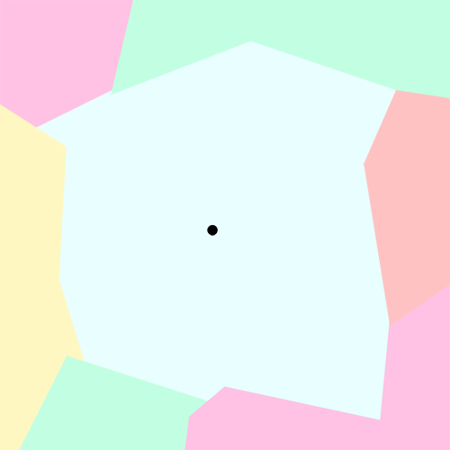
Formal Definition of Certification
For given system and data instance with true label , compute larger , such that
Larger certified radius
= Tighter certification
= Better certified robustness

Slide 11
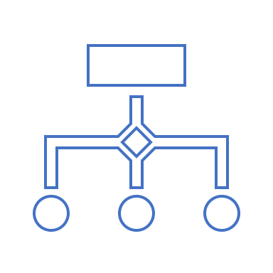
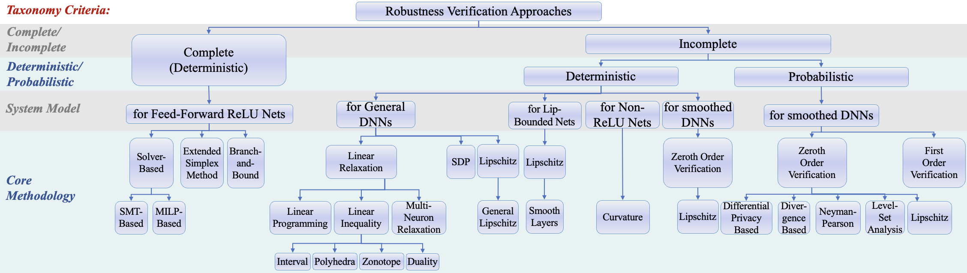
Taxonomy of Verification Method
SOTA determinisitc certified robustness for general DNNs
SOTA probabilistic certified robustness
Only method supporting large models

Slide 12
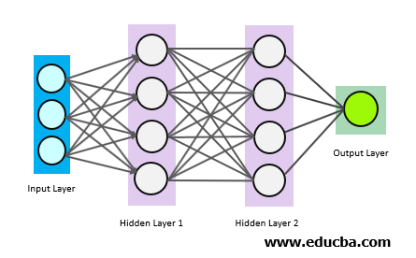

DNN Architecture
  Input layer: vector $x_{0}$
  Weights: $\left(W_{0},b_{0}\right), \left(W_{1},b_{1}\right),…(W_{L−1},b_{L−1})$.
  Activation function:
    $ReLU\left(x\right)=max⁡\{x,0\}$
  Computation:
    $x_{1}=ReLU(W_{0}x_{0}+b_{0})$,
    $x_{2}=ReLU(W_{1}x_{1}+b_{1})$,
    …
    $x_{L}=W_{L−1}x_{L−1}+b_{L−1}$
  Output: $x_{L}$ - confidence score for each class
https://www.educba.com/deep-learning-technique/

Slide 13
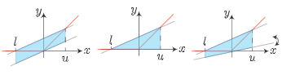

Linear Relaxation of ReLU
Different Linear Relaxations for ReLU$\left(x\right)=max \{x,0\}$
Weng, Lily, et al. “Towards fast computation of certified robustness for relu networks.” ICML 2018
Wong, Eric, and Zico Kolter. “Provable defenses against adversarial examples via the convex outer adversarial polytope.” ICML 2018
Singh, Gagandeep, et al. “Fast and Effective Robustness Certification.” NIPS 2018

Slide 14
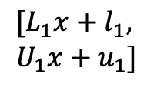

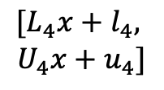
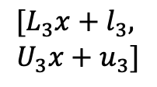
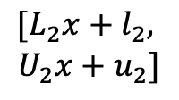
Linear Relaxation Induces Linear Inequality
Propagate linear inequalities that bound possible output region
Layer 1
Layer 2
Output Layer
Layer 3
Linear Bound Propagation
$$[L_{1}x+l_{1},$$
$$U_{1}x+u_{1}]$$
$$[L_{2}x+l_{2},$$
$$U_{2}x+u_{2}]$$
$$[L_{3}x+l_{3},$$
$$U_{3}x+u_{3}]$$
$$[L_{4}x+l_{4},$$
$$U_{4}x+u_{4}]$$
$$[x, x]$$

Slide 15

Combat Over-Relaxation with Branch-and-Bound
Conditioned on two branches: $x≤0$ and $x>0$,
each ReLU neuron is reduced to linear constraints: $y=0$ or $y=x$
Select some neurons to condition on, and solve two subproblems
If x<=0, y=0 (linearized subproblem)
If x> 0, y=x (linearized subproblem)
Relax other neurons by linear relaxation and bound propagation
Most scalable verification method so far

Slide 16
Randomized Smoothing
Train a model (“base classifier”) under some known noise
Smooth into a new classifier (“smoothed classifier”), such that
  = the most probable prediction by under noised corruptions of
In deployment, use smoothed classifier

Slide 17
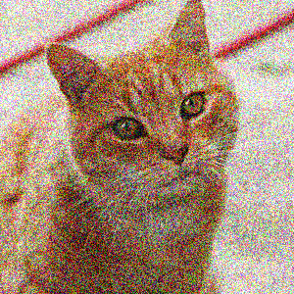
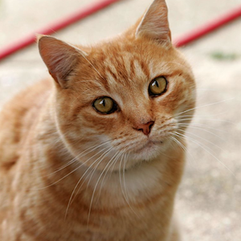
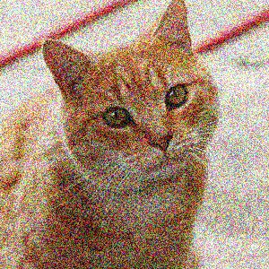
Illustration of Randomized Smoothing
80%±1%
…
…
15%±1%
cat
Cat
Dog
…
+
Gaussian
noise

Slide 18
Randomized Smoothing
Enables Certified Robustness
Shift center of the distribution cannot change probability much
If order doesn’t change, then consistent prediction guaranteed
Dog
Cat
80%±1%
55%±1%
15%±1%
40%±1%
cat
Cat
Dog
…
Cat
Dog
…

Slide 19
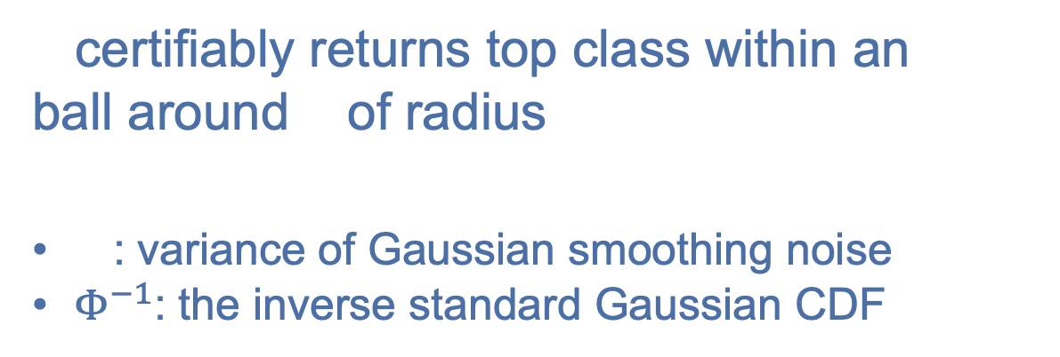
Closed-form Robustness Guarantee
’s probability of the top class (cat)
’s probability of the runner-up class (dog)
80%±1%
15%±1%
Cat
Dog
…
certifiably returns top class within an
ball around of radius
: variance of Gaussian smoothing noise
$Φ^{−1}$: the inverse standard Gaussian CDF
Jeremy M Cohen, Elan Rosenfeld, J. Zico Kolter. Certified Adversarial Robustness via Randomized Smoothing. ICML 2019

Slide 20
Certification Induces Robust Training
Training DNN in specific ways can improve certified robustness
For linear relaxation + branch-and-bound:
training to reduce upper bound of loss function computed from over-approximation
For randomized smoothing:
training to predict correctly for noised inputs

Slide 21
How Far Are We on Real-World Datasets?

Slide 22

On MNIST
$ℓ_{∞}$ norm, $r = 0.3$
SOTA Certified Robust Accuracy: 94.02%
  [CVPR 2021] Towards Evaluating and Training Verifiably Robust Neural Networks
SOTA Empirical Robust Accuracy (against existing attacks): 96.34%
  https://github.com/MadryLab/mnist_challenge
  Uncovering the Limits of Adversarial Training against Norm-Bounded Adversarial Examples
  ArXiv: 2010.03593
Not much difference

Slide 23

On CIFAR-10
$ℓ_{∞}$ norm, $r=8/255$:
SOTA Certified Robust Accuracy: 40.39%
  [NeurIPS 2022] Rethinking Lipschitz Neural Networks and Certified Robustness: A Boolean Function Perspective
SOTA Empirical Robust Accuracy (against existing attacks): 71.29%
  [ICML 2022] Diffusion Models for Adversarial Purification
Still a gap

Slide 24

On ImageNet
$ℓ_{2}$ norm, $r=2.0$
SOTA Certified Robust Accuracy: 30.4%
  Our paper at [ICLR 2022] On the Certified Robustness for Ensemble Models and Beyond
SOTA empirical robustness accuracy: 43.18%
  Against $ℓ_{∞}$ norm, $r=\frac{4}{255}$
  [ICML 2022] Diffusion Models for Adversarial Purification
Hard to achieve robustness

Slide 25
Key Messages
Since 2017, many methods proposed to provide & improve DNN certified robustness
  Linear relaxation
  Branch-and-bound
  Randomized smoothing
  …
Remarkable certified robustness achieved on small datasets, but still challenging on large ones
  Good on MNIST
  To be improved on CIFAR-10 and ImageNet
Certification for p-norm bounded adversary generalizable for other threat models
  Semantic adversary
  Patch adversary
  Word substitution adversary
  Control state perturbation
  Poisoning attack
  …

Slide 26


sokcertifiedrobustness.github.io
Taxonomy
Summary
Discussion
Benchmark
Characteristics
Strengths
Limitations
Connections
Generalization
…
Current Research
Theoretical Barriers
Main Challenges
Future Directions
…
VeriGauge
Open-source platform for 20+ approaches

