Slide 1

CMPT 405/705
Design & Analysis of Algorithms
April 4, 2022

Slide 2
Plan for today
Linear Programming Duality
A combinatorial algorithm for weighted min vertex cover
More on Linear Programming:
Min cost perfect matching in bipartite graphs

Slide 3
A combinatorial algorithm for weighted vertex cover

Slide 4
LP for min-weight vertex cover
Given a graph G=(V,E) and weights w_{v}≥0, we have a variable x_{v} for each v∈V
minimize ∑_{v∈V} w_{v}x_{v}
subject to x_{u}+x_{v} ≥ 1 for (u,v) ∈E
x_{v} ≥ 0 for v∈V
What is the dual of this LP?
maximize b^{T}y=∑_{e∈E} y_{e}
subject to ∑_{(u,v)∈E} y_{(u,v)} ≤ w_{u} for u∈V
y_{e} ≥ 0 for e∈E
If we compute the dual LP, then minVC(G) ≥ OPT(primal-LP) = OPT(dual-LP)
Next: a (combinatorial) linear time algorithm that finds a vertex cover S of weight
weight(S) ≤ 2 OPT(dual-LP)
Find a feasible solution to dual-LP
Doesn’t have to be optimal
Give me any solution
c=
w₁ | w₂ | w₃ | w₄ | w₅ | w₆ | w₇
1 | 0 | 0 | 1 | 0 | 0 | 0
1 | 0 | 0 | 0 | 0 | 1 | 0
0 | 1 | 0 | 0 | 1 | 0 | 0
… | … | … | … | … | … | …
0 | 1 | 0 | 1 | 0 | 0 | 0
1
1
1
1
1
A=
b=

Slide 5
LP for min-weight vertex cover
Given a graph G=(V,E) and weights w_{v}≥0, we have a variable x_{v} for each v∈V
minimize ∑_{v∈V} w_{v}x_{v}
subject to x_{u}+x_{v} ≥ 1 for (u,v)∈E
x_{v} ≥ 0 for v∈V
Dual of this LP:
maximize ∑_{e∈E} y_{e}
subject to ∑_{(u,v)∈E} y_{(u,v)} ≤ w_{u} for u∈V
y_{e} ≥ 0 for e∈E
Think of y_{e} as cost we charge for the edge e ∈E.
We want to maximize the total cost, while not “overcharging” for each vertex.
c=
w₁ | w₂ | w₃ | w₄ | w₅ | w₆ | w₇
1 | 0 | 0 | 1 | 0 | 0 | 0
1 | 0 | 0 | 0 | 0 | 1 | 0
0 | 1 | 0 | 0 | 1 | 0 | 0
… | … | … | … | … | … | …
0 | 1 | 0 | 1 | 0 | 0 | 0
1
1
1
1
1
A=
b=

Slide 6
Algorithm for min-weight vertex cover
We get a graph G=(V,E) and weights {w_{v} : v∈V},
We design an algorithm that returns
A set of vertices S that is a vertex cover of G
A feasible solution (y_{e})_{e∈E} for the dual LP
Such that w(S) ≤ 2*∑_{e∈E} y_{e} = dual-LP-val(y)
This implies
w(S) ≤ 2*dual-LP-val(y) ≤ 2*OPT(dual LP)
= 2*OPT(primal LP) ≤ 2*minVC(G)

Slide 7
Algorithm for min-weight vertex cover
Given a graph G=(V,E) and weights {w_{v} : v∈V}, the algorithm works as follows:
Define variables y_{e}=0 for each e∈E. // cost for each edge
Define variables c_{v}=0 for each v∈V. // total charge per vertex – at most w_{v}
For each e=(u,v)∈E do
  Set y_{(u,v)}=min{w_{v} - c_{v} , w_{u} - c_{u}}
  // increase c_{v} or c_{u} to max
  Update c_{v} = c_{v} + y_{(u,v)}
  Update c_{u} = c_{u} + y_{(u,v)}
Return S={v∈V : c_{v} = w_{v}}
w₂
w₃
w₁
y₁₂=w₁
y₂₃=w₂-w₁
Q: What is the total running time?
A: O(|E|) – same as in the unweighted case

Slide 8
Algorithm for min-weight vertex cover
Claim 1: The algorithm returns a vertex cover of G.
Proof: Fix an edge (u,v)∈E.
When we handled this edge in the loop, we did
  Set y_{(u,v)}=min{w_{v} - c_{v} , w_{u} - c_{u}}
  Update c_{v} = c_{v} + y_{(u,v)}
  Update c_{u} = c_{u} + y_{(u,v)}
That is, either (1) we increased c_{u} to w_{u} or (2) we increased c_{v} to w_{v}.
Therefore (u,v) is covered by S = {v∈V : c_{v} = w_{v}}

Slide 9
Algorithm for min-weight vertex cover
Given a graph G=(V,E) and weights {w_{v} : v∈V}, the algorithm works as follows:
Define variables y_{e}=0 for each e∈E. // charge for each edge
Define variables c_{v}=0 for each v∈V. // total charge per vertex
For each e=(u,v)∈E do
  Set y_{(u,v)}=min{w_{v} - c_{v} , w_{u} - c_{u}}
  Update c_{v} = c_{v} + y_{(u,v)}
  Update c_{u} = c_{u} + y_{(u,v)}
Return S={v∈V : c_{v} = w_{v}}

Slide 10
Algorithm for min-weight vertex cover
Claim 2: Throughout the algorithm {y_{e}:e ∈E} is a feasible solution to dual LP.
Proof: In the beginning y_{e}=0, which is a feasible solution
In each iteration we do.
  Set y_{(u,v)}=min{w_{v} - c_{v} , w_{u} - c_{u}}
  Update c_{v} = c_{v} + y_{(u,v)}
  Update c_{u} = c_{u} + y_{(u,v)}
This update, clearly, keeps {y_{e} : e ∈E} a feasible solution. This is because
in each iteration c_{u}=∑_{(u,v)∈E} y_{(u,v)}
maximize ∑_{e∈E} y_{e}
subject to ∑_{(u,v)∈E} y_{(u,v)} ≤ w_{u} for u∈V
y_{e} ≥ 0 for e∈E

Slide 11
Algorithm for min-weight vertex cover
For each e=(u,v)∈E do
  Set y_{(u,v)}=min{w_{v} - c_{v} , w_{u} - c_{u}}
  Update c_{v} = c_{v} + y_{(u,v)}
  Update c_{u} = c_{u} + y_{(u,v)}
Return S={v∈V : c_{v} = w_{v}}
Claim 3: w(S) ≤ 2 OPT(dual LP).
Proof: Note that in each iteration we increase
(1) the charge of the two vertices (c_{v} and c_{u}), and
(2) the charge of the edge y_{(u,v)} between them.
Therefore, in each iteration we have
∑_{v∈V} c_{v} = 2∑_{e∈E} y_{e}.
Our outputs is the set S = {v∈V : c_{v} = w_{v}}. And it’s weight is
w(S) = ∑_{v∈S} w_{v} = ∑_{v∈S} c_{v} ≤ ∑_{v∈V} c_{v} = 2∑_{e∈E} y_{e}
= 2 dual-LP-value(y) ≤ 2 OPT(dual LP).

Slide 12
Algorithm for min-weight vertex cover
Conclusion: We have a O(|E|) time algorithm that outputs a vertex cover S s.t.
w(S) ≤ 2 OPT(dual LP).
We also know that
OPT(dual-LP) = OPT(primal-LP) ≤ minVC(G) .
Therefore,
w(S) ≤ 2 OPT(dual LP) ≤ 2minVC(G)
As required.
For each e=(u,v)∈E do
  Set y_{(u,v)}=min{w_{v} - c_{v} , w_{u} - c_{u}}
  Update c_{v} = c_{v} + y_{(u,v)}
  Update c_{u} = c_{u} + y_{(u,v)}
Return S={v∈V : c_{v} = w_{v}}

Slide 13
Linear Programming
Geometry of Polytopes

Slide 14
Min cost perfect matching in bipartite graphs

Slide 15
Perfect matching in bipartite graphs
Goal: Given an edge weighted bipartite graph G find a perfect matching of minimum weight.
We saw a solution that uses the polynomial method.
Today we’ll see a solution using LPs.

Slide 16
Linear Programming
Goal: find the feasible area of
Subject to:
x+y>=6
y-2x <= 2
x-2y <= 0
0 <= x <= 10
0 <= y <= 10
y-2x<=2
x=0
x=10
Feasible area
y=10
y=0
x+y>=6
x-2y<=0
(4,2)

Slide 17
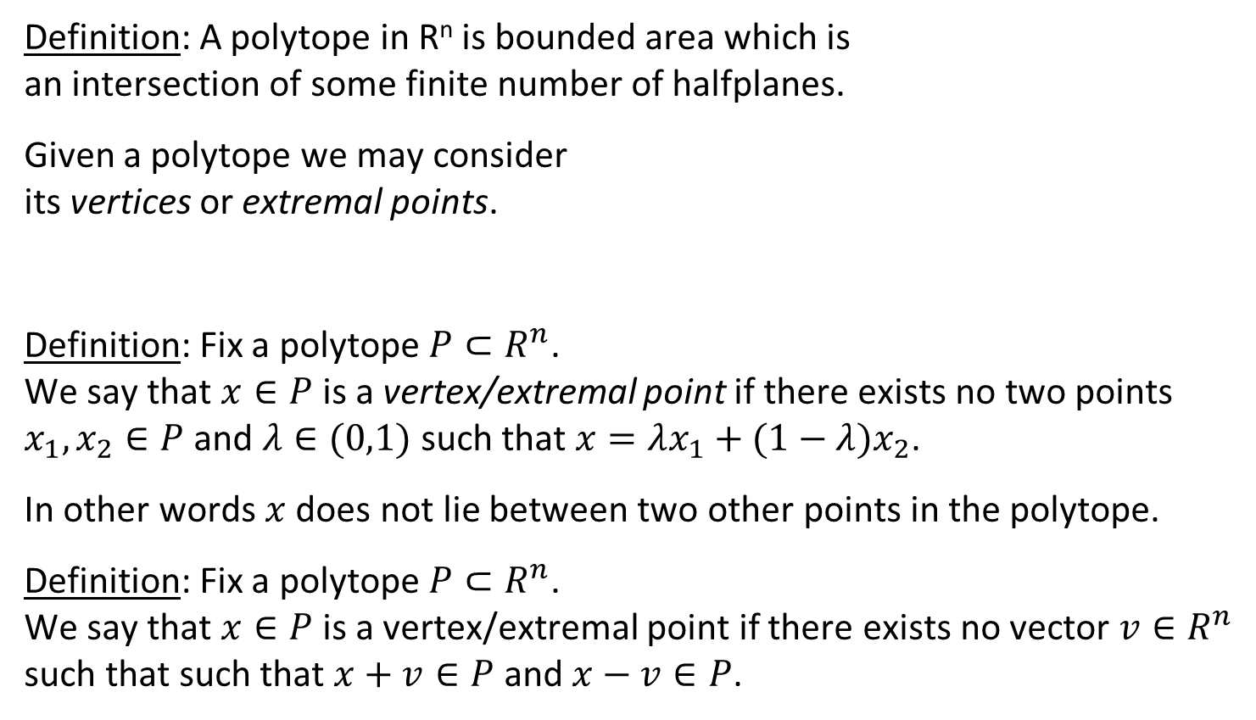
Linear Programming
(4,6)
(10,6)
Definition: A polytope in R^{n} is bounded area which is
an intersection of some finite number of halfplanes.
Given a polytope we may consider
its vertices or extremal points.
Definition: Fix a polytope $P⊂R^{n}$.
We say that $x∈P$ is a vertex/extremal point if there exists no two points $x_{1},x_{2}∈P$ and $λ∈(0,1)$such that $x=λx_{1}+(1−λ)x_{2}$.
In other words $x$ does not lie between two other points in the polytope.
Definition: Fix a polytope $P⊂R^{n}$.
We say that $x∈P$ is a vertex/extremal point if there exists no vector $v∈R^{n}$ such that such that $x+v∈P \text{a}\text{nd} x−v∈P$.
(3,4)
(10,4)
(4,2)

Slide 18
Linear Programming
(4,6)
(10,6)
Extremal points:
(3,4)
(10,4)
(4,2)
Not an extremal point

Slide 19
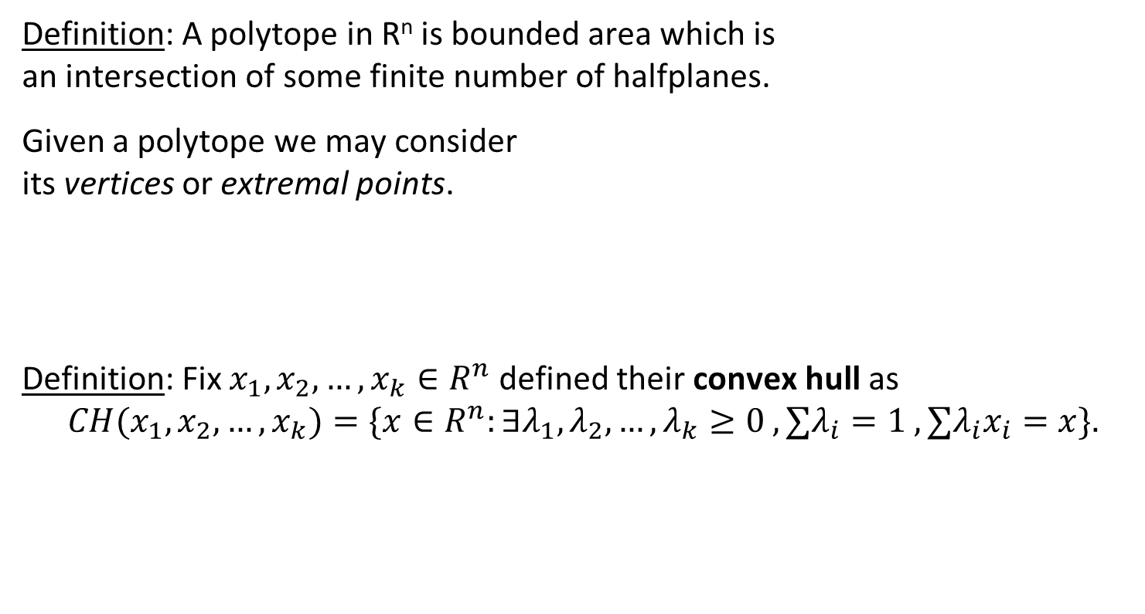
Linear Programming
(4,6)
(10,6)
Definition: A polytope in R^{n} is bounded area which is
an intersection of some finite number of halfplanes.
Given a polytope we may consider
its vertices or extremal points.
Definition: Fix $x_{1},x_{2},…,x_{k}∈R^{n}$ defined their convex hull as
$${CH(x}_{1},x_{2},…,x_{k})=\{x∈R^{n}:∃λ_{1},λ_{2},…,λ_{k}≥0 , ∑λ_{i}=1 , ∑λ_{i}x_{i}=x\}.$$
(3,4)
(10,4)
(4,2)

Slide 20
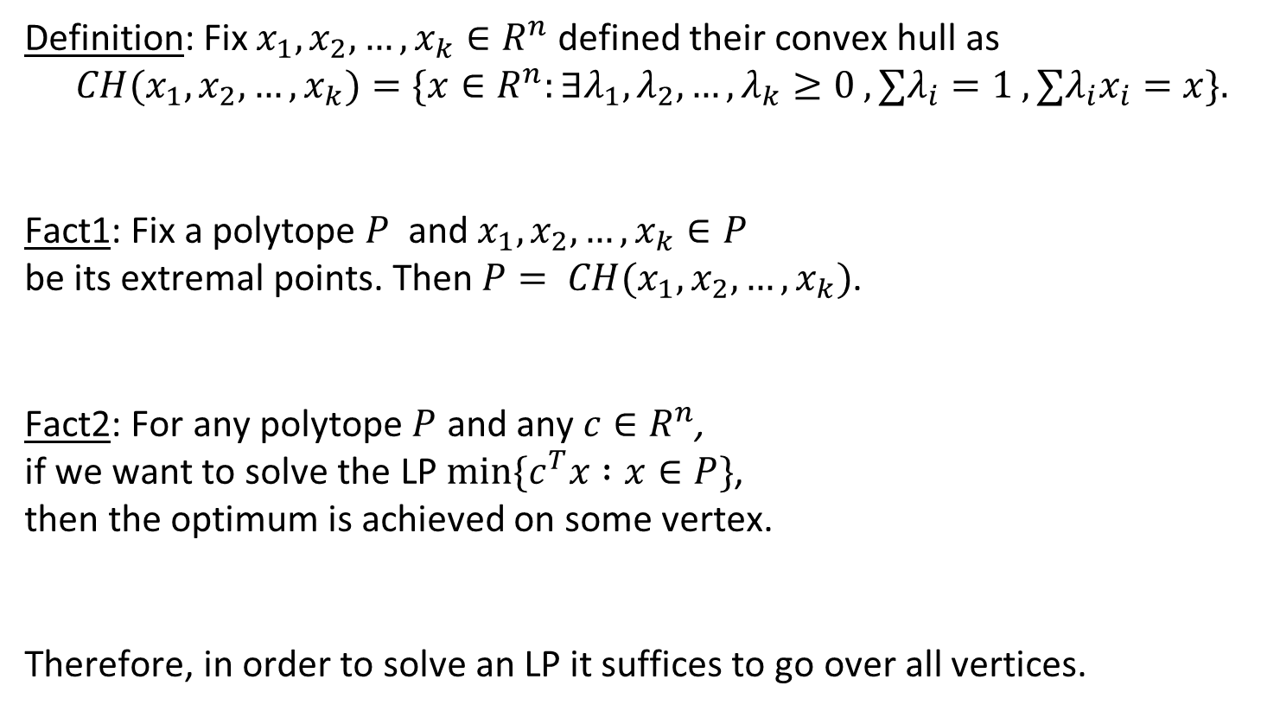
Linear Programming
Definition: Fix $x_{1},x_{2},…,x_{k}∈R^{n}$ defined their convex hull as
$${CH(x}_{1},x_{2},…,x_{k})=\{x∈R^{n}:∃λ_{1},λ_{2},…,λ_{k}≥0 , ∑λ_{i}=1 , ∑λ_{i}x_{i}=x\}.$$
Fact1: Fix a polytope $P$ and $x_{1},x_{2},…,x_{k}∈P$
be its extremal points. Then $P= CH(x_{1},x_{2},…,x_{k})$.
Fact2: For any polytope $P$ and any $c∈R^{n}$,
if we want to solve the LP $min\{c^{T}x :x∈P\}$,
then the optimum is achieved on some vertex.
Therefore, in order to solve an LP it suffices to go over all vertices.
(4,6)
(10,6)
Find a polytope over n variables that
Can be described using poly(n) linear constraints
has 2^{n} vertices
(3,4)
(10,4)
(4,2)
2x+3y=14
2x+3y=7
2x+3y=0

Slide 21
Back to
min cost perfect matching in bipartite graphs

Slide 22
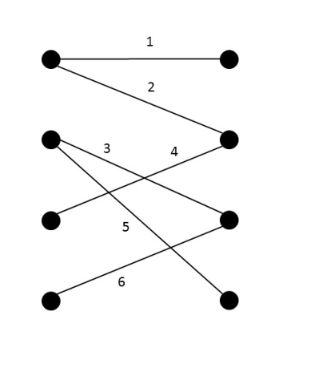
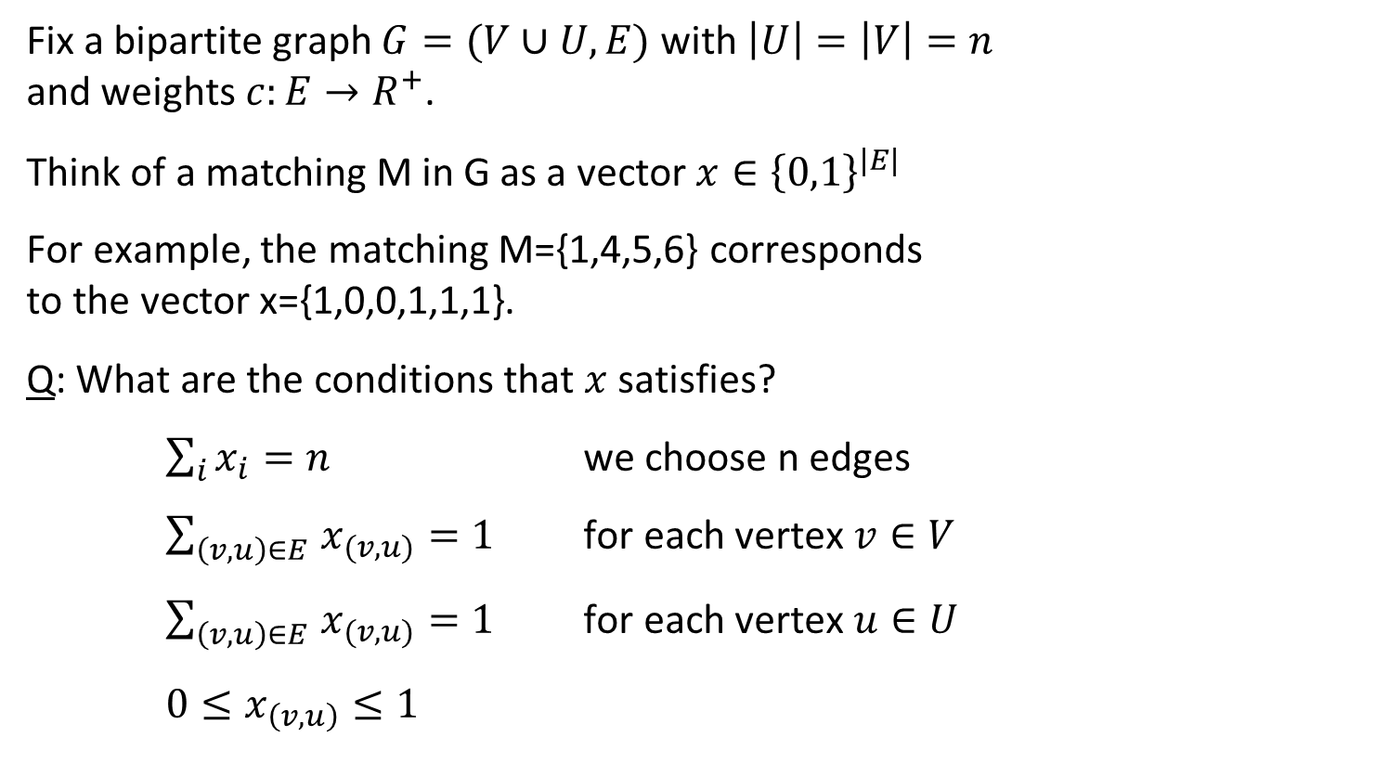
Min-cost perfect matching in bipartite graphs
Fix a bipartite graph $G=(V∪U,E)$ with $\left|U\right|=\left|V\right|=n$
and weights $c:E→R^{+}$.
Think of a matching M in G as a vector $x∈{\left\{0,1\right\}}^{|E|}$
For example, the matching M={1,4,5,6} corresponds
to the vector x={1,0,0,1,1,1}.
Q: What are the conditions that $x$ satisfies?
$\sum_{i}{x_{i}}=n$ we choose n edges
$\sum_{\left(v,u\right)∈E }{x_{(v,u)}}=1$ for each vertex $v∈V$
$\sum_{\left(v,u\right)∈E }{x_{(v,u)}}=1$ for each vertex $u∈U$
$0≤x_{\left(v,u\right)}≤1$

Slide 23
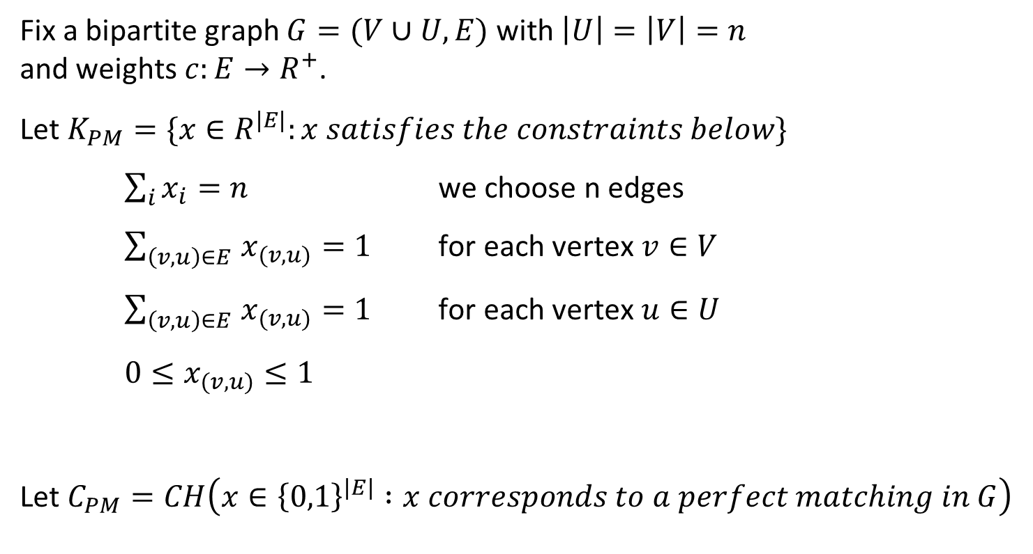
Perfect matching in bipartite graphs
Fix a bipartite graph $G=(V∪U,E)$ with $\left|U\right|=\left|V\right|=n$
and weights $c:E→R^{+}$.
Let $K_{PM}=\{x∈R^{|E|}:x satisfies the constraints below\}$
$\sum_{i}{x_{i}}=n$ we choose n edges
$\sum_{\left(v,u\right)∈E }{x_{(v,u)}}=1$ for each vertex $v∈V$
$\sum_{\left(v,u\right)∈E }{x_{(v,u)}}=1$ for each vertex $u∈U$
$0≤x_{(v,u)}≤1$
Let $C_{PM}=CH\left(x∈{\left\{0,1\right\}}^{\left|E\right|} :x corresponds to a perfect matching in G\right)$

Slide 24
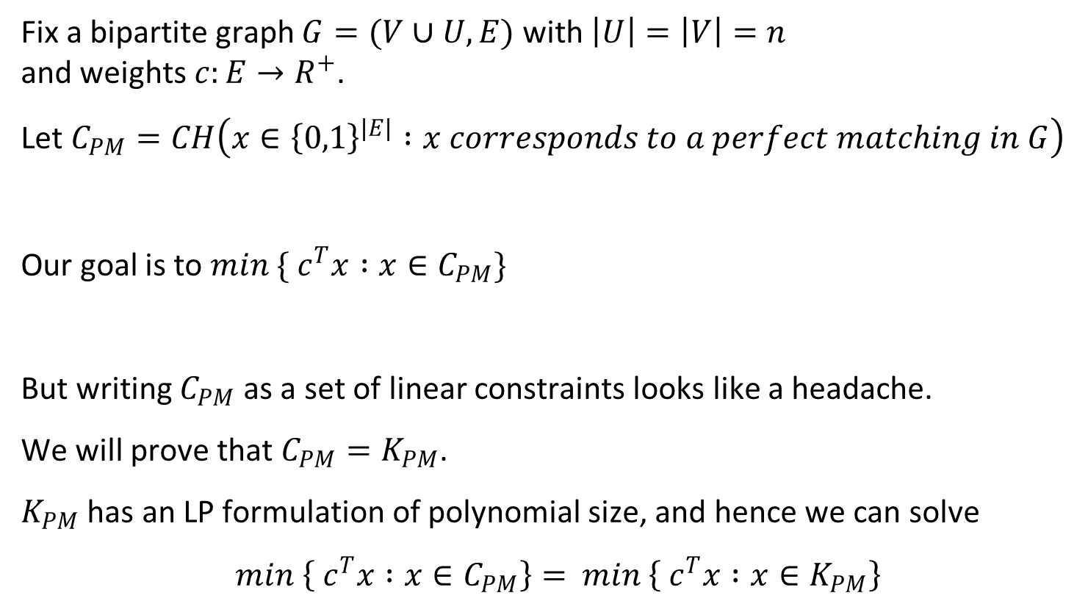
Perfect matching in bipartite graphs
Fix a bipartite graph $G=(V∪U,E)$ with $\left|U\right|=\left|V\right|=n$
and weights $c:E→R^{+}$.
Let $C_{PM}=CH\left(x∈{\left\{0,1\right\}}^{\left|E\right|} :x corresponds to a perfect matching in G\right)$
Our goal is to $min \{ c^{T}x :x∈C_{PM}\}$
But writing $C_{PM}$ as a set of linear constraints looks like a headache.
We will prove that $C_{PM}=K_{PM}$.
$K_{PM}$ has an LP formulation of polynomial size, and hence we can solve
$min \left\{ c^{T}x :x∈C_{PM}\right\}=$ $min \left\{ c^{T}x :x∈K_{PM}\right\}$

Slide 25
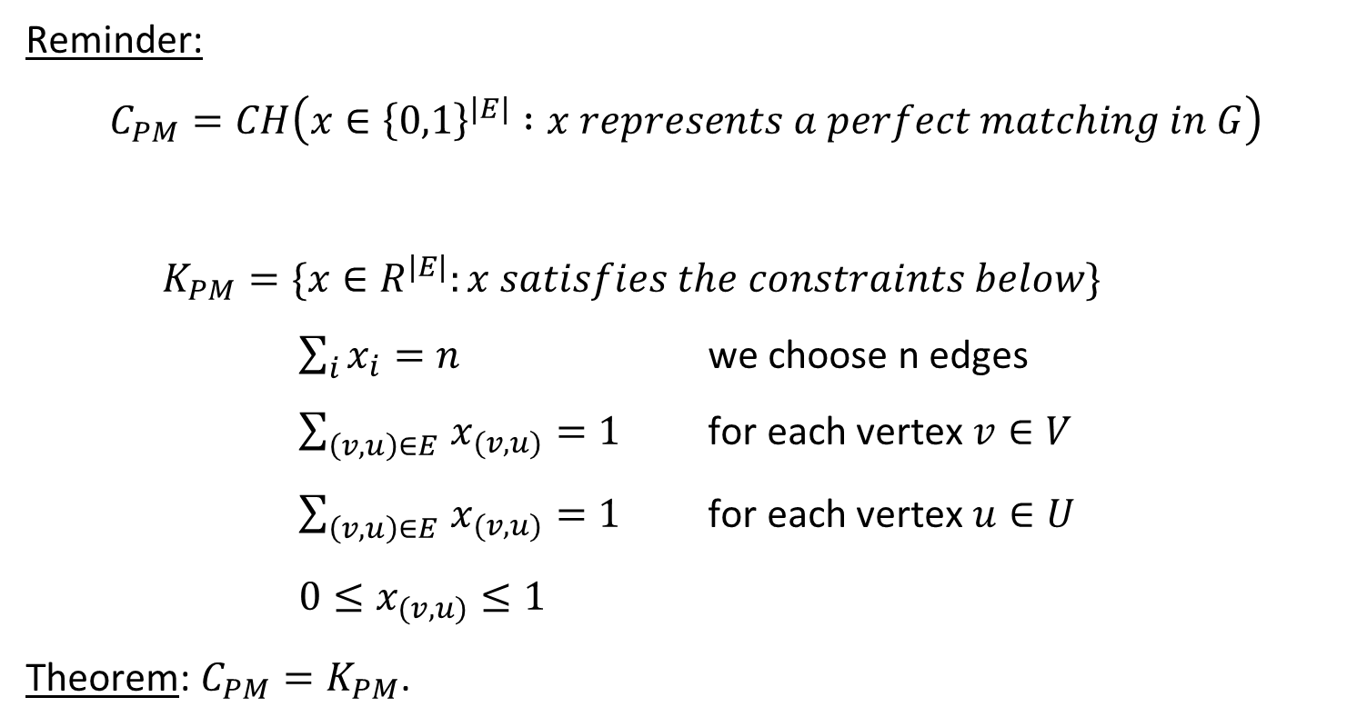
Perfect matching in bipartite graphs
Reminder:
$$C_{PM}=CH\left(x∈{\left\{0,1\right\}}^{\left|E\right|} :x represents a perfect matching in G\right)$$
$K_{PM}=\{x∈R^{|E|}:x satisfies the constraints below\}$
$\sum_{i}{x_{i}}=n$ we choose n edges
$\sum_{\left(v,u\right)∈E }{x_{(v,u)}}=1$ for each vertex $v∈V$
$\sum_{\left(v,u\right)∈E }{x_{(v,u)}}=1$ for each vertex $u∈U$
$0≤x_{(v,u)}≤1$
Theorem: $C_{PM}=K_{PM}$.

Slide 26
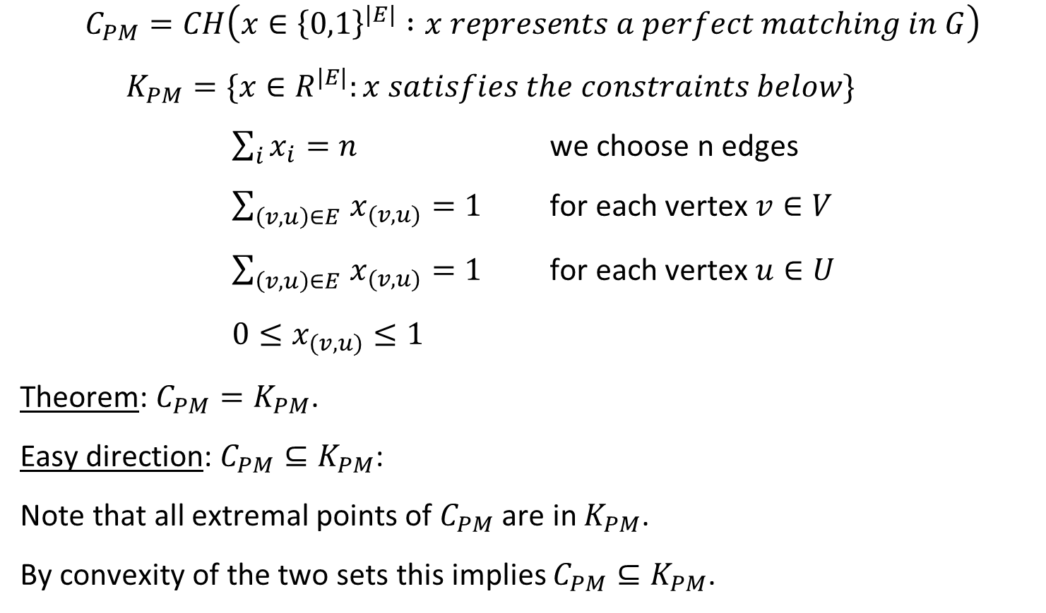
Perfect matching in bipartite graphs
$$C_{PM}=CH\left(x∈{\left\{0,1\right\}}^{\left|E\right|} :x represents a perfect matching in G\right)$$
$K_{PM}=\{x∈R^{|E|}:x satisfies the constraints below\}$
$\sum_{i}{x_{i}}=n$ we choose n edges
$\sum_{\left(v,u\right)∈E }{x_{(v,u)}}=1$ for each vertex $v∈V$
$\sum_{\left(v,u\right)∈E }{x_{(v,u)}}=1$ for each vertex $u∈U$
$0≤x_{(v,u)}≤1$
Theorem: $C_{PM}=K_{PM}$.
Easy direction: $C_{PM}⊆K_{PM}$:
Note that all extremal points of $C_{PM}$ are in $K_{PM}$.
By convexity of the two sets this implies $C_{PM}⊆K_{PM}$.

Slide 27
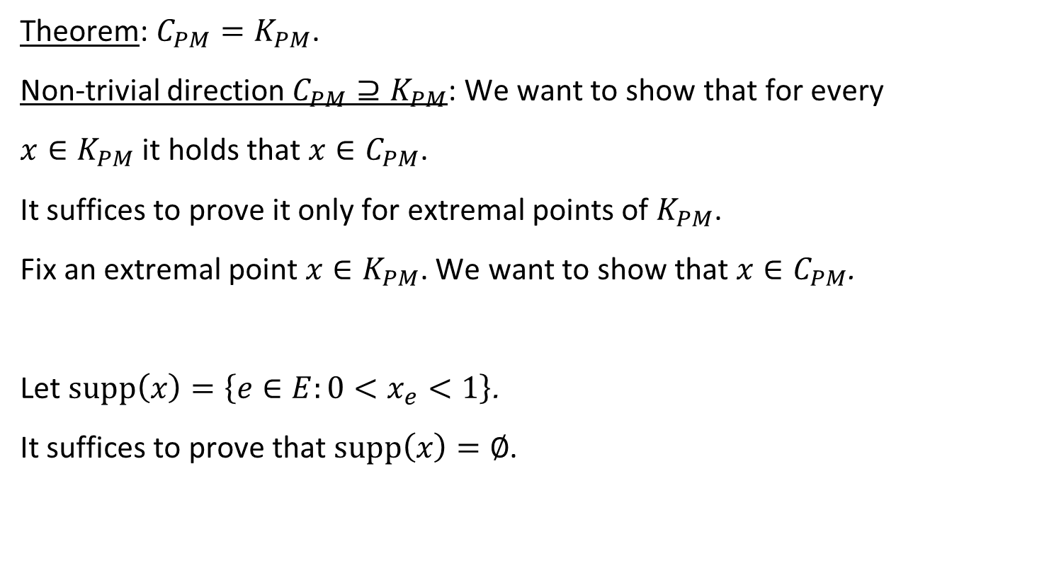
Perfect matching in bipartite graphs
Theorem: $C_{PM}=K_{PM}$.
Non-trivial direction $C_{PM}⊇K_{PM}$: We want to show that for every
$x∈K_{PM}$ it holds that $x∈C_{PM}$.
It suffices to prove it only for extremal points of $K_{PM}$.
Fix an extremal point $x∈K_{PM}$. We want to show that $x∈C_{PM}$.
Let $supp\left(x\right)=\left\{e∈E:0<x_{e}<1\right\}$.
It suffices to prove that $supp\left(x\right)=∅$.

Slide 28



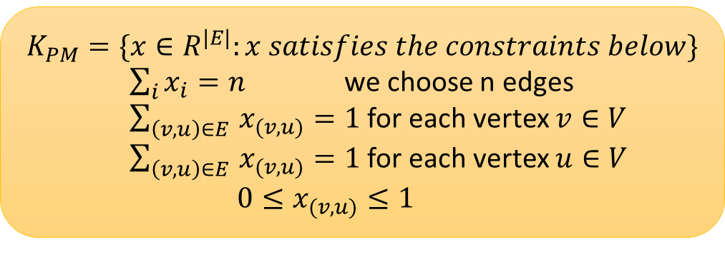






Perfect matching in bipartite graphs
$$K_{PM}=\{x∈R^{|E|}:x satisfies the constraints below\}$$
$\sum_{i}{x_{i}}=n$ we choose n edges
$\sum_{\left(v,u\right)∈E }{x_{(v,u)}}=1$ for each vertex $v∈V$
$\sum_{\left(v,u\right)∈E }{x_{(v,u)}}=1$ for each vertex $u∈V$
$0≤x_{(v,u)}≤1$
Fix an extremal point $x∈K_{PM}$. We want to show that $x∈C_{PM}$.
Let $supp\left(x\right)=\left\{e∈E:0<x_{e}<1\right\}$, and suppose that $supp\left(x\right)$ is non-empty.
Since $E$ is a finite set, there exists some $ε>0$ such that
$ε<x_{e}<1−ε$ for all $e∈supp\left(x\right)$.
Claim: $supp\left(x\right)$does not have cycles in $G$.
Proof: Suppose supp(𝑥) has an (even length) cycle in 𝐺.
We claim that $x$ cannot be an extremal point in $K_{PM}$.
x₂
x₂- $ε$
x₂+ $ε$
x₁
x₁+ $ε$
x₁- $ε$
= ½ + ½
x₃
x₃+ $ε$
x₃- $ε$
x₄
X₄ - $ε$
X₄ + $ε$

Slide 29
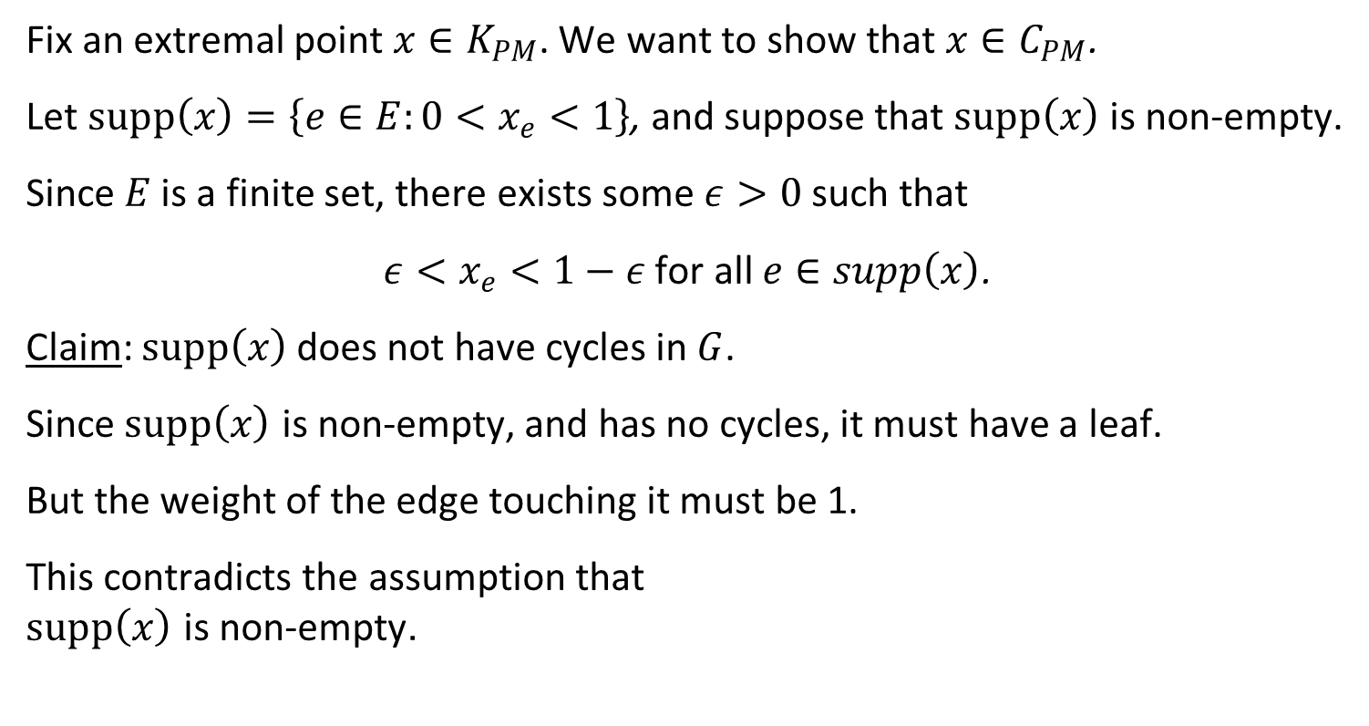
Perfect matching in bipartite graphs
Fix an extremal point $x∈K_{PM}$. We want to show that $x∈C_{PM}$.
Let $supp\left(x\right)=\left\{e∈E:0<x_{e}<1\right\}$, and suppose that $supp\left(x\right)$ is non-empty.
Since $E$ is a finite set, there exists some $ε>0$ such that
$ε<x_{e}<1−ε$ for all $e∈supp\left(x\right)$.
Claim: $supp\left(x\right)$does not have cycles in $G$.
Since $supp\left(x\right)$ is non-empty, and has no cycles, it must have a leaf.
But the weight of the edge touching it must be 1.
This contradicts the assumption that
$supp\left(x\right)$ is non-empty.
x_{e}=1

Slide 30

Perfect matching in bipartite graphs
Theorem: $C_{PM}=K_{PM}$.
Easy direction: $C_{PM}⊆K_{PM}$
Non-trivial direction $C_{PM}⊇K_{PM}$: We showed that every extremal point of $K_{PM}$ is integral, and hence is contained in $C_{PM}$.

Slide 31
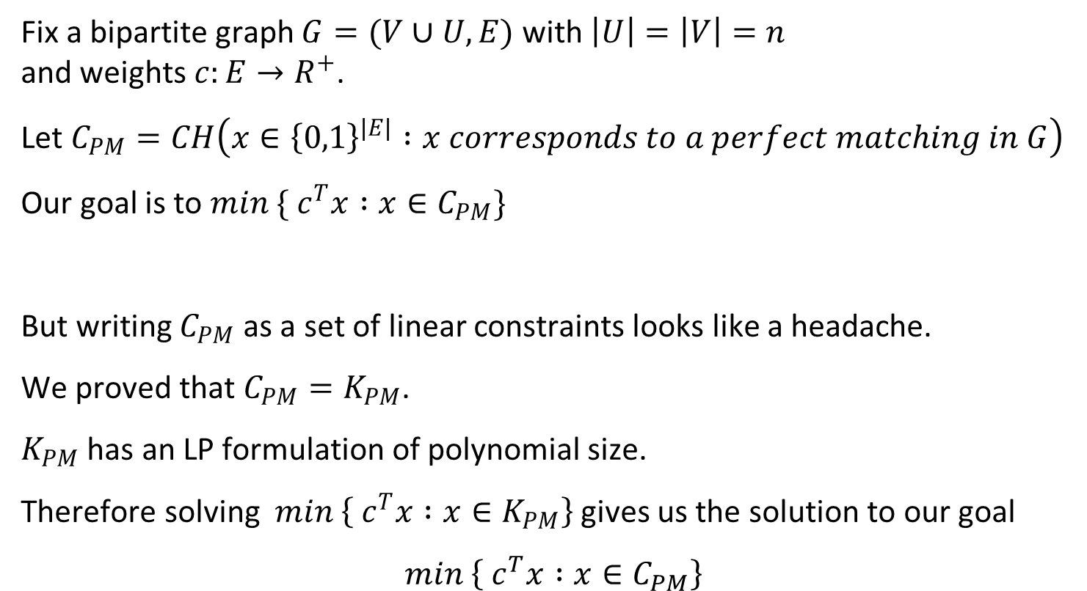
Perfect matching in bipartite graphs
Fix a bipartite graph $G=(V∪U,E)$ with $\left|U\right|=\left|V\right|=n$
and weights $c:E→R^{+}$.
Let $C_{PM}=CH\left(x∈{\left\{0,1\right\}}^{\left|E\right|} :x corresponds to a perfect matching in G\right)$
Our goal is to $min \{ c^{T}x :x∈C_{PM}\}$
But writing $C_{PM}$ as a set of linear constraints looks like a headache.
We proved that $C_{PM}=K_{PM}$.
$K_{PM}$ has an LP formulation of polynomial size.
Therefore solving $min \left\{ c^{T}x :x∈K_{PM}\right\}$ gives us the solution to our goal
$$min \left\{ c^{T}x :x∈C_{PM}\right\}$$

Slide 32
Questions?
Comments?

