Slide 1

CMPT 405/705
Design & Analysis of Algorithms
March 30, 2022

Slide 2
Plan for today
Linear Programming Duality

Slide 3
Linear Programming
Duality

Slide 4
LP Duality
Recall canonical form of a minimization LP
Input: A∈R^{MxN}, b∈R^{M}, c∈R^{N},
Goal: find a solution x∈R^{N} that
minimize c^{T}x
subject to Ax ≥b
and x ≥ 0.

Slide 5
LP Duality
We said last week that LP can be solved in poly time. But we didn’t prove it
Let’s focus of minimization-LP
Minimize c^{T}x ≤ k subject to Ax ≥ b and x ≥ 0.
An “NP-question”: Convince me that OPT(LP) ≤ k
In order to convince me, just give me x satisfying the constraints and c^{T}x ≤ k.
“A coNP-question”: Convince me that OPT(LP) ≥ k.
Today: a procedure that can verify OPT(LP) ≥ k in polytime.
We will write another LP that convinces us that OPT(LP) ≥ k.

Slide 6
LP Duality
Convince me that OPT(LP) ≥ 0
2x + 4y + z ≥ 0 because x,y,z>=0
minimize 2x+4y+z
Subject to 2x - y ≥ 2 -x + 2y - z ≥ -1 4y +z ≥ 1
x,y,z ≥0
A feasible solution
(x,y,z) = (12/11, 2/11, 3/11)
LP-value ≤ 35/11 = 3.18181
Convince me that OPT(LP) ≥ 1
Look at the third equation:
2x + 4y + z ≥ (4y + z) ≥ 1
Convince me that OPT(LP) ≥ 3
Convince me that OPT(LP) ≥ 35/11
2x + 4y + z ≥ (2x-y) + (4y+z) ≥ 3
Let k=2/11. Then
2x + 4y + z = 6k(2x-y) + k(-x+2y-z) + (k+1)*(4y+z)
= (12/11)*(2x-y) + (2/11)*(-x+2y-z) + (13/11)*(4y+z) ≥ 35/11

Slide 7
LP Duality
minimize 2x+4y+z
Subject to (1) 2x - y ≥ 2 (2) -x + 2y - z ≥ -1 (3) 4y + z ≥ 1
x,y,z ≥ 0
So what are we doing here?
We are looking for coefficients a,b,c≥0 such that
2x+4y+z ≥a*(1) + b*(2) + c*(3)
If we find such a,b,c≥0, then for any feasible solution the objective function at this solution must be at least 2*a+(-1)*b+1*c.
Convince me that OPT(LP) ≥ 3
2x + 4y + z ≥ (2x-y) + (4y+z) ≥ 3

Slide 8
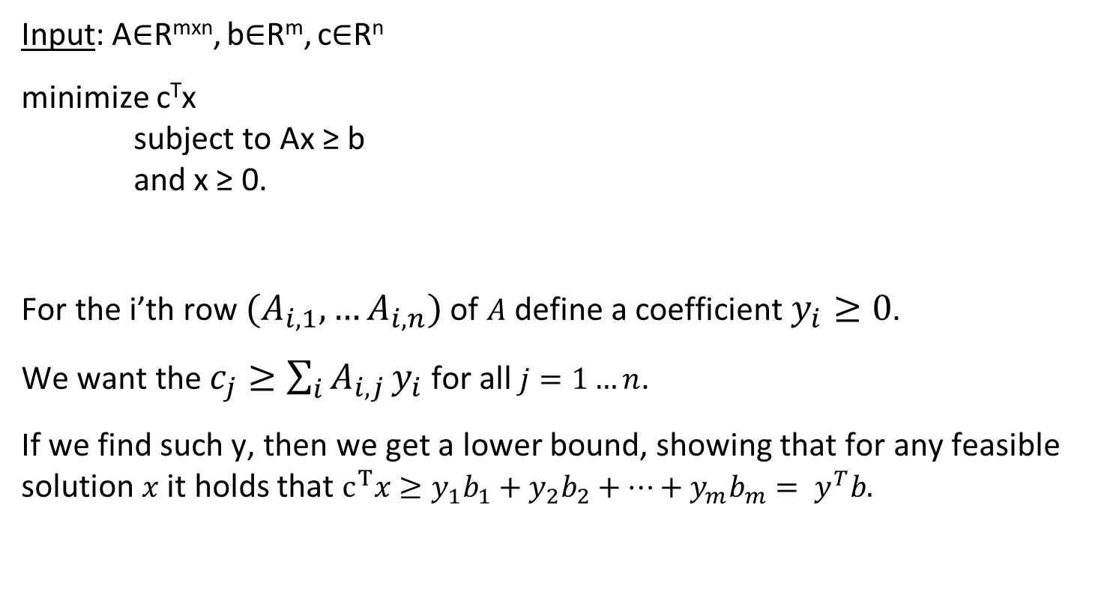
LP Duality
c=
1 | -1 | 0 | 2 | 1 | 3 | 0
Input: A∈R^{mxn}, b∈R^{m}, c∈R^{n}
minimize c^{T}x subject to Ax ≥ b and x ≥ 0.
For the i’th row $(A_{i,1},…A_{i,n})$of $A$ define a coefficient $y_{i}≥0$.
We want the $c_{j}≥\sum_{i}{A_{i,j}}y_{i}$ for all $j=1…n$.
If we find such y, then we get a lower bound, showing that for any feasible solution $x$ it holds that $c^{T}x≥y_{1}b_{1}+y_{2}b_{2}+…+y_{m}b_{m}={ y}^{T}b.$
y₁
y₂
y₃
y₄
y₅
1 | -1 | 0 | 2 | 1 | 3 | 0
2 | 1 | 0 | -2 | -4 | 1 | 0
0 | 0 | 2 | 0 | 1 | 6 | 2
2 | 0 | 0 | 2 | 0 | 0 | 0
1 | -3 | 0 | 1 | -1 | 0 | 1
2
1
0
4
-2
y=
A=
b=

Slide 9
LP Duality
c=
1 | -1 | 0 | 2 | 1 | 3 | 0
Input: A∈R^{mxn}, b∈R^{m}, c∈R^{n}
minimize c^{T}x subject to Ax ≥ b and x ≥ 0.
In other words, we are looking for y∈R^{m} such that
1) y_{i}≥ 0 for all i=1…m
2) c ≥ A^{T}y
And our goal is to maximize y₁b₁+ y₂b₂+…y_{m}b_{m}.
Y₁
y₂
y₃
y₄
y₅
1 | -1 | 0 | 2 | 1 | 3 | 0
2 | 1 | 0 | -2 | -4 | 1 | 0
0 | 0 | 2 | 0 | 1 | 6 | 2
2 | 0 | 0 | 2 | 0 | 0 | 0
1 | -3 | 0 | 1 | -1 | 0 | 1
2
1
0
4
-2
y=
A=
b=
Dual LP: Find y∈R^{m}
Maximize b^{T}y
Subject to A^{T}y ≤ c
y ≥ 0

Slide 10
LP Duality
Input: A∈R^{mxn}, b∈R^{m}, c∈R^{n}
Weak duality theorem: Suppose that the primal LP is feasible and finite.
Then OPT(primal LP) ≥ OPT(dual LP).
Strong duality theorem: Suppose that the primal LP is feasible and finite.
Then OPT(primal LP) = OPT(dual LP)
Primal LP: Find x∈R^{n}
minimize c^{T}x subject to Ax ≥ b and x ≥ 0
Dual LP: Find y∈R^{m}
maximize b^{T}y
subject to A^{T}y ≤ c
and y ≥ 0

Slide 11
LP Duality
Primal LP: Find x∈R^{n}
minimize c^{T}x subject to Ax ≥ b and x ≥ 0
Dual LP: Find y∈R^{m}
maximize b^{T}y
subject to A^{t}y ≤ c
and y ≥ 0
Strong duality theorem:
If the primal LP is feasible and finite, then OPT(primal LP) = OPT(dual LP).
If the primal LP is unbounded, the dual LP is infeasible.
Dual of dual is the primal.

Slide 12
A combinatorial algorithm for weighted vertex cover

Slide 13
LP for min-weight vertex cover
Given a graph G=(V,E) and weights w_{v}≥0, we have a variable x_{v} for each v∈V
minimize ∑_{v∈V} w_{v}x_{v}
subject to x_{u}+x_{v} ≥ 1 for (u,v) ∈E x_{v} ≥ 0 for v∈V
What is the dual of this LP?
maximize b^{T}y=∑_{e∈E} y_{e}
subject to ∑_{(u,v)∈E} y_{(u,v)} ≤ w_{u} for u∈V
y_{e} ≥ 0 for e∈E
If we compute the dual LP, then minVC(G) ≥ OPT(primal-LP) ≥ OPT(dual-LP)
Next time: a (combinatorial) linear time algorithm for finding a vertex cover of weight
weight(S) ≤ 2 OPT(dual-LP)
1 | 0 | 0 | 1 | 0 | 0 | 0
1 | 0 | 0 | 0 | 0 | 1 | 0
0 | 1 | 0 | 0 | 1 | 0 | 0
… | … | … | … | … | … | …
0 | 1 | 0 | 1 | 0 | 0 | 0
1
1
1
1
1
A=
b=

Slide 14
LP for min-weight vertex cover
Given a graph G=(V,E) and weights w_{v}≥0, we have a variable x_{v} for each v∈V
minimize ∑_{v∈V} w_{v}x_{v}
subject to x_{u}+x_{v} ≥ 1 for (u,v)∈E x_{v} ≥ 0 for v∈V
Dual of this LP:
maximize ∑_{e∈E} y_{e}
subject to ∑_{(u,v)∈E} y_{(u,v)} ≤ w_{u} for u∈V
y_{e} ≥ 0 for e∈E
Think of y_{e} as cost we charge for the edge e ∈E.
We want to maximize the total cost, while not “overcharging” for each vertex.

Slide 15
Questions?
Comments?

