Slide 1

CMPT 405/705
Design & Analysis of Algorithms
March 21, 2022

Slide 2
Plan for today
More on the probabilistic method
7/8-approximation for Max-3-SAT – a deterministic algorithm
Using Chernoff bound
computing π
Discrepancy of a hypergraph
Approximate DNF Counting

Slide 3
7/8 Approximation for MAX-3-CNF

Slide 4
7/8 approximation for Max-3-CNF
Write a polynomial time algorithm for the following problem
Input: A 3-CNF formula 𝛷 with n variables and m clauses.
Goal : Find and assignment that satisfies at least 7m/8 clauses.
Algorithm (randomized):
Repeat T=m*ln(m) times
Choose each x_{i} to be 0 or 1 independently w.p. ½ each.
Count the number of clauses satisfied by this x.
If the number of satisfied clauses is ≥ 7m/8, return this assignment
If reached here, return FAIL

Slide 5
7/8 approximation for Max-3-CNF
The analysis:
E[number of satisfied clauses] =7m/8
Pr[number of satisfied clauses ≥ 7m/8] ≥ 8/(m+8) > 1/m
If we repeat enough times, Pr[one of the repetitions will succeed]>0.999.
Can we derandomize this algorithm?
A “philosophical” question:
- Where does the randomness come from?
- What if the random outcomes are not so random?

Slide 6
A deterministic 7/8-approximation for MAX-3-CNF

Slide 7
7/8 approximation for Max-3-CNF
Let 𝛷 be a 3-CNF formula, i.e. formula of the form
(x₁ v x₂ v ~x₃) ⋀ (~x₂ v x₃ v ~x₄) ⋀ … ⋀ (~x₁ v x₂ v ~x₅)
Claim: If 𝛷 is a 3-CNF formula with m clauses, then there exists an assignment to x that satisfies at least 7m/8 clauses.
We saw a randomized algorithm that finds such an assignment with high probability.
Goal: Write a deterministic algorithm that finds such an assignment.

Slide 8
7/8 approximation for Max-3-CNF
How do we compute the expected number of satisfied clauses?
Algorithm (deterministic):
For each x_{i} do
Fix x_{i}=0 and compute the expected number of satisfied clauses where the non-fixed-variables x_{i} are chosen to be 0 or 1 independently w.p. ½ each.
Fix x_{i}=1 and compute the expected number of satisfied clauses where the non-fixed-variables x_{i} are chosen to be 0 or 1 independently w.p. ½ each.
Set x_{i} to the one that maximizes the expectation
Return the assignment
Claim: In every iteration at least one of the expectations (in line 1 or 2) is at least 7m/8.
Proof: Because their average is equal to 7m/8

Slide 9
7/8 approximation for Max-3-CNF
Q: How to compute the expected number of satisfied clauses?
After some variables are fixed: let’s focus on a specific clause, compute the probability that it is satisfied, and then use linearity of expectation.
A clauses has one literal already satisfied, e.g., (x₁ v ~x₆ v x₈) and x₈=true then Pr[clause will be satisfied] = 1
A clauses has all three variables left: (x₁ v ~x₆ v x₈), then Pr[clause will be satisfied] = 7/8
If a clauses has two literals left: (x₁ v ~x₆ v x₈) and x₁=false then Pr[clause will be satisfied] = 3/4
If a clauses has one literal left: (x₁ v ~x₆ v x₈) and x₁=false, x₆=true then Pr[clause will be satisfied] = 1/2
A clauses has no literals left: (x₁ v ~x₆ v x₈) and x₁=false , x₆=true , x₈=false then Pr[clause will be satisfied] = 0

Slide 10
7/8 approximation for Max-3-CNF
Q: How to compute the expected number of satisfied clauses?
After some variables are fixed: let’s focus on a specific clause, compute the probability that it is satisfied, and then use linearity of expectation.
Denote by p_{i}=Pr[i’th clause will be satisfied by random assignment, conditioned on the fixed values].
Then E[number of satisfied clauses | fixed values] = p₁ + p₂ + … + p_{m}

Slide 11
7/8 approximation for Max-3-CNF
Example: 𝛷 = (x₁ v x₂ v ~x₃) ⋀ (~x₁ v x₃ v ~x₄) ⋀ (~x₁ v x₂ v x₅) ⋀ (~x₂ v x₃ v x₄)
Iteration 1:
x₁ = true: E[# sat clauses | x₁=1] = 1 + 3/4 + 3/4 +7/8
x₁ = false: E[# sat clauses | x₁=0] = 3/4 + 1 + 1 +7/8
Iteration 2:
x₂ = true: E[# sat clauses | x₁=0, x₂=1] = 1 + 1 + 1 + 3/4
x₂ = false: E[# sat clauses | x₁=0, x₂=0] = 1/2 + 1 + 1 + 1
Iteration 3:
x₃ = true: E[# sat clauses | x₁=0, x₂=1, x₃=1] = 1 + 1 + 1 + 1
x₃ = false: E[# sat clauses | x₁=0, x₂=1, x₃=0] = 1/2 + 1 + 1 + 1/2
x₁ = false
x₂ = true
x₃ = true

Slide 12
7/8 approximation for Max-3-CNF
Algorithm (deterministic):
For each x_{i} do
Fix x_{i}=0 and compute the expected number of satisfied clauses where the non-fixed-variables x_{i} are chosen to be 0 or 1 independently w.p. ½ each.
Fix x_{i}=1 and compute the expected number of satisfied clauses where the non-fixed-variables x_{i} are chosen to be 0 or 1 independently w.p. ½ each.
Set x_{i} to the one that maximizes the expectation
Return the assignment
What is the runtime of the algorithm?

Slide 13
7/8 approximation for Max-3-CNF
Our algorithm finds an assignment satisfying 7/8-fraction of clauses.
Can we do better?
Inapproximability Theorem [Håstad ‘97] For all ε>0, given a satisfiable 3CNF formula, it is NP-hard to find an assignment that satisfies more than (7/8+ε)m clauses.
Conclusion: The trivial algorithm that chooses a random assignment is essentially optimal.

Slide 14
More examples of the probabilistic method

Slide 15
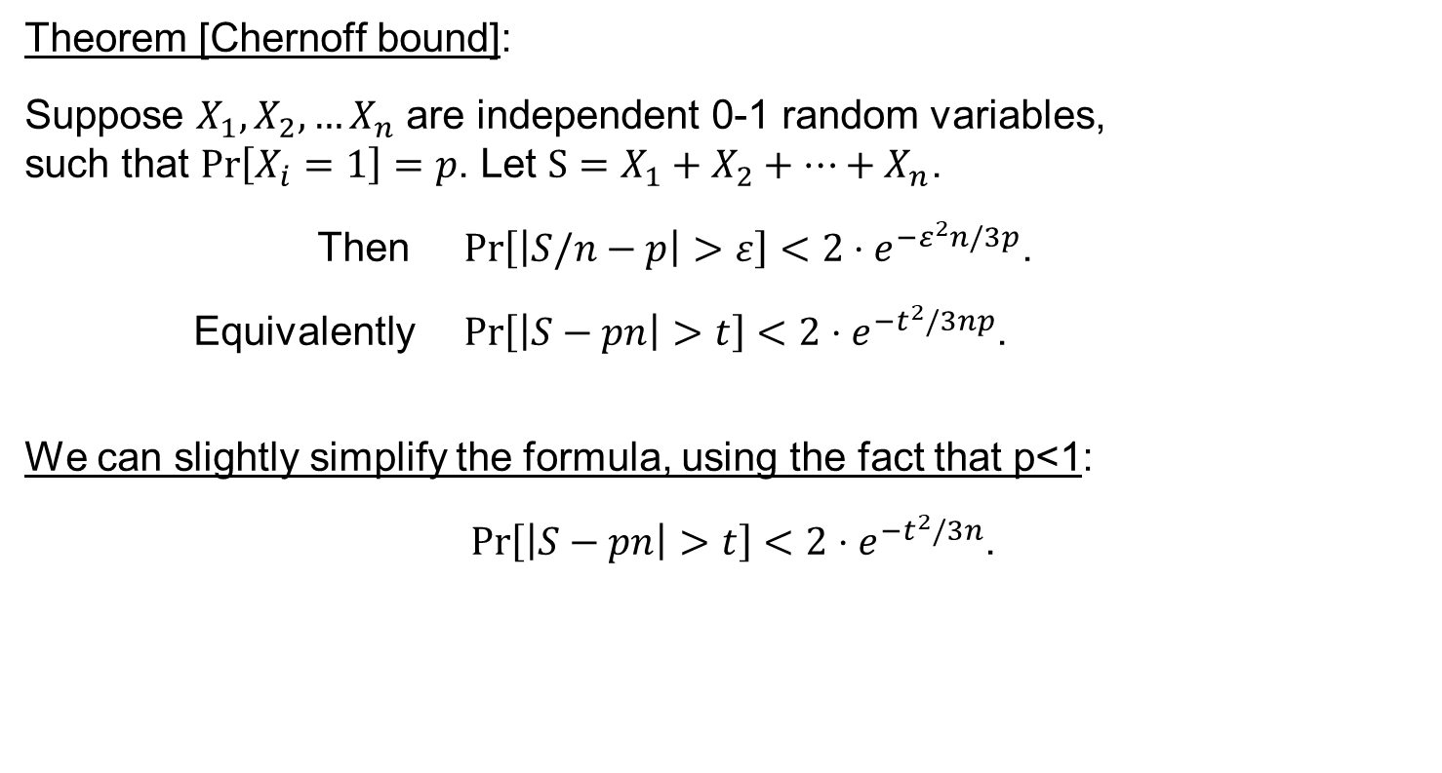
Chernoff bound
Theorem [Chernoff bound]:
Suppose $X_{1},X_{2},…X_{n}$ are independent 0-1 random variables, such that $\operatorname{Pr}\left[X_{i}=1\right]=p$. Let $S=X_{1}+X_{2}+…+X_{n}$.
Then $\operatorname{Pr}\left[\left|S/n−p\right|>ε\right]<2⋅e^{{−ε}^{2}n/3p}$.
Equivalently $\operatorname{Pr}\left[\left|S−pn\right|>t\right]<2⋅e^{{−t}^{2}/3np}$.
We can slightly simplify the formula, using the fact that p<1:
$\operatorname{Pr}\left[\left|S−pn\right|>t\right]<2⋅e^{{−t}^{2}/3n}$.

Slide 16
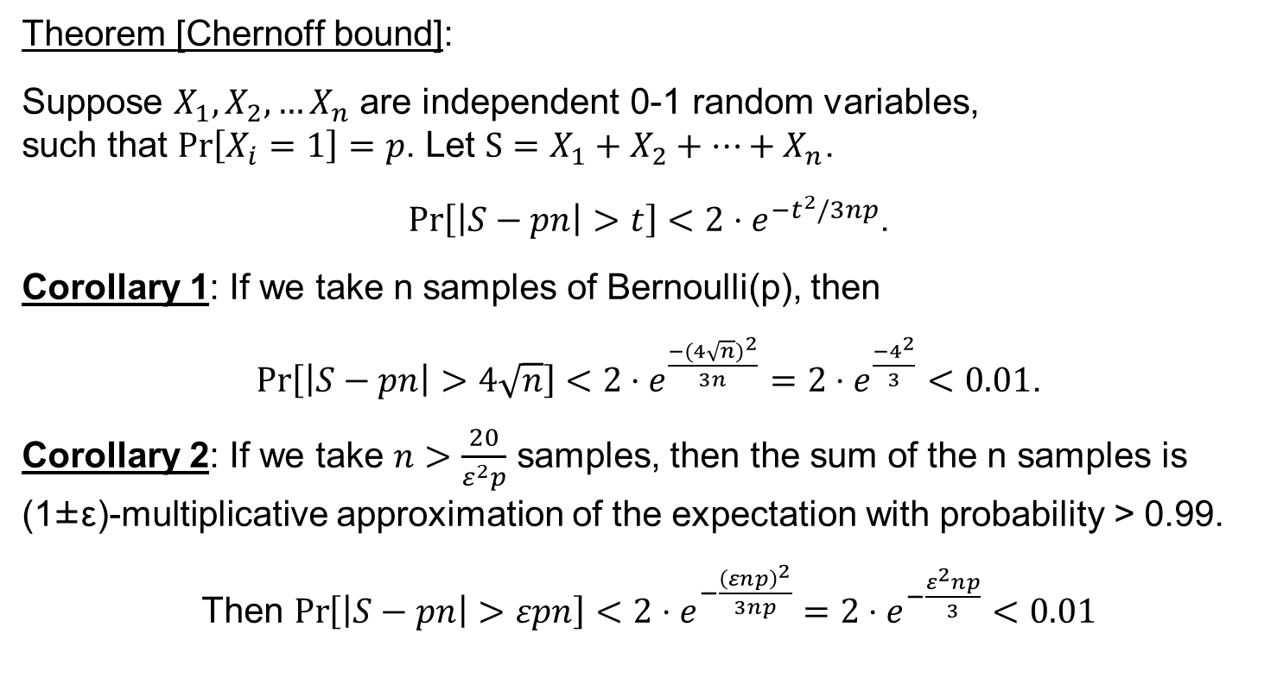
Chernoff bound
Theorem [Chernoff bound]:
Suppose $X_{1},X_{2},…X_{n}$ are independent 0-1 random variables, such that $\operatorname{Pr}\left[X_{i}=1\right]=p$. Let $S=X_{1}+X_{2}+…+X_{n}$.
$\operatorname{Pr}\left[\left|S−pn\right|>t\right]<2⋅e^{{−t}^{2}/3np}$.
Corollary 1: If we take n samples of Bernoulli(p), then
$\operatorname{Pr}\left[\left|S−pn\right|>4\sqrt{n}\right]<2⋅e^{\frac{−{(4\sqrt{n})}^{2}}{3n}}=2⋅e^{\frac{−4^{2}}{3}}<0.01$.
Corollary 2: If we take $n>\frac{20}{ε^{2}p}$ samples, then the sum of the n samples is (1±ε)-multiplicative approximation of the expectation with probability > 0.99.
Then $\operatorname{Pr}\left[\left|S−pn\right|>εpn\right]<2⋅e^{−\frac{{\left(εnp\right)}^{2}}{3np}}=2⋅e^{−\frac{ε^{2}np}{3}}<0.01$

Slide 17
A randomized algorithm for computing π

Slide 18
A randomized algorithm for computing π
Goal: Write an algorithm that prints π up to ±ε error
Equivalently: Compute the area of a unit disk up to ±ε decimal digits.
Fact: the area of a unit disc = π
Idea: Estimate p₀ = Pr_{x,y in [-1,1]}[(x,y) is in the disc]
Since the area of the square is 4 it follows that area of the disc is π = 4*p₀
Q: How can we compute p₀?
Idea: Sample random points in [-1,1], and check how many are in the disc.

Slide 19
A randomized algorithm for computing π
Goal: Write an algorithm that prints π up to ±ε error.
Equivalently: Compute the area of a unit disk up to ±ε error.
Fact: the are of a unit disc = π
Algorithm:
Sample n random points (x_{i},y_{i}) ∈[-1,1] x [-1,1]
Let S be the number of point such that x_{i}²+ y_{i}² ≤1
Let p_{est} = S/n, and output 4*p_{est}.

Slide 20
A randomized algorithm for computing π
Algorithm:
Sample n random points (x_{i},y_{i}) ∈[-1,1] x [-1,1]
Let S be the number of point s.t. x_{i}²+ y_{i}² ≤1
Let p_{est} = S/n, and output 4* p_{est} .
Analysis: Use the concentration inequalities
Intuitively, S/n should roughly be equal to the relative size of the disc in the square.

Slide 21
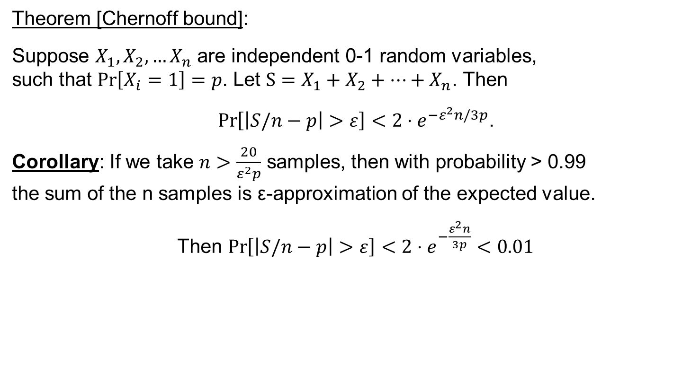
Chernoff bound
Theorem [Chernoff bound]:
Suppose $X_{1},X_{2},…X_{n}$ are independent 0-1 random variables, such that $\operatorname{Pr}\left[X_{i}=1\right]=p$. Let $S=X_{1}+X_{2}+…+X_{n}$. Then
$$\operatorname{Pr}\left[\left|S/n−p\right|>ε\right]<2⋅e^{{−ε}^{2}n/3p}\text{.}$$
Corollary: If we take $n>\frac{20}{ε^{2}p}$ samples, then with probability > 0.99 the sum of the n samples is ε-approximation of the expected value.
Then $\operatorname{Pr}\left[\left|S/n−p\right|>ε\right]<2⋅e^{−\frac{ε^{2}n}{3p}}<0.01$

Slide 22
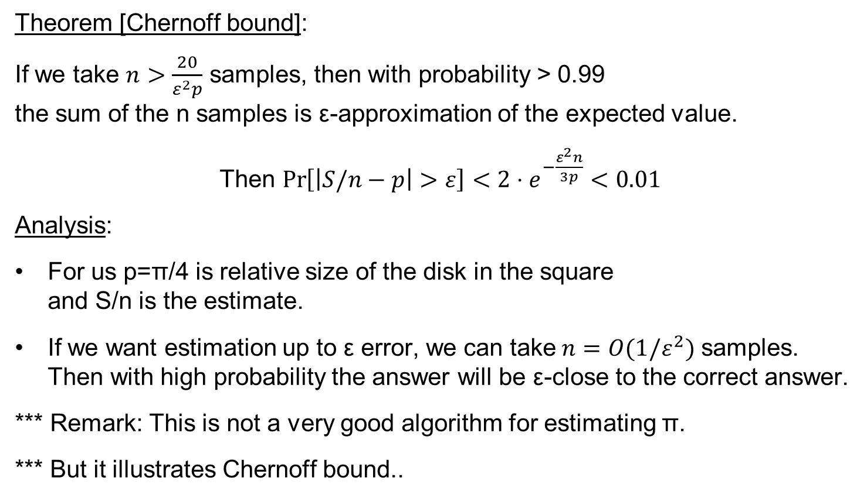
A randomized algorithm for computing π
Theorem [Chernoff bound]:
If we take $n>\frac{20}{ε^{2}p}$ samples, then with probability > 0.99 the sum of the n samples is ε-approximation of the expected value.
Then $\operatorname{Pr}\left[\left|S/n−p\right|>ε\right]<2⋅e^{−\frac{ε^{2}n}{3p}}<0.01$
Analysis:
For us p=π/4 is relative size of the disk in the square and S/n is the estimate.
If we want estimation up to ε error, we can take$n=O(1/ε^{2})$ samples. Then with high probability the answer will be ε-close to the correct answer.
*** Remark: This is not a very good algorithm for estimating π.
*** But it illustrates Chernoff bound..

Slide 23
Discrepancy of a hypergraph

Slide 24
Discrepancy
Input: A hypergraph H = (V, F)
Goal: color the vertices of the hypergraph using two colors so that the edges of H are as “balanced” as possible.

Slide 25
Discrepancy
Fix a coloring X:V → {-1,1}
Define the discrepancy of the hyperedge f∈F using X as disc_{X}(f) =| ∑_{v∈f}X(v) |
Discrepancy of H with X is disc_{X}(H) = max_{f∈F} disc_{X}(f)
Discrepancy of H is defined
Disc(H) = min_{X:V→{-1,1}}disc_{X}(H)
Disc(H)=d ⬅➔ some coloring satisfies: all edges have discrepancy ≤d.

Slide 26
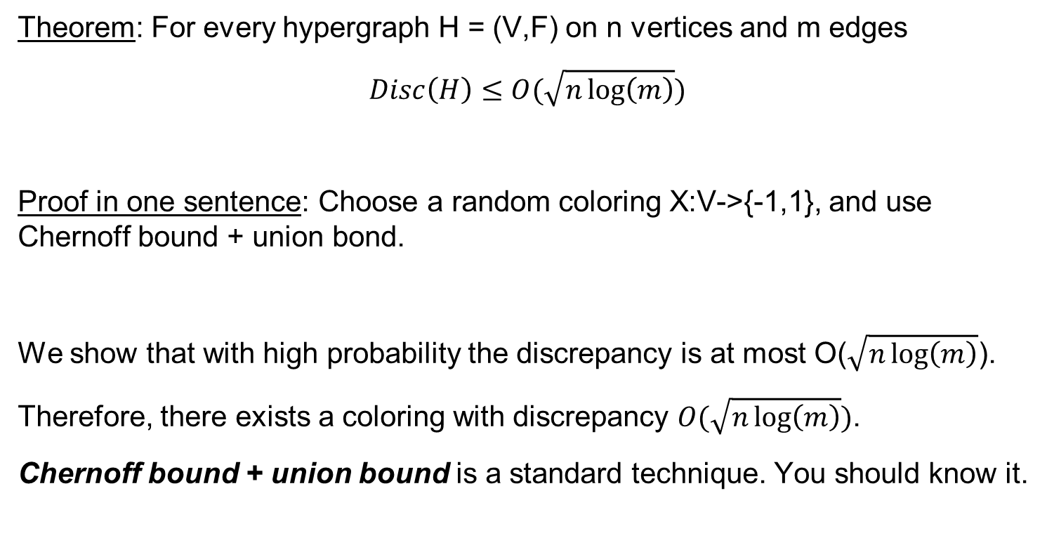
Discrepancy
Theorem: For every hypergraph H = (V,F) on n vertices and m edges
$$Disc\left(H\right)≤O(\sqrt{n\log\left(m\right)})$$
Proof in one sentence: Choose a random coloring X:V->{-1,1}, and use Chernoff bound + union bond.
We show that with high probability the discrepancy is at most O($\sqrt{n\log\left(m\right)}$).
Therefore, there exists a coloring with discrepancy $O(\sqrt{n\log\left(m\right)})$.
Chernoff bound + union bound is a standard technique. You should know it.

Slide 27
Chernoff bound
Theorem [Chernoff bound]:
Suppose $X_{1},X_{2},…X_{n}$ are independent 0-1 random variables, such that $\operatorname{Pr}\left[X_{i}=1\right]=p$. Let $S=X_{1}+X_{2}+…+X_{n}$.
Then $\operatorname{Pr}\left[\left|S/n−p\right|>ε\right]<2⋅e^{{−ε}^{2}n/3p}$.
Equivalently $\operatorname{Pr}\left[\left|S−pn\right|>t\right]<2⋅e^{{−t}^{2}/3np}$.
We can slightly simplify the formula, using the fact that p<1:
$\operatorname{Pr}\left[\left|S−pn\right|>t\right]<2⋅e^{{−t}^{2}/3n}$.

Slide 28
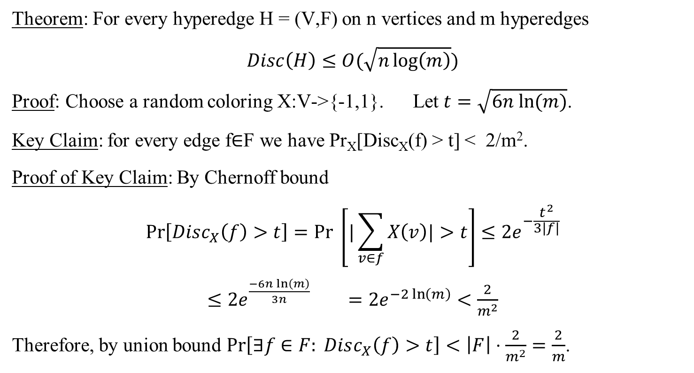
Discrepancy
Theorem: For every hyperedge H = (V,F) on n vertices and m hyperedges
$$Disc\left(H\right)≤O(\sqrt{n\log\left(m\right)})$$
Proof: Choose a random coloring X:V->{-1,1}. Let $t=\sqrt{6n ln⁡(m)}$.
Key Claim: for every edge f∈F we have Pr_{X}[Disc_{X}(f) > t] < 2/m².
Proof of Key Claim: By Chernoff bound
$$\operatorname{Pr}\left[Disc_{X}\left(f\right)>t\right]=Pr \left[|\sum_{v∈f}{X\left(v\right)|>t}\right]≤2e^{−\frac{t^{2}}{3|f|}}$$
$≤2e^{\frac{−6n\ln\left(m\right)}{3n}}$ $=2e^{−2\ln\left(m\right)}<\frac{2}{m^{2}}$
Therefore, by union bound $\operatorname{Pr}\left[∃f∈F: Disc_{X}\left(f\right)>t\right]<\left|F\right|⋅\frac{2}{m^{2}}=\frac{2}{m}$.

Slide 29

Discrepancy – bounded degree case
Beck-Fiala Theorem: Let H = (V,F), s.t. every vertex has degree at most t, i.e. every vertex belongs to at most t sets. Then $Disc\left(H\right)<2t$.
Beck-Fiala Conjecture: Let H = (V,F), s.t. every vertex has degree at most t, i.e. every vertex belongs to at most t sets. Then $Disc\left(H\right)<O(\sqrt{t}$).
Banaszczyk ‘98: Let H = (V,F), s.t. every vertex has degree at most t, i.e. every vertex belongs to at most t sets. Then $Disc\left(H\right)<O(\sqrt{t log⁡(|F|)}$.

Slide 30
Approximate DNF Counting

Slide 31
Approximate DNF Counting
Let 𝛷 be a DNF formula, i.e. formula of the form
(x₁ ⋀ x₂ ⋀ ~x₃ ⋀ x₄) v (~x₂ ⋀ x₃ ⋀ ~x₅ ⋀ x₆ ) v … v (~x₁ ⋀ x₂ ⋀ x₄ ⋀ ~x₆ ⋀ ~x₈)
Note that finding a satisfying solution is easy.
Input: A DNF formula 𝛷 with n variables and m clauses.
Goal: Find the #SAT(𝛷) = number of satisfying assignments.
Observation: The problem is hard NP-hard.
(If we could tell if the number of solutions is 2^{n}, then we could solve 3-SAT)
Goal 2: Approximate the number of satisfying assignments.

Slide 32
Approximate DNF Counting
Input: A DNF formula 𝛷 with n variables and m clauses.
Goal: Approximate the number of satisfying assignments.
Question: What do we mean by approximate?
A1: Up to an additive error up to ε2^{n}
A2: Up to a small multiplicative error
Algorithm for A1 is rather easy:
Sample x₁, x₂, … , x_{t} ∈ {0,1}^{n} for t = O(1/ε²)
Let S = be the number of x_{i}’s that satisfy 𝛷.
Output (s/t)*2^{n}
Analysis: By Chernoff bound Pr[ | #SAT(𝛷) - (S/t)*2^{n} | < ε2^{n}] > 0.99.

Slide 33

Approximate DNF Counting
So far:
Input: A DNF formula 𝛷 with n variables and m clauses.
Goal: Approximate #SAT(𝛷) up to an additive error up to ε2^{n}.
Goal*: Approximate #SAT(𝛷) up to a multiplicative error of (1± ε).
That is, output A such that
$\left(1−ε\right)⋅\#SAT\left(Φ\right)≤A≤\left(1+ε\right)⋅\#SAT(Φ)$.
Suppose each clause has 0.5n literals, and there are poly(n) clauses,
Then #SAT(𝛷)<poly(n)*2^{0.5n}
For such 𝛷 if we make << 2^{n/2} samples, the algorithm will only see unsat-assignments 0 with high probability

Slide 34
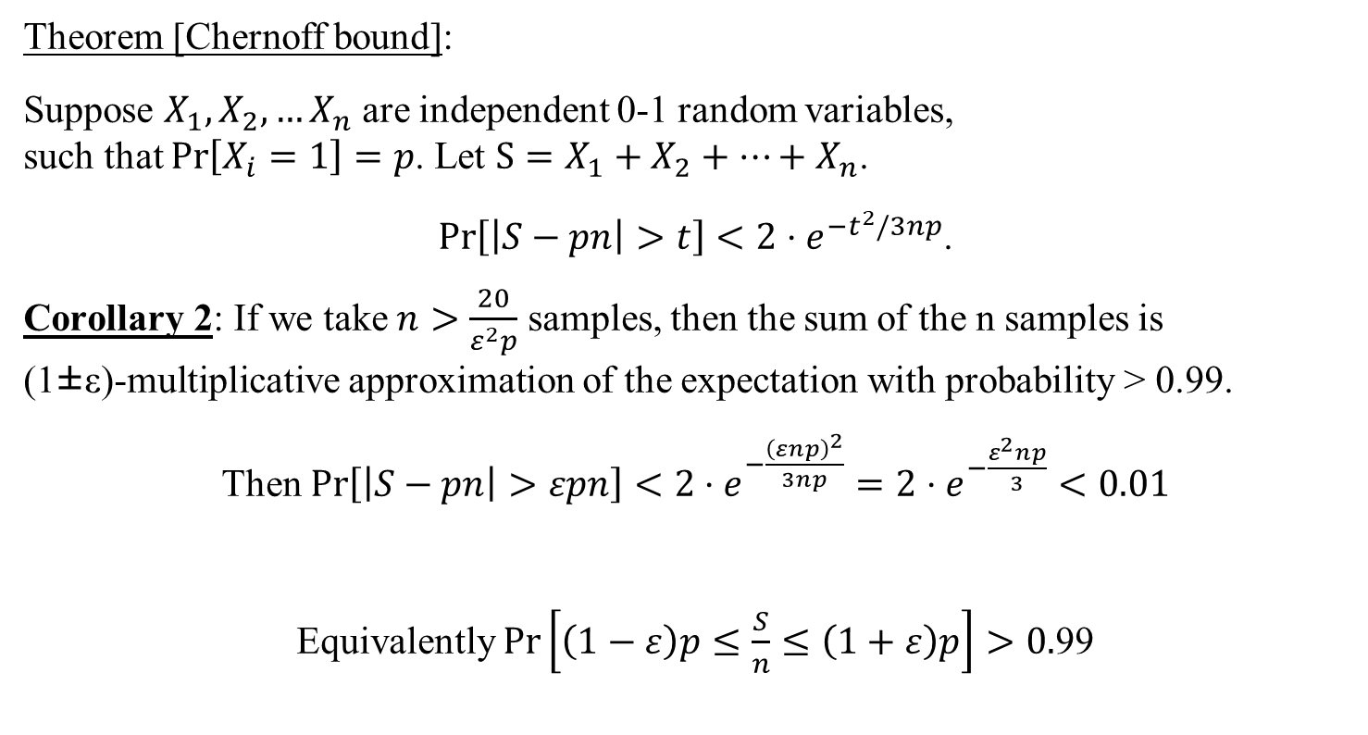
Chernoff bound
Theorem [Chernoff bound]:
Suppose $X_{1},X_{2},…X_{n}$ are independent 0-1 random variables, such that $\operatorname{Pr}\left[X_{i}=1\right]=p$. Let $S=X_{1}+X_{2}+…+X_{n}$.
$\operatorname{Pr}\left[\left|S−pn\right|>t\right]<2⋅e^{{−t}^{2}/3np}$.
Corollary 2: If we take $n>\frac{20}{ε^{2}p}$ samples, then the sum of the n samples is (1±ε)-multiplicative approximation of the expectation with probability > 0.99.
Then $\operatorname{Pr}\left[\left|S−pn\right|>εpn\right]<2⋅e^{−\frac{{\left(εnp\right)}^{2}}{3np}}=2⋅e^{−\frac{ε^{2}np}{3}}<0.01$
Equivalently $\operatorname{Pr}\left[\left(1−ε\right)p≤\frac{S}{n}≤\left(1+ε\right)p\right]>0.$99

Slide 35
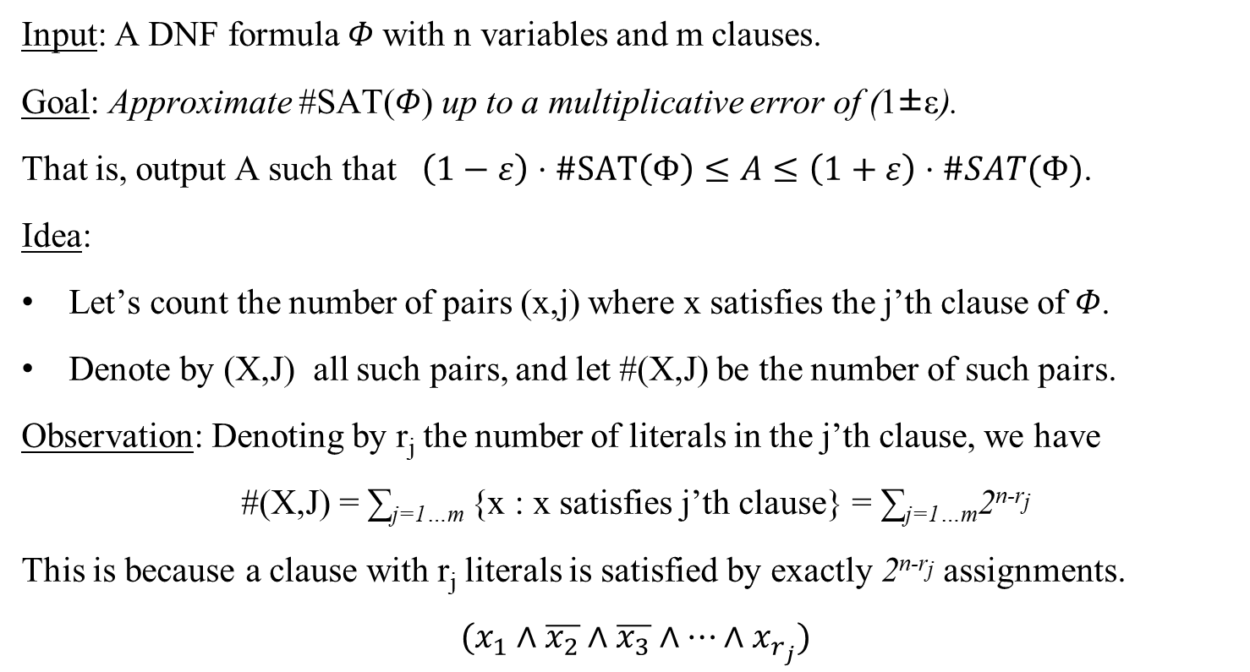
Approximate DNF Counting
Input: A DNF formula 𝛷 with n variables and m clauses.
Goal: Approximate #SAT(𝛷) up to a multiplicative error of (1±ε).
That is, output A such that $\left(1−ε\right)⋅\#SAT\left(Φ\right)≤A≤\left(1+ε\right)⋅\#SAT(Φ)$.
Idea:
Let’s count the number of pairs (x,j) where x satisfies the j’th clause of 𝛷.
Denote by (X,J) all such pairs, and let #(X,J) be the number of such pairs.
Observation: Denoting by r_{j} the number of literals in the j’th clause, we have
#(X,J) = ∑_{j=1…m} {x : x satisfies j’th clause} = ∑_{j=1…m}2^{n-rj}
This is because a clause with r_{j} literals is satisfied by exactly 2^{n-rj} assignments.
$$(x_{1}∧\overline{x_{2}}∧\overline{x_{3}}∧…∧x_{r_{j}})$$

Slide 36
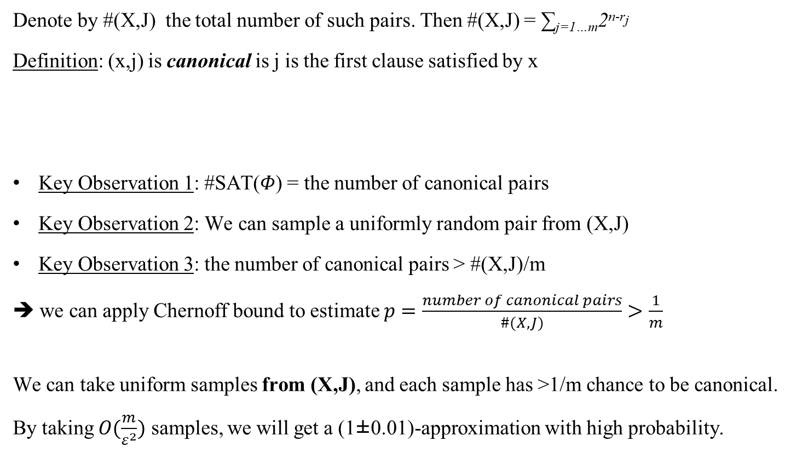
Approximate DNF Counting
Denote by #(X,J) the total number of such pairs. Then #(X,J) = ∑_{j=1…m}2^{n-rj}
Definition: (x,j) is canonical is j is the first clause satisfied by x
Key Observation 1: #SAT(𝛷) = the number of canonical pairs
Key Observation 2: We can sample a uniformly random pair from (X,J)
Key Observation 3: the number of canonical pairs > #(X,J)/m
➔ we can apply Chernoff bound to estimate $p=\frac{number of canonical pairs}{\#(X,J)}>\frac{1}{m}$
We can take uniform samples from (X,J), and each sample has >1/m chance to be canonical.
By taking $O(\frac{m}{ε^{2}})$ samples, we will get a (1±0.01)-approximation with high probability.
Need to approximate the number of canonical pairs

Slide 37
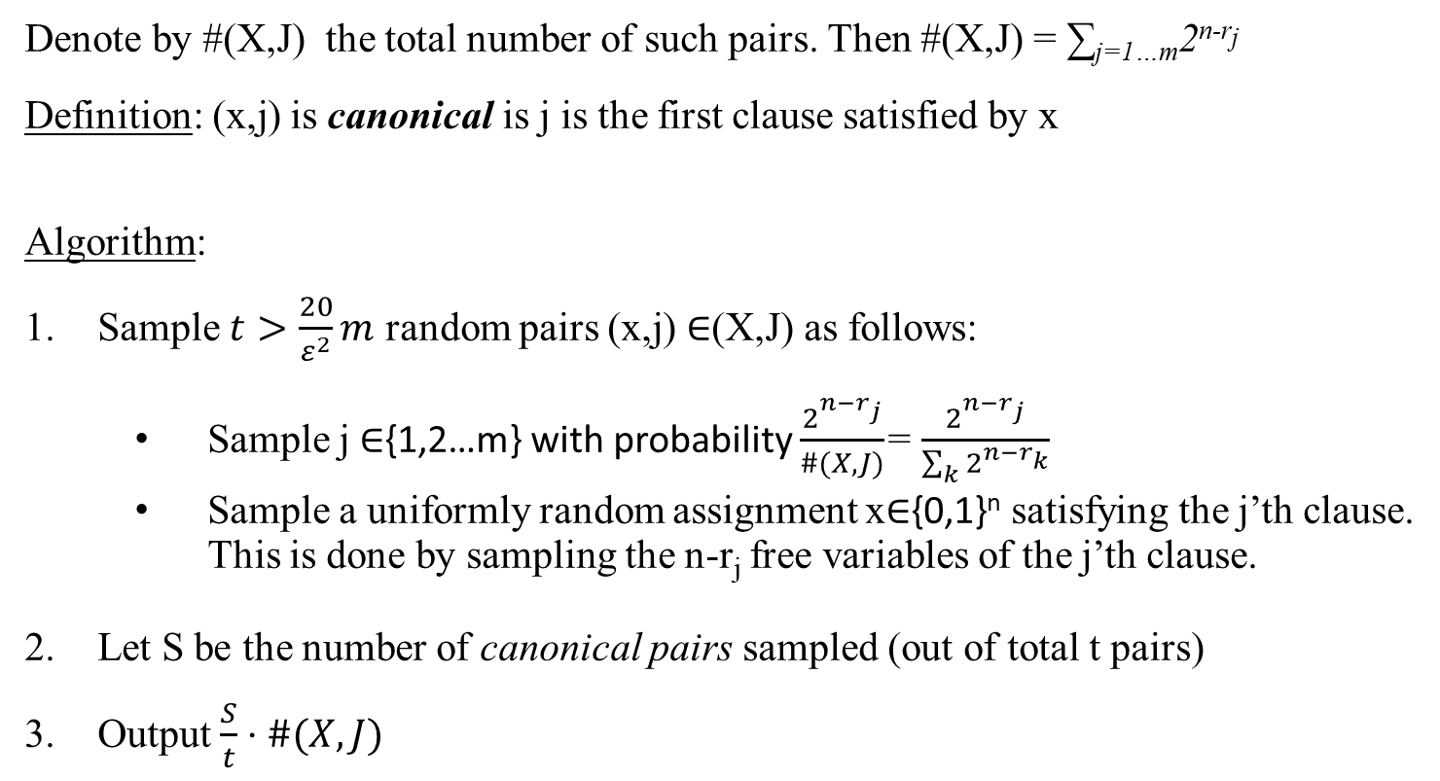
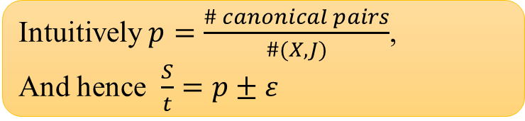
Approximate DNF Counting
Denote by #(X,J) the total number of such pairs. Then #(X,J) = ∑_{j=1…m}2^{n-rj}
Definition: (x,j) is canonical is j is the first clause satisfied by x
Algorithm:
Sample $t>\frac{20}{ε^{2}}m$ random pairs (x,j) ∈(X,J) as follows:
Sample j ∈{1,2…m} with probability $\frac{2^{n−r_{j}}}{\#(X, J)}$= $\frac{2^{n−r_{j}}}{\sum_{k}{2^{n−r_{k}}}}$
Sample a uniformly random assignment x∈{0,1}^{n} satisfying the j’th clause. This is done by sampling the n-r_{j} free variables of the j’th clause.
Let S be the number of canonical pairs sampled (out of total t pairs)
Output $\frac{S}{t}⋅\#(X,J)$
Intuitively $p=\frac{\# canonical pairs}{\#(X,J)}$,
And hence $\frac{S}{t}=p±ε$

Slide 38
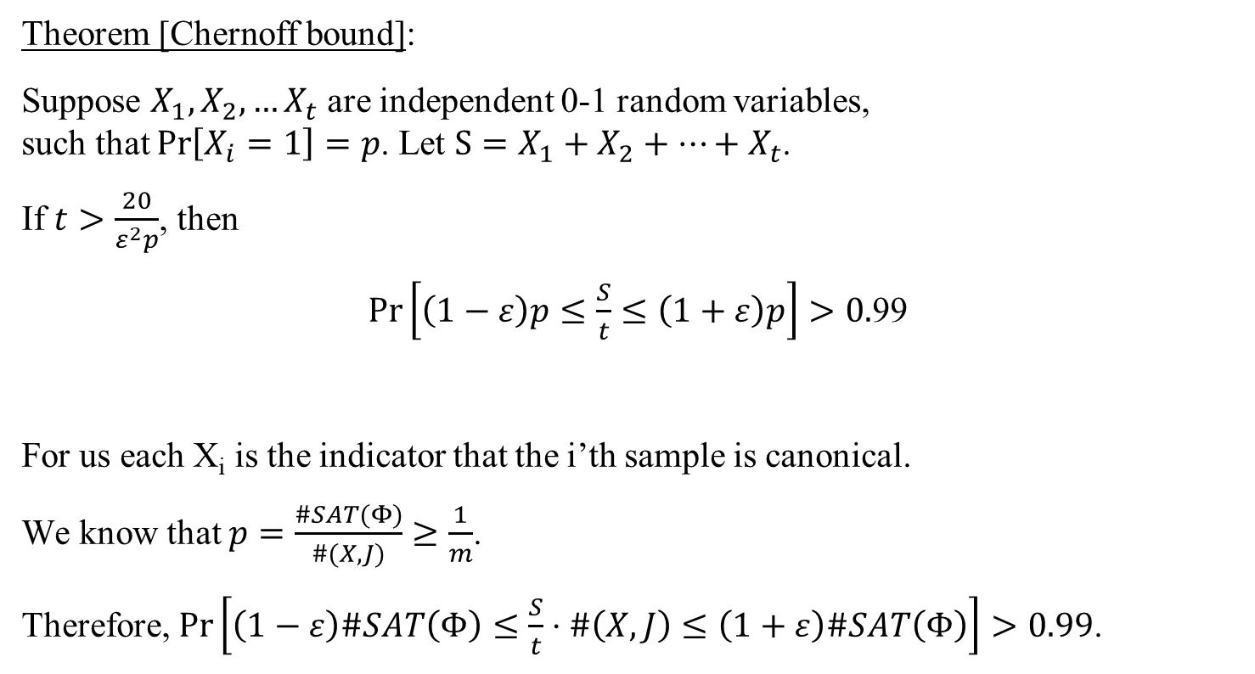
Approximate DNF Counting
Theorem [Chernoff bound]:
Suppose $X_{1},X_{2},…X_{t}$ are independent 0-1 random variables, such that $\operatorname{Pr}\left[X_{i}=1\right]=p$. Let $S=X_{1}+X_{2}+…+X_{t}$.
If $t>\frac{20}{ε^{2}p}$, then
$\operatorname{Pr}\left[\left(1−ε\right)p≤\frac{S}{t}≤\left(1+ε\right)p\right]>0.$99
For us each X_{i} is the indicator that the i’th sample is canonical.
We know that $p=\frac{\#SAT(Φ)}{\#(X,J)}≥\frac{1}{m}$.
Therefore, $Pr\left[\left(1−ε\right)\#SAT\left(Φ\right)≤\frac{S}{t}⋅\#\left(X,J\right)≤\left(1+ε\right)\#SAT\left(Φ\right)\right]>0.99$.

Slide 39
Approximate DNF Counting
Open problem: What about deterministic algorithms for approximate DNF counting?
For additive approximation ε2^{n} the best deterministic algorithm runs in time O(n^{loglog(n)}).
It is a very nice open problem to design a deterministic poly-time algorithm for ε2^{n} additive approximation (with constant ε, say ε=0.1)

Slide 40
Questions?
Comments?

