Slide 1

CMPT 405/705
Design & Analysis of Algorithms
March 16, 2022

Slide 2
Plan for today
More approximation algorithms
7/8 approximation for Max-3-SAT
Quick Sort with random pivot

Slide 3
7/8 approximation for Max-3-CNF
Let 𝛷 be a 3-CNF formula, i.e., the formula of the form
(x₁ v x₂ v ~x₃) ⋀ (~x₂ v x₃ v ~x₄) ⋀ … ⋀ (~x₁ v x₂ v ~x₅)
Claim: If 𝛷 is a 3-CNF formula with m clauses, then there exists an assignment to x that satisfies at least 7m/8 clauses.
Proof:
Choose each x_{i} to be 0 or 1 independently w.p. ½ each.
Let Z_{i}∈{0,1} be the indicator that the i’th clause is satisfied.
Then E[Z_{i}] = Pr[Z_{i} = 1] = 7/8 (because 7 out of 8 assignments are satisfying)
The expected number of satisfied clauses is
E[Z₁+Z₂+…+Z_{m}] = E[Z₁]+ E[Z₂]+… E[Z_{m}] = 7m/8.
Therefore, there exists an assignment that satisfies at least 7m/8 clauses.

Slide 4
7/8 approximation for Max-3-CNF
Write a polynomial time algorithm for the following problem
Input: A 3-CNF formula 𝛷 with n variables and m clauses.
Goal : Find and assignment that satisfies at least 7m/8 clauses.
Algorithm (randomized):
Repeat T=m*ln(m) times
Choose each x_{i} to be 0 or 1 independently w.p. ½ each.
Count the number of clauses satisfied by this x.
If the number of satisfied clauses is ≥ 7m/8, return this assignment
If reached here, return FAIL

Slide 5
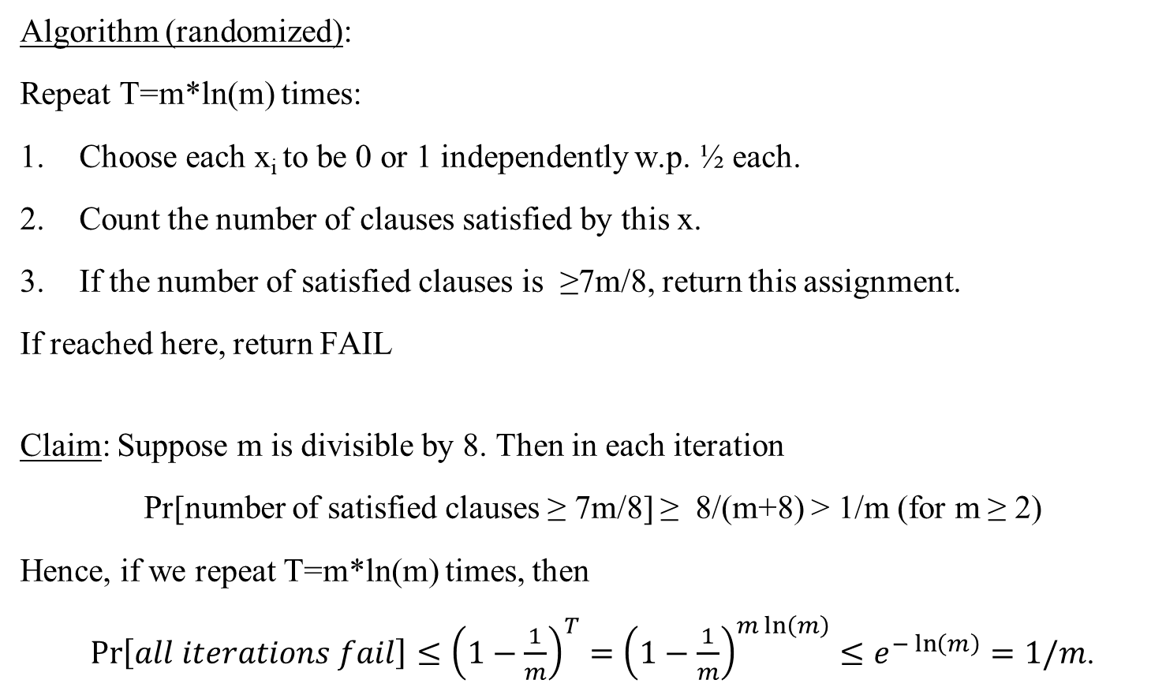
7/8 approximation for Max-3-CNF
Algorithm (randomized):
Repeat T=m*ln(m) times:
Choose each x_{i} to be 0 or 1 independently w.p. ½ each.
Count the number of clauses satisfied by this x.
If the number of satisfied clauses is ≥7m/8, return this assignment.
If reached here, return FAIL
Claim: Suppose m is divisible by 8. Then in each iteration
Pr[number of satisfied clauses ≥ 7m/8] ≥ 8/(m+8) > 1/m (for m ≥ 2)
Hence, if we repeat T=m*ln(m) times, then
$\operatorname{Pr}\left[all iterations fail\right]≤{\left(1−\frac{1}{m}\right)}^{T}={\left(1−\frac{1}{m}\right)}^{m\ln\left(m\right)}≤e^{−\ln\left(m\right)}=1/m$.

Slide 6
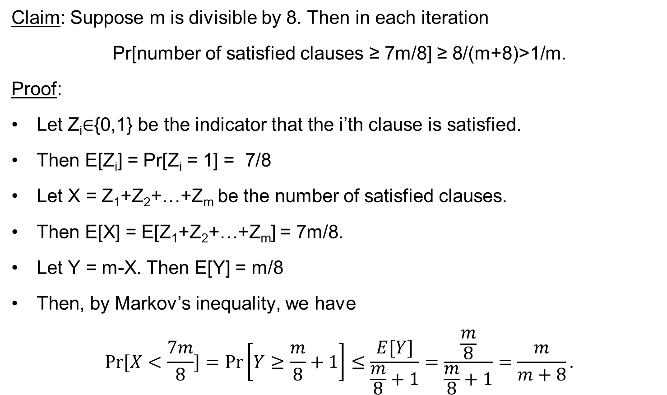
7/8 approximation for Max-3-CNF
Claim: Suppose m is divisible by 8. Then in each iteration
Pr[number of satisfied clauses ≥ 7m/8] ≥ 8/(m+8)>1/m.
Proof:
Let Z_{i}∈{0,1} be the indicator that the i’th clause is satisfied.
Then E[Z_{i}] = Pr[Z_{i} = 1] = 7/8
Let X = Z₁+Z₂+…+Z_{m} be the number of satisfied clauses.
Then E[X] = E[Z₁+Z₂+…+Z_{m}] = 7m/8.
Let Y = m-X. Then E[Y] = m/8
Then, by Markov’s inequality, we have
$$\operatorname{Pr}{[X<\frac{7m}{8}]}=\operatorname{Pr}\left[Y≥\frac{m}{8}+1\right]≤\frac{E[Y]}{\frac{m}{8}+1}=\frac{\frac{m}{8}}{\frac{m}{8}+1}=\frac{m}{m+8}.$$

Slide 7

7/8 approximation for Max-3-CNF
A stronger claim: If 𝛷 is a 3-CNF formula with m clauses, then
Pr[a random assignment satisfies at least 7m/8 clauses] > 0.1.
In particular, it suffices to repeat the randomized algorithm only O(1) times for 0.99 success probability.
But I don’t know an elementary proof of this fact.
Algorithm (randomized):
Repeat T=10m times:
Choose each x_{i} to be 0 or 1 independently w.p. ½ each.
Count the number of satisfied clauses by this x
If the number of satisfied clauses is ≥ m/8, return this assignment
If reached here, return FAIL
Claim: Suppose m is divisible by 8. Then in each iteration
Pr[number of satisfied clauses ≥ 7m/8] ≥ 8/(m+8)>1/m (for m>2)
If we repeat T = 10m times, then
$\operatorname{Pr}\left[found an assignemnt satisfying≥\frac{7m}{8}clauses\right]≥1−{\left(1−\frac{1}{m}\right)}^{T=10m}>1−e^{−10}$.
What about a deterministic algorithm?

Slide 8
Back to QuickSort

Slide 9
Quick Sort
Given an array A[0…n-1]
  Choose an element in the array, call it the pivot.
  Rearrange the elements in the array so that:
    All A[i] < pivot are to the left of pivot.
    All A[i] >= pivot are to the right of pivot.
  Recursively sort to the left of the pivot.
  Recursively sort to the right of the pivot.

Slide 10
Quick Sort
Example: Input: [4, 1, 8, 7, 10, 3]
Let pivot =7
Rearrange to get [4,1,3] and [10, 8]
Sort [4, 1, 3] ➔[1, 3, 4]
Sort [10, 8] ➔ [8, 10]
The steps are:
Choose a pivot
Compare all numbers in A to the pivot, and move them if needed
Run recursion

Slide 11
Quick Sort
Running time – O(n log(n)) for good pivots
Q: What is a good pivot?
A:The one that splits the array into equal halves, or n/3 ---- 2n/3
For example: if we split n/5 ---- 4n/5, we get
T(n) = O(n) + T(n/5) + T(4n/5)
We saw that the running time is T(n) = O(n log(n))
Q: how can we find a good pivot?
Choose pivot /
Rearrange
Recursion

Slide 12
Quick Sort
Q: how can we find a good pivot?
A: random pivot works
Given an array A[0…n-1]
  Choose a random index i∈[0…n-1 uniformly
  set pivot=A[i].
  Rearrange the elements in the array so that:
    All A[i] < pivot are to the left of pivot.
    All A[i] ≥ pivot are to the right of pivot.
  Recursively sort to the left of the pivot.
  Recursively sort to the right of the pivot.

Slide 13
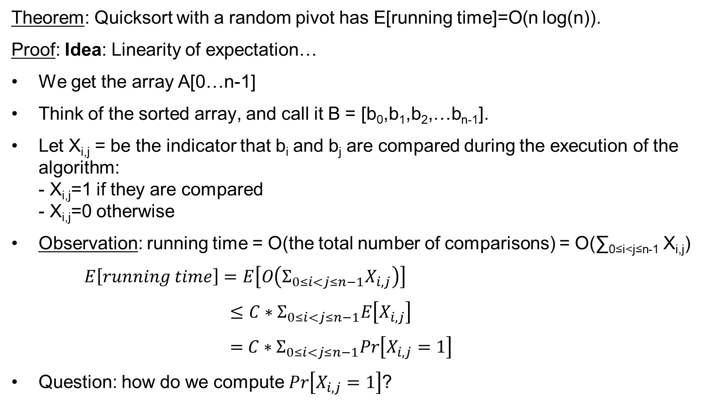
Quick Sort
Theorem: Quicksort with a random pivot has E[running time]=O(n log(n)).
Proof: Idea: Linearity of expectation…
We get the array A[0…n-1]
Think of the sorted array, and call it B = [b₀,b₁,b₂,…b_{n-1}].
Let X_{i,j} = be the indicator that b_{i} and b_{j} are compared during the execution of the algorithm:
- X_{i,j}=1 if they are compared
- X_{i,j}=0 otherwise
Observation: running time = O(the total number of comparisons) = O(∑_{0≤i<j≤n-1} X_{i,j})
$E\left[running time\right]=E\left[O\left(Σ_{0≤i<j≤n−1}X_{i,j}\right)\right]$
$≤C∗Σ_{0≤i<j≤n−1}E\left[X_{i,j}\right]$
$=$ $C∗Σ_{0≤i<j≤n−1}Pr\left[X_{i,j}=1\right]$
Question: how do we compute $Pr\left[X_{i,j}=1\right]$?

Slide 14
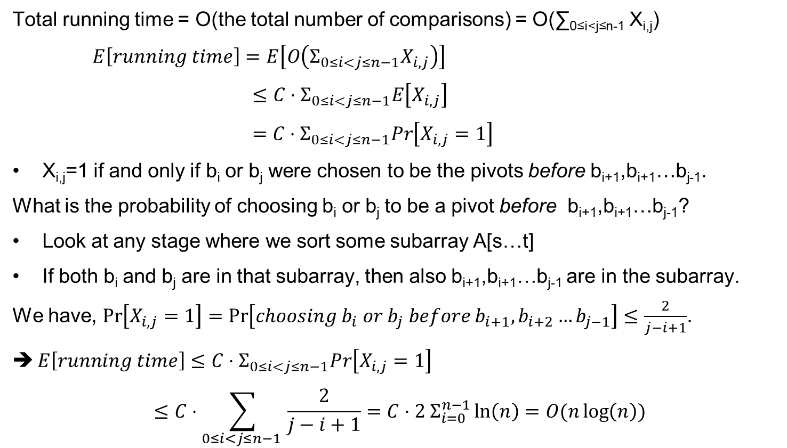
Quick Sort
Total running time = O(the total number of comparisons) = O(∑_{0≤i<j≤n-1} X_{i,j})
$E\left[running time\right]=E\left[O\left(Σ_{0≤i<j≤n−1}X_{i,j}\right)\right]$
$≤C⋅Σ_{0≤i<j≤n−1}E\left[X_{i,j}\right]$
$=$ $C⋅Σ_{0≤i<j≤n−1}Pr\left[X_{i,j}=1\right]$
X_{i,j}=1 if and only if b_{i} or b_{j} were chosen to be the pivots before b_{i+1},b_{i+1}…b_{j-1}.
What is the probability of choosing b_{i} or b_{j} to be a pivot before b_{i+1},b_{i+1}…b_{j-1}?
Look at any stage where we sort some subarray A[s…t]
If both b_{i} and b_{j} are in that subarray, then also b_{i+1},b_{i+1}…b_{j-1} are in the subarray.
We have, $\operatorname{Pr}\left[X_{i,j}=1\right]=\operatorname{Pr}\left[choosing b_{i} or b_{j} before b_{i+1}, b_{i+2}…b_{j−1}\right]≤\frac{2}{j−i+1}$.
$E\left[running time\right]≤C⋅Σ_{0≤i<j≤n−1}Pr\left[X_{i,j}=1\right]$
$$≤C⋅\sum_{0≤i<j≤n−1 }{\frac{2}{j−i+1}}={C⋅2 Σ}_{i=0}^{n−1}\ln\left(n\right)=O(n\log\left(n\right))$$

Slide 15
Quick Sort
Theorem: Quicksort with a random pivot has E[running time]= C*n log(n) for some constant C>0.
Therefore, by Markov’s inequality
Pr[ running time > 100 C n log(n) ] = Pr[running time > 100*expectation] < 1/100

Slide 16
Questions?
Comments?

