Slide 1

CMPT 405/705
Design & Analysis of Algorithms
March 7, 2022

Slide 2
Plan for today
Dynamic programming
Finding a path of length k in time exp(k)
  Color coding

Slide 3
Finding a path of length k

Slide 4

Finding a path of length k
Input: A graph G=(V,E) with |V|=n, and a parameter k.
Output: A simple path of length k
Example: A path of length 4
A trivial solution: try all sequences of length k, and check if it gives a solution
Running time: $O(n^{k}∗poly(n))$
B
C
A
D
G
F
E

Slide 5
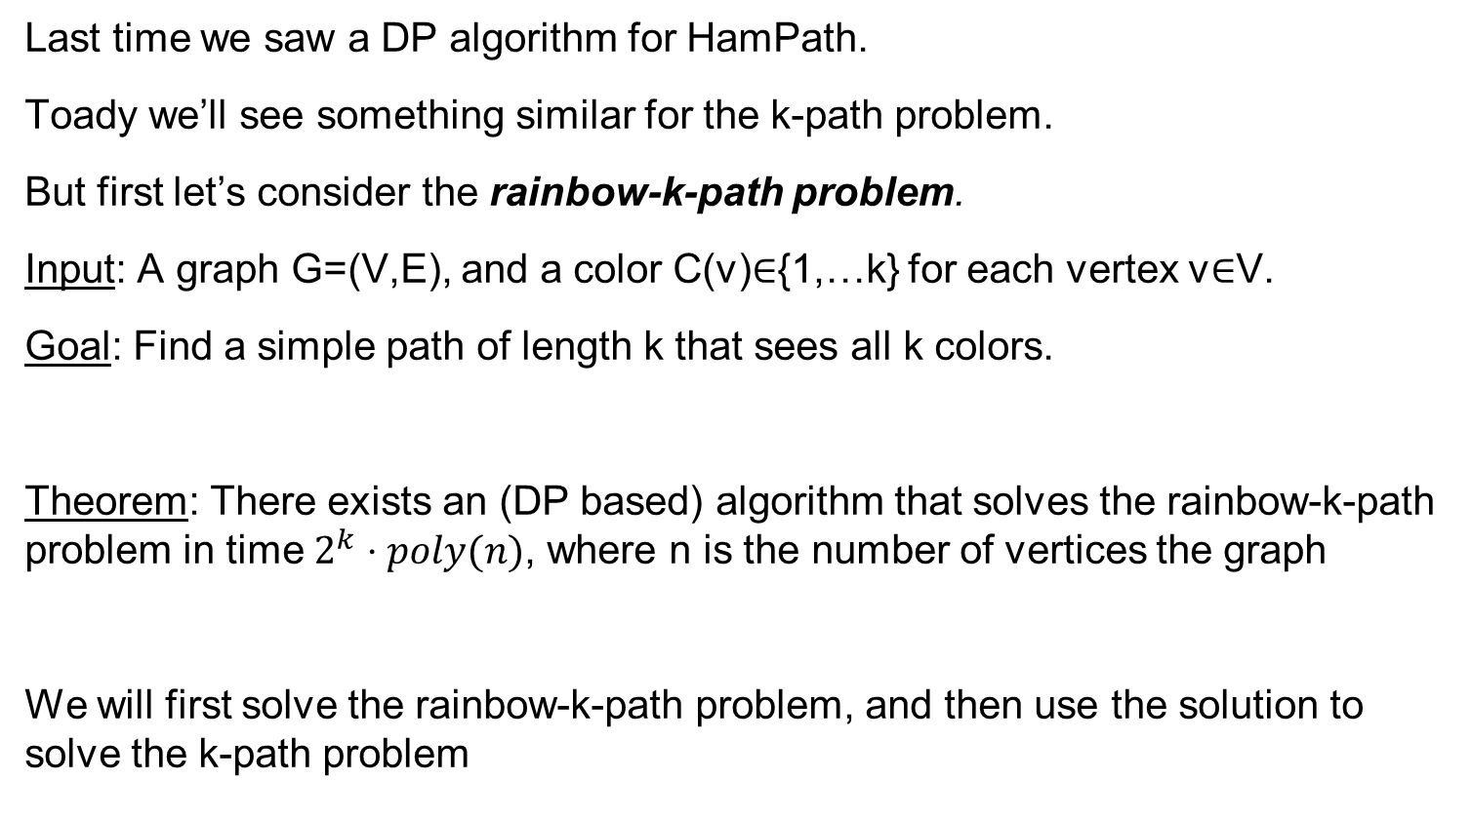
Finding a colorful path of length k
Last time we saw a DP algorithm for HamPath.
Toady we’ll see something similar for the k-path problem.
But first let’s consider the rainbow-k-path problem.
Input: A graph G=(V,E), and a color C(v)∈{1,…k} for each vertex v∈V.
Goal: Find a simple path of length k that sees all k colors.
Theorem: There exists an (DP based) algorithm that solves the rainbow-k-path problem in time $2^{k}⋅poly(n)$, where n is the number of vertices the graph
We will first solve the rainbow-k-path problem, and then use the solution to solve the k-path problem

Slide 6
Rainbow-k-path problem
Input: A graph G=(V,E), and a color C(v)∈{1,…k} for each vertex v∈V
Goal: Find a simple path of length k that sees all k colors.
Approach: Dynamic Programming.
Idea: Try to construct a rainbow-k-path, by walking along a path v₁, v₂,v₃…
Suppose you visited t vertices so far: v₁, v₂,…v_{t}
Key observation: You do not need to remember the vertices you have visited. You only need to remember
The last vertex, and
the set of colors you visited.
Note: there are no more than n*2^{k} choices for the colors

Slide 7
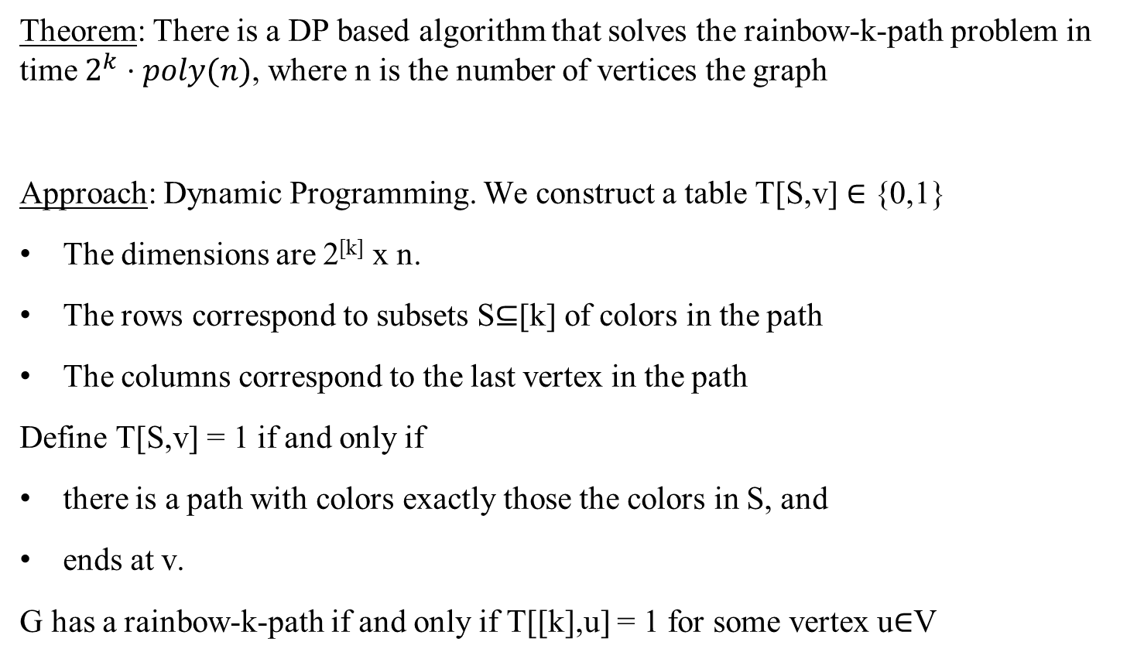
Rainbow-k-path problem
Theorem: There is a DP based algorithm that solves the rainbow-k-path problem in time $2^{k}⋅poly(n)$, where n is the number of vertices the graph
Approach: Dynamic Programming. We construct a table T[S,v] ∈ {0,1}
The dimensions are 2^{[k]} x n.
The rows correspond to subsets S⊆[k] of colors in the path
The columns correspond to the last vertex in the path
Define T[S,v] = 1 if and only if
there is a path with colors exactly those the colors in S, and
ends at v.
G has a rainbow-k-path if and only if T[[k],u] = 1 for some vertex u∈V

Slide 8
Rainbow-k-path problem
We construct a table T[S,v] ∈ {0,1}
The rows correspond to subsets S⊆[k] of the colors in the path
The columns correspond to the last vertex in the path
Define T[S,v] = 1 if and only if
The colors in the path are exactly those in the set S, and the path ends at v.
Algorithm: We fill in the entries in the table as follows
For sets of size 1 we set T[ S={c},v] = 1 if and only if C(v)=c
For each i=2…k
2.1 For all S⊆V with |S|=i and v∈V do:
Set T[S,v]=1 iff there is (u,v)∈E such that T[S-{C(v)}, u] = 1
G has a rainbow-k-path if and only if T[[k],u] = 1 for some vertex u∈V

Slide 9
Rainbow-k-path problem
Algorithm: We fill in the entries in the table as follows
For sets of size 1 we set T[ S={c},v] = 1 if and only if C(v)=c
For each i=2…k
2.1 For all S⊆[k] with |S|=i and v∈V do:
Set T[S,v]=1 iff there is (u,v)∈E such that T[S-{C(v)}, u] = 1
G has a rainbow-k-path if and only if T[[k],u] = 1 for some vertex u∈V.
Correctness: clear by definition of T.
Running time: Size of T is O(n*2^{k}), computing an entry is done in poly(n) time.
Therefore, the total time is poly(n)*2^{k}.

Slide 10
Rainbow-3-path problem
 | A | B | C | D
{BLUE} | 1 |  |  | 1
{GREEN} |  | 1
{RED} |  |  | 1
{BLUE, GREEN} | 1 | 1 |  | 1
{RED, GREEN} |  | 1 | 1
{RED, BLUE}
{RED, BLUE, GREEN} | 1 | 0 | 1 | 1
B
A
C
D

Slide 11
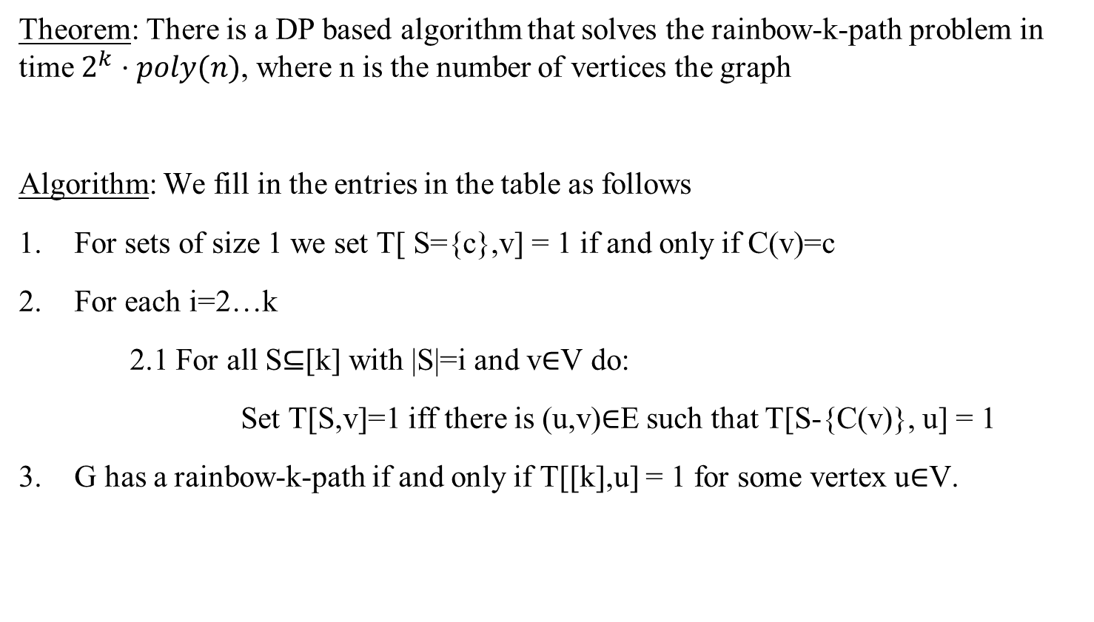
Rainbow-k-path problem
Theorem: There is a DP based algorithm that solves the rainbow-k-path problem in time $2^{k}⋅poly(n)$, where n is the number of vertices the graph
Algorithm: We fill in the entries in the table as follows
For sets of size 1 we set T[ S={c},v] = 1 if and only if C(v)=c
For each i=2…k
2.1 For all S⊆[k] with |S|=i and v∈V do:
Set T[S,v]=1 iff there is (u,v)∈E such that T[S-{C(v)}, u] = 1
G has a rainbow-k-path if and only if T[[k],u] = 1 for some vertex u∈V.

Slide 12
Finding a k-path in a graph
But what if we are not given any colors, and we don’t have any restrictions…
Input: A graph G=(V,E) with |V|=n, and a parameter k.
Output: A simple path of length k
Idea: Given a graph G, let’s assign random colors to the vertices
Consider a k-path in G
Let’s hope that the path gets all different colors
Run the rainbow-k-path algorithm

Slide 13
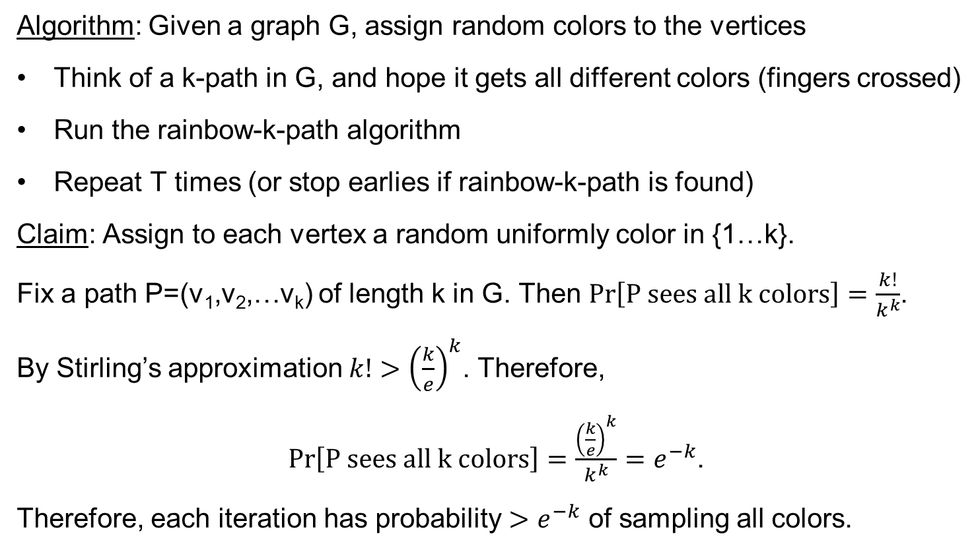
Finding a k-path in a graph
Algorithm: Given a graph G, assign random colors to the vertices
Think of a k-path in G, and hope it gets all different colors (fingers crossed)
Run the rainbow-k-path algorithm
Repeat T times (or stop earlies if rainbow-k-path is found)
Claim: Assign to each vertex a random uniformly color in {1…k}.
Fix a path P=(v₁,v₂,…v_{k}) of length k in G. Then $Pr\left[P sees all k colors\right]=\frac{k!}{k^{k}}$.
By Stirling’s approximation $k!>{\left(\frac{k}{e}\right)}^{k}$. Therefore,
$Pr\left[P sees all k colors\right]=\frac{{\left(\frac{k}{e}\right)}^{k}}{k^{k}}=e^{−k}$.
Therefore, each iteration has probability $>e^{−k}$ of sampling all colors.

Slide 14
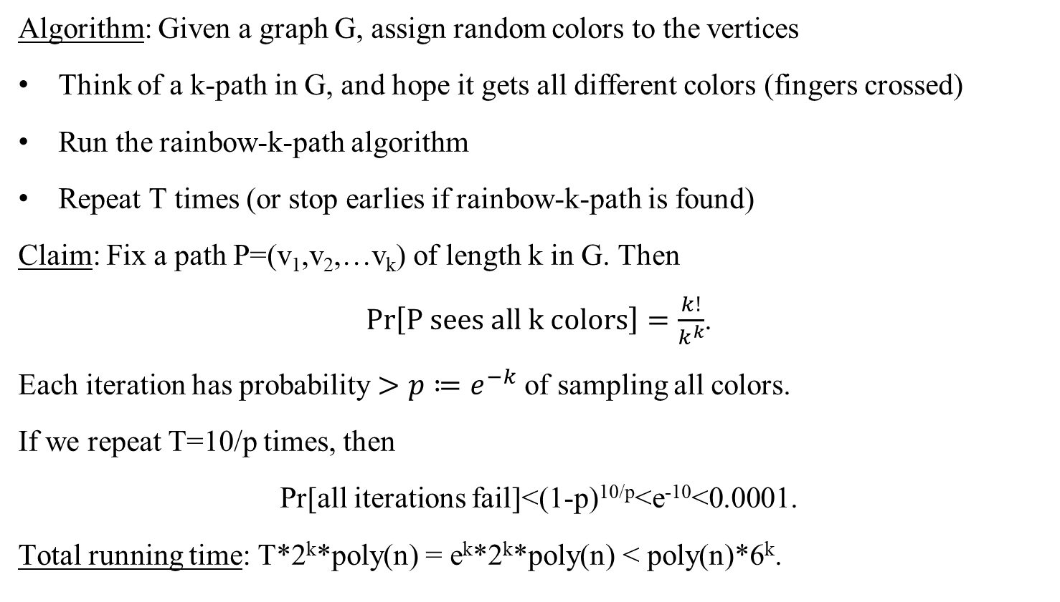
Finding a k-path in a graph
Algorithm: Given a graph G, assign random colors to the vertices
Think of a k-path in G, and hope it gets all different colors (fingers crossed)
Run the rainbow-k-path algorithm
Repeat T times (or stop earlies if rainbow-k-path is found)
Claim: Fix a path P=(v₁,v₂,…v_{k}) of length k in G. Then
$Pr\left[P sees all k colors\right]=\frac{k!}{k^{k}}$.
Each iteration has probability $>p≔e^{−k}$ of sampling all colors.
If we repeat T=10/p times, then
Pr[all iterations fail]<(1-p)^{10/p}<e⁻¹⁰<0.0001.
Total running time: T*2^{k}*poly(n) = e^{k}*2^{k}*poly(n) < poly(n)*6^{k}.

Slide 15
Questions?
Comments?

