Slide 1

CMPT 405/705
Design & Analysis of Algorithms
March 2, 2022

Slide 2
Plan for this week
Dynamic programming
The knapsack problem
Finding Hamiltonian path in time O(2^{n})
Finding a path of length k in time exp(k)
Color coding

Slide 3
The Knapsack problem

Slide 4
The knapsack problem
Input: A set of n objects each having values {v_{i}}_{i=1…n} and int weights {w_{i}>0}_{i=1…n}
A weight limit W>0.
Output: Select objects of total weight at most W such that the sum of values is maximized.
Example:
Snacks: v₁ = 100, w₁ = 20
Water: v₂ = 200, w₂ = 20
Warm Jacket: v₃ = 200, w₃ = 50
Ski Equipment: v₄ = 10, w₄ = 100
Phone: v₅ = 1000, w₅ = 5
Maximum weight W = 60
Answer: Probably take Phone, Snacks, Water

Slide 5
The knapsack problem
Input: A set of n objects each having values {v_{i}}_{i=1…n} and weights {w_{i}}_{i=1…n}
A weight limit W. - all w_{i}’s and W are positive integers.
Output: Select objects of total weight at most W such that the sum of values is maximized.
Idea: Suppose we decided on all objects except for the last one (v_{n}, w_{n}).
Should we add the last object?
Two cases:
Take a solution that does not involve the last object.
If there is room for the last object, i.e., total weight is less than W-w_{n}, then we can add it to the solution– this adds value v_{n} .

Slide 6
The knapsack problem
Goal: compute M[n,W]
Algorithm:
Create a matrix M[0…n, 0…W]
M[ i, w ] will have the optimal value up to weight w using items 1…i
For w = 0…W
Set M[ 0 , w ] = 0 // no items used ➔ total value = 0
For i=1…n
Set M[ i , 0 ] = 0 // zero weight is allowed ➔ total value = 0
For i=1…n
For each w = 1…W
Set M[ i , w ] = max ( M[i-1, w], M[i-1, w - w_{i} ] + v_{i} )
Return M[n ,W]
Don’t use the i’th item
Use the i’th item. Update the total value

Slide 7
The knapsack problem
What is the runtime of the algorithm?
Algorithm:
Create a matrix M[0…n, 0…W]
M[ i, w ] will have the optimal value up to weight w using items 1…i
For w = 0…W
Set M[ 0 , w ] = 0 // no items used ➔ total value = 0
For i=1…n
Set M[ i , 0 ] = 0 // zero weight is allowed ➔ total value = 0
For i=1…n
For each w = 1…W
Set M[ i , w ] = max ( M[i-1, w], M[i-1, w - w_{i} ] + v_{i} )
Return M[n ,W]
The matrix has nW entries, each entry requires O(1) time
Therefore, the total running time is O(nW)
Note that this might be
exponential in the input length

Slide 8
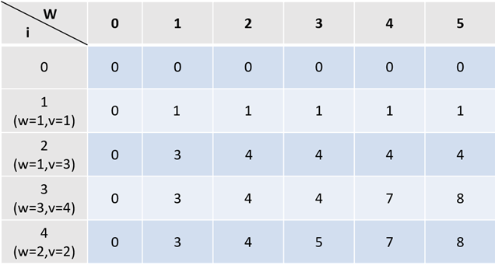
The knapsack problem
Example: We have four items and weight limit W = 5
v₁ = 1, w₁ = 1
v₂ = 3, w₂ = 1
v₃ = 4, w₃ = 3
v₄ = 2, w₄ = 2
Do not use item 3
Use item 3

Slide 9
Hamiltonian Path

Slide 10

The Hamiltonian Path problem
Input: A graph G=(V,E) with |V|=n.
Output: A path that visits each vertex exactly once (or report “does not exist”)
A Hamiltonian Path in this graph: BAGFECD
A trivial solution: try all permutations of V, and check if it gives a solution
Running time: ${O\left(n∗n!\right)>\left(n/2\right)}^{n/2}={\left(2^{log\left(n\right)−1}\right)}^{n/2}=2^{Θ(n⋅\log{(n)})}$
B
C
A
D
G
F
E

Slide 11

The Hamiltonian Path problem
Input: A graph G=(V,E) with |V|=n.
Output: A path that visits each vertex exactly once (or report “does not exist)
A slightly trivial solution: try all possible walks: try all staring points, and try all paths until either visit all vertices or get stuck
Running time: if all degrees are > cn, we get running time
$$O(\left|V\right|∗\prod_{v∈V}{\deg\left(v\right)}>{\left(cn\right)}^{n}=2^{Θ(n⋅log⁡(n))}$$
B
C
A
D
G
F
E

Slide 12
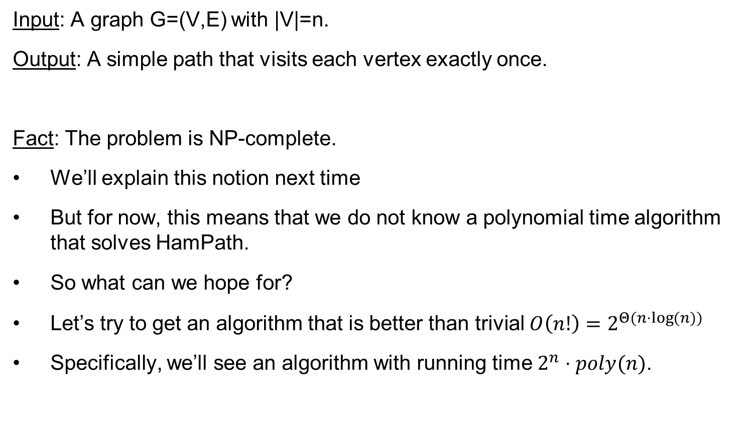
The Hamiltonian Path problem
Input: A graph G=(V,E) with |V|=n.
Output: A simple path that visits each vertex exactly once.
Fact: The problem is NP-complete.
We’ll explain this notion next time
But for now, this means that we do not know a polynomial time algorithm that solves HamPath.
So what can we hope for?
Let’s try to get an algorithm that is better than trivial $O\left(n!\right)=2^{Θ(n⋅\log{(n)})}$
Specifically, we’ll see an algorithm with running time $2^{n}⋅poly(n)$.

Slide 13
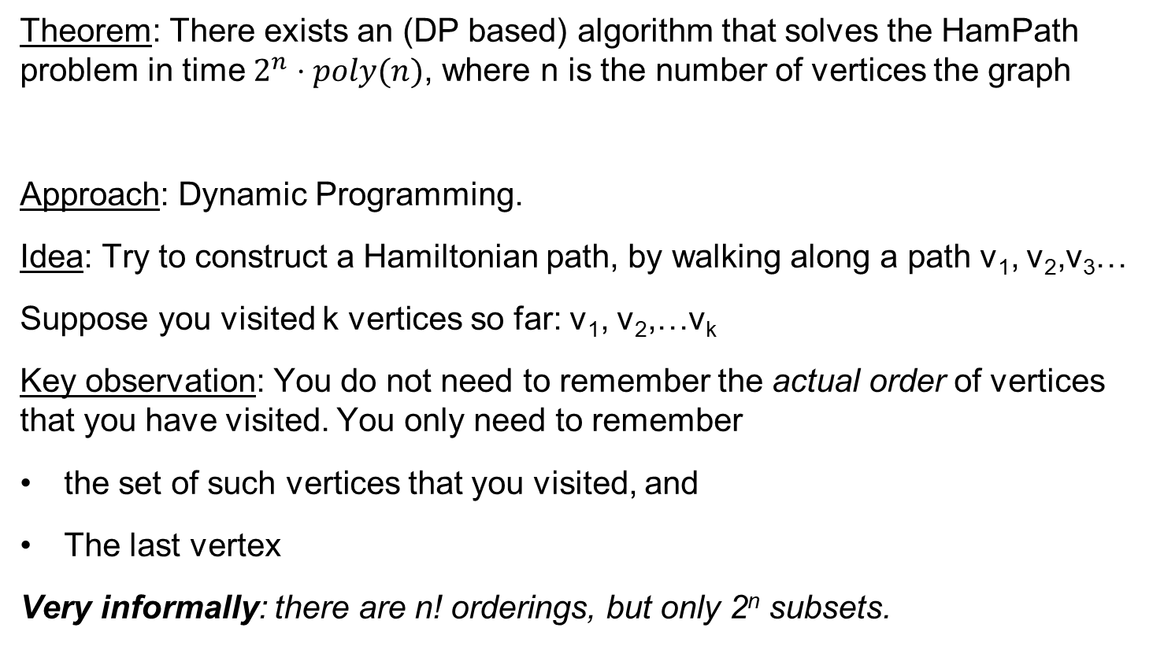
The Hamiltonian Path problem
Theorem: There exists an (DP based) algorithm that solves the HamPath problem in time $2^{n}⋅poly(n)$, where n is the number of vertices the graph
Approach: Dynamic Programming.
Idea: Try to construct a Hamiltonian path, by walking along a path v₁, v₂,v₃…
Suppose you visited k vertices so far: v₁, v₂,…v_{k}
Key observation: You do not need to remember the actual order of vertices that you have visited. You only need to remember
the set of such vertices that you visited, and
The last vertex
Very informally: there are n! orderings, but only 2^{n} subsets.

Slide 14
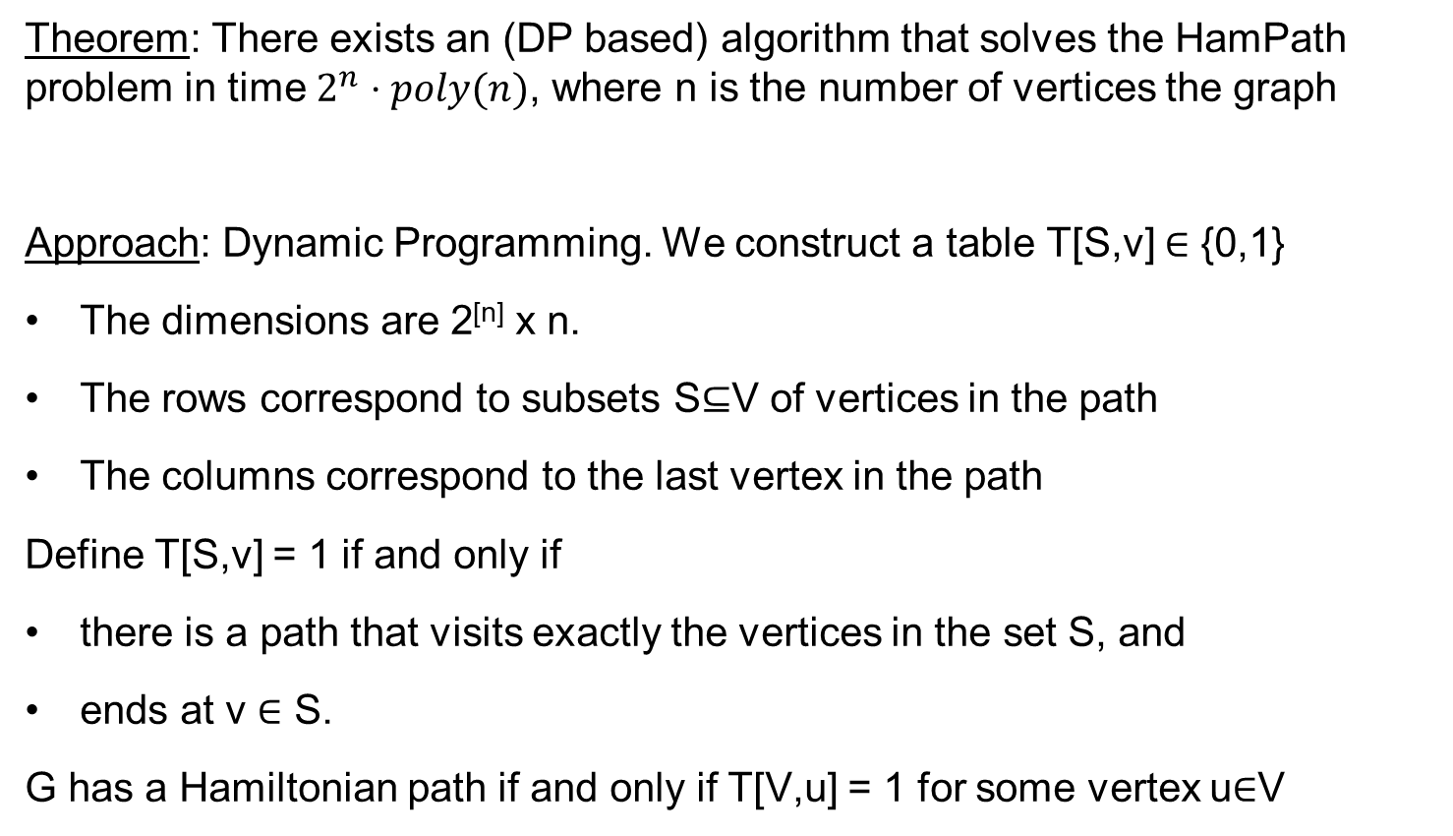
The Hamiltonian Path problem
Theorem: There exists an (DP based) algorithm that solves the HamPath problem in time $2^{n}⋅poly(n)$, where n is the number of vertices the graph
Approach: Dynamic Programming. We construct a table T[S,v] ∈ {0,1}
The dimensions are 2^{[n]} x n.
The rows correspond to subsets S⊆V of vertices in the path
The columns correspond to the last vertex in the path
Define T[S,v] = 1 if and only if
there is a path that visits exactly the vertices in the set S, and
ends at v ∈ S.
G has a Hamiltonian path if and only if T[V,u] = 1 for some vertex u∈V

Slide 15
The Hamiltonian Path problem
We construct a table T[S,v] ∈ {0,1}
The rows correspond to subsets S⊆V of vertices in the path
The columns correspond to the last vertex in the path
Define T[S,v] = 1 if and only if
there is a path that visits exactly the vertices in the set S, and ends at v∈S.
Algorithm: We fill in the entries in the table as follows
Set T[{v},v] = 1 and T[{v},u] = 0 for all vertices u≠v
For each k=2…n
2.1 For all S⊆V with |S|=k and v∈S do:
Set T[S,v]=1 iff there is (u,v)∈E such that T[S-{v}, u] = 1
G has a Hamiltonian path if and only if T[V,v] = 1 for some vertex v∈V.

Slide 16
The Hamiltonian Path problem
 | A | B | C | D
{A} | 1
{B} |  | 1
{C} |  |  | 1
{D} |  |  |  | 1
{A,B} | 1 | 1
{A,C} | 0 |  | 0
{A,D} | 0 |  |  | 1
… | 1 | 1
{B,C} |  | 1 | 1
…
{A,B,C} | 1 | 0 | 1
B
A
C
D

Slide 17
The Hamiltonian Path problem
 | A | B | C | D
{A} | 1
{B} |  | 1
{C} |  |  | 1
{D} |  |  |  | 1
…
…
…
{A,B,C} | 1 | 0 | 1
{A,B,D} | 1 | 0 |  | 1
{A,C,D} | 0 |  | 0 | 0
{B,C,D} |  | 1 | 1 | 1
{A,B,C,D} | 1 | 0 | 1 | 1
B
A
C
D

Slide 18
The Hamiltonian Path problem
Algorithm: We fill in the entries in the table as follows
Set T[{v},v] = 1 and T[{v},u] = 0 for all vertices u≠v
For each k=2…n
2.1 For all S⊆V with |S|=k and v∈S do:
Set T[S,v]=1 iff there is (u,v)∈E such that T[S-{v}, u] = 1
G has a Hamiltonian path if and only if T[V,v] = 1 for some vertex v∈V.
This solves the decision version of the problem.
Correctness: clear by definition of T.
Running time: Size of T is O(n*2^{n}), computing an entry is done in poly(n) time.
Therefore, the total time is poly(n)*2^{n}.
HW3: modify the algorithm to solve the search version of the problem

Slide 19
Questions?
Comments?

