Slide 1

CMPT 405/705
Design & Analysis of Algorithms
February 28, 2022

Slide 2
Plan for this week
Dynamic programming
Fibonacci sequence (a warmup example)
Edit distance/Sequence alignment
The knapsack problem
Finding Hamiltonian path in time O(2^{n})
Finding a path of length k in time exp(k)
Color coding

Slide 3
Dynamic Programming (DP)

Slide 4
Dynamic Programming
A general paradigm that in which a problem is solved by
breaking it into smaller subproblems
tackling them one by one, smallest first
using the answers to small subproblems solve the larger problem
Similar to the divide-and-conquer paradigm using recursion.
However, instead of recursive calls we use memorization.

Slide 5
Simple Example:
Fibonacci sequence

Slide 6
Fibonacci sequence
Fibonacci sequence:
Fib(0) = 0, Fib(1) = 1
Fib(n) = Fib(n-1) + Fib(n-2) for all n>1.
That is, the sequence is: 0, 1, 1, 2, 3, 5, 8, 13, 21, 34, 55, 89, 144…
Write an algorithm that gets an integer n>=0 and outputs Fib(n).

Slide 7
Fibonacci sequence – very inefficient
Input: A positive integer n
Output: Fib(n)
Recursive algorithm:
If n <= 1
return n
Otherwise
Let x = Fib(n-1)
Let y = Fib(n-2)
return x+y
What is the runtime of the algorithm?
Denote by T(n) the runtime of Fib(n)
Then T(n) = T(n-1) + T(n-2) + O(1) > 2*T(n-2) + O(1)
T(n) > 2*T(n-2) > 4*T(n-4) > 8*T(n-6)…
T(n) > 2^{n/2}=1.4^{n}

Slide 8
Fibonacci sequence – more efficient
Input: A positive integer n
Output: Fib(n)
A “dynamic programming approach” :
Create an array A[0…n]
Set A[0] = 0
Set A[1] = 1
For i=2…n
A[i] = A[i-1] + A[i-2]
Return A[n]
What is the runtime of the algorithm?
T(n) = O(n)
Actually, it’s O(n²) bit operations because each number is Θ(n) digits long
We used memorization to avoid repeated recursive calls

Slide 9
Fibonacci sequence – even more efficient
Input: A positive integer n
Goal: Compute Fib(n) in O(log(n)) operations.
Fib(n) uses Θ(n) digits, which would imply O(n log(n)) time.
But if we don’t want to worry about bit representation,
we can slightly change the goal:
Input: A positive integer n, and a prime p (say p=7)
Goal: Compute Fib(n) mod p in O(log(n)) time.

Slide 10
Fibonacci sequence – even more efficient
Input: A positive integer n, and a prime p (say p=7)
Goal: Compute Fib(n) mod p in O(log(n)) time.
Idea: Use some more linear algebra:
A =
0 | 1
1 | 1
F_{n}
F_{n+1}
=
0 | 1
1 | 1
F_{n-1}
F_{n}

Slide 11
Fibonacci sequence – even more efficient
F₁=1
F₂=1
=
0 | 1
1 | 1
0
1
F₂=1
F₃=2
=
0 | 1
1 | 1
F₁=1
F₂=1
=
0 | 1
1 | 1
0 | 1
1 | 1
0
1
*
*
*
F₃=2
F₄=3
=
0 | 1
1 | 1
*
0 | 1
1 | 1
*
0 | 1
1 | 1
*
0
1

Slide 12
Fibonacci sequence – even more efficient
Input: A positive integer n, and a prime p (say p=7)
Goal: Compute Fib(n) mod p in O(log(n)) time.
Algorithm:
Q: How to compute A^{n} (mod p) in time O(log n)?
Let A =
0 | 1
1 | 1
A: Compute
A² = A * A
A⁴ = A² * A²
A⁸ = A⁴ * A⁴
…
Use these to compute A^{n}
(hint: look at the binary expansion of n)
F_{n}
F_{n+1}
0
1
Then
=
A^{n}
For example: A¹³ = A⁸ * A⁴ * A

Slide 13
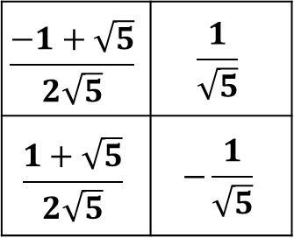
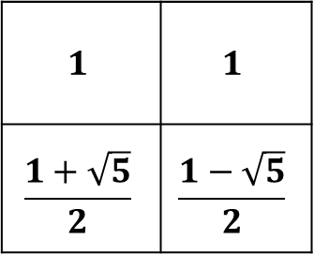
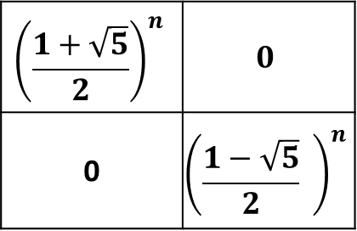
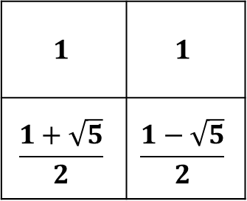
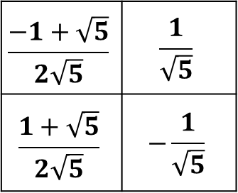
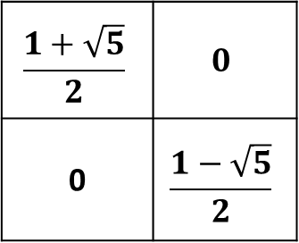
Fibonacci sequence – closed formula
F_{n}
F_{n+1}
0
1
0 | 1
1 | 1
Then
=
A^{n}
Let A =
$$1$$ | $$1$$
$$\frac{1+\sqrt{5}}{2}$$ | $$\frac{1−\sqrt{5}}{2}$$
$$\frac{1+\sqrt{5}}{2}$$ | $$0$$
0 | $$\frac{1−\sqrt{5}}{2}$$
$$\frac{−1+\sqrt{5}}{2\sqrt{5}}$$ | $$\frac{1}{\sqrt{5}}$$
$$\frac{1+\sqrt{5}}{2\sqrt{5}}$$ | $$−\frac{1}{\sqrt{5}}$$
SVD: A =
A = UDU⁻¹
A^{n} = (UDU⁻¹)*(UDU⁻¹)*…*(UDU⁻¹)
= U * D^{n} * U⁻¹
$$1$$ | $$1$$
$$\frac{1+\sqrt{5}}{2}$$ | $$\frac{1−\sqrt{5}}{2}$$
$${\left(\frac{1+\sqrt{5}}{2}\right)}^{n}$$ | $$0$$
0 | $${\left(\frac{1−\sqrt{5}}{2} \right)}^{n}$$
$$\frac{−1+\sqrt{5}}{2\sqrt{5}}$$ | $$\frac{1}{\sqrt{5}}$$
$$\frac{1+\sqrt{5}}{2\sqrt{5}}$$ | $$−\frac{1}{\sqrt{5}}$$
A^{n} =

Slide 14
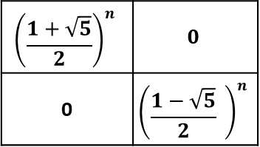
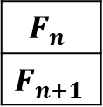
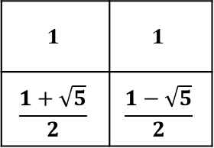
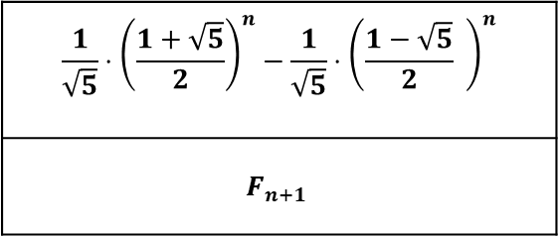
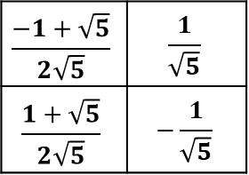
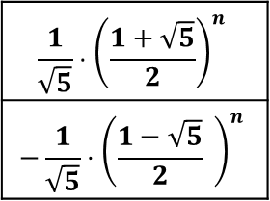
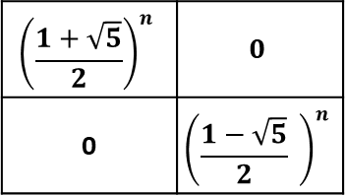
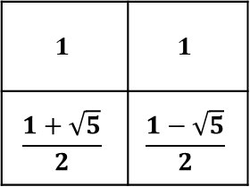
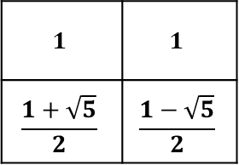
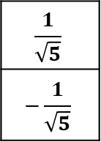
Fibonacci sequence – closed formula
$$F_{n}$$
$$F_{n+1}$$
=
A^{n}
0
1
$$1$$ | $$1$$
$$\frac{1+\sqrt{5}}{2}$$ | $$\frac{1−\sqrt{5}}{2}$$
$${\left(\frac{1+\sqrt{5}}{2}\right)}^{n}$$ | $$0$$
0 | $${\left(\frac{1−\sqrt{5}}{2} \right)}^{n}$$
$$\frac{−1+\sqrt{5}}{2\sqrt{5}}$$ | $$\frac{1}{\sqrt{5}}$$
$$\frac{1+\sqrt{5}}{2\sqrt{5}}$$ | $$−\frac{1}{\sqrt{5}}$$
0
1
=
$$1$$ | $$1$$
$$\frac{1+\sqrt{5}}{2}$$ | $$\frac{1−\sqrt{5}}{2}$$
$${\left(\frac{1+\sqrt{5}}{2}\right)}^{n}$$ | $$0$$
0 | $${\left(\frac{1−\sqrt{5}}{2} \right)}^{n}$$
$$\frac{1}{\sqrt{5}}$$
$$−\frac{1}{\sqrt{5}}$$
=
$$1$$ | $$1$$
$$\frac{1+\sqrt{5}}{2}$$ | $$\frac{1−\sqrt{5}}{2}$$
$$\frac{1}{\sqrt{5}}⋅{\left(\frac{1+\sqrt{5}}{2}\right)}^{n}$$
$$−\frac{1}{\sqrt{5}}⋅{\left(\frac{1−\sqrt{5}}{2} \right)}^{n}$$
$$\frac{1}{\sqrt{5}}⋅{\left(\frac{1+\sqrt{5}}{2}\right)}^{n}−\frac{1}{\sqrt{5}}⋅{\left(\frac{1−\sqrt{5}}{2} \right)}^{n}$$
$$F_{n+1}$$
=
=

Slide 15
Fibonacci sequence – even more efficient
Comments: The recursive formula doesn’t work mod p
Because the eigenvalues don’t work mod p

Slide 16
Edit distance /
Sequence alignment

Slide 17
Edit distance
Input: Two strings X and Y
Goal: find smallest number of edit operations required to convert X into Y.
Mismatch
X = G T A G C G G C G
Y = G T A A C G G C G
Gap in X / Insertion in Y
X = G T A G C G C G
Y = G T A G C T G C G
Gap in Y / Insertion in X
X = G T A G C G C G
Y = G T G C G C G

Slide 18
Edit distance
Input: Two strings X and Y
Goal: find smallest number of edit operations required to convert X into Y.
Example:
X = G C G T A T G A G G C T A A C G C
Y = G C T A T G C G G C T A T A C G C
Optimal alignment
X = G C G T A T G A G G C T A – A C G C
Y = G C – T A T G C G G C T A T A C G C
Edit Distance = 3

Slide 19
Hamming distance
A related (simpler) notion: Two strings X and Y of the same length
Goal: smallest number of mismatches between X to Y.
Examples:
Design a linear time algorithm that given two strings X,Y of length n, computes the hamming distance between X and Y.
X = G T A C G G C G G A C A
Y = G T A A C G G C G G A T
X = G T A G C G G C G G A C
Y = G T A A C G G C G G A T
HamDist(X,Y) = 2
X = S T R O N G E R
Y = S T R E N G T H
HamDist(X,Y) = 3

Slide 20
Edit distance vs Hamming distance
Claim: For two strings X, Y of equal length
EditDist(X, Y) <= HammingDist(X, Y)
Proof: For edit distance we can use substitution only.
What about the other direction? Is there any non-trivial relation?
Example: X = ababababababababab Y = bababababababababa
Q1: What is the edit distance between X and Y?
A1: EditDist(X,Y) = 2 : remove a from the beginning of X and add a to the end.
Q2: What is the HammingDist(X, Y)?
A2: HammingDist(X, Y) = n

Slide 21
Edit distance
Input: Two strings X and Y
Goal: find smallest number of edit operations required to convert X into Y.
Allowed operations:
R – replace
I – insert into X
D – delete from X
X = G C G T A T G A G G C T A A C G C
Y = G C T A T G C G G C T A T A C G C
X = G C G T A T G A G G C T A – A C G C
Y = G C – T A T G C G G C T A T A C G C
Edit Distance = 3

Slide 22
Edit distance
Idea: input X of length n, and Y of length m
Let OPT(i,j) = min cost of aligning prefix strings X[1…i] and Y[1…j].
Then, the goal is to compute OPT(n,m)
Suppose that (by recursion) we can solve the shorter subproblems.
We want to compute OPT(i,j): we have 4 options
4.1 If X[i] = Y[j] : use the optimal alignment for X[1…i-1] and Y[1…j-1]
4.2 Try replacing X[i] with Y[j]
4.3 Try deleting X[i] from X
4.4 Try appending Y[j] to X[1…i]
Choose the best of the four options

Slide 23
Edit distance
Input: Two strings: X of length n and Y of length m
Goal: Find an optimal alignment of X and Y, i.e., smallest number of edit operations required to convert X into Y.
Algorithm:
Define a matrix D[0…n,0….m], so that D[i,j] = EditDist( X[1…i] , Y[1…j] )
Set D[i,0] = i for all i=0…n
Set D[0,j] = j for all j=0…m
For i>0,j>0 define
(D[ i, j-1 ] + 1 // Insert Y[j] after X[i] D[i,j] = min (D[ i-1 , j ] + 1 // Delete X[i] from X (D[ i-1 , j-1 ] + 1_{X[i] ≠ Y[j]} // Match or Mismatch
Here:
1_{X[i] ≠ Y[j]} = 1 if X[i] ≠ Y[j]
1_{X[i] ≠ Y[j]} = 0 if X[i] = Y[j]

Slide 24
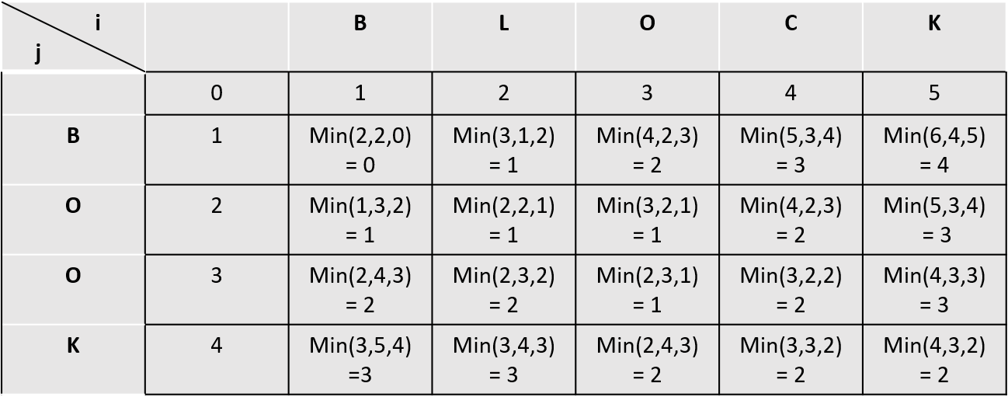
Edit distance
Example: X = BLOCK Y = BOOK:
A solution: (1) remove L and (2) replace C with O.
(D[ i , j-1 ] + 1 // Insert Y[j] after X[i] D[i,j] = min (D[ i-1 , j ] + 1 // Delete X[i] from X (D[ i-1, j-1 ] + 1_{X[i] ≠ Y[j]} // Match or Mismatch

Slide 25
Edit distance
Example: X = BLOCK Y = BOOK:
A solution: (1) remove L and (2) replace C with O.
(D[ i , j-1 ] + 1 // Insert Y[j] after X[i] D[i,j] = min (D[ i-1 , j ] + 1 // Delete X[i] from X (D[ i-1, j-1 ] + 1_{X[i] ≠ Y[j]} // Match or Mismatch

Slide 26
Edit distance
Example: X = BLOCK Y = BOOK:
A solution: (1) replace L with O and (2) remove C.
(D[ i , j-1 ] + 1 // Insert Y[j] after X[i] D[i,j] = min (D[ i-1 , j ] + 1 // Delete X[i] from X (D[ i-1, j-1 ] + 1_{X[i] ≠ Y[j]} // Match or Mismatch

Slide 27
Edit distance with costs
Algorithm:
Define a matrix D[0…n,0….m], so that D[i,j] = min-cost( X[1…i] , Y[1…j] )
Set D[i,0] = i*δ for all i=0…n
Set D[0,j] = j*δ for all j=0…m
For i>0,j>0 define
(D[ I , j-1 ] + δ // Insert Y[j] after X[i] D[i,j] = min (D[ i-1 , j ] + δ // Delete X[i] from X (D[ i-1 , j-1 ] + α_{X[i], Y[j]} // Match or Mismatch
Q: What is the running time?
A: The table is of size m*n, and computing each entry takes O(1) operations.\
Therefore, the running time is O(nm)

Slide 28
Edit distance with costs
Theorem: There is an algorithm that given strings X and Y on inputs of length n, computes the edit distance is time O(n²)
Q: Can we design a faster algorithm?
A: Theorem. [Backurs–Indyk 2015] If can compute edit distance of two strings of length n in O(n^{1.99}) time,
then we can solve SAT with n variables and m clauses in poly(m) 2^{(1−δ)n} time for some constant δ > 0
I will talk about SAT next week.
But the points is: if we can solve Edit Distance faster, then we can solve some other problems faster than we expect possible

Slide 29
The Shortest Path – Bellman-Ford Algorithm

Slide 30
The shortest path problem
Input: G= (V,E) with distances {c(e)>0 : e∈E} on edges, and two vertices s,t∈V.
Output: Shortest path from s to t.
Denote by dist(s,v,i) the shortest path from s to v that uses at most i edges.
Observation1: One of the two cases always holds:
Either dist(s,v,i) =dist(s,v,i-1)
Or dist(s,v,i) = min_{(u,v)∈E} { dist(s,u,i-1) + c_{(u,v)} }
Observation2: the shortest path uses at most n-1 edges, where n=|V|
u
s
t
v

Slide 31
The shortest path problem
Input: G= (V,E) with distances {c(e)>0 : e∈E} on edges, and two vertices s,t∈V.
Output: Shortest path from s to t.
Algorithm:
Create a matrix dist of dimensions V x n // dist(v,i) = the shortest path from s to v that uses at most i edges.
Set dist(s,0) = 0 and dist(v,0) = ∞ for all v∈V\ {s}
For i=1…n
For each v∈V
Set d₁ = min _{(u,v)∈E} { dist(u,i-1) + c_{(u,v)} }
Set d₂ = dist(v,i-1)
Set dist(v,i) = min(d₁, d₂)
Return dist(t,n-1)
Correctness is usually done by induction on the distance between s and t.
But let’s skip the proof of correctness

Slide 32
The shortest path problem
Input: G= (V,E) with distances {c(e)>0 : e∈E} on edges, and two vertices s,t∈V.
Output: Shortest path from s to t.
Algorithm:
Create a matrix dist of dimensions V x n // dist(s,i) = the shortest path from s to v that uses at most i edges.
Set dist(s,0) = 0 and dist(v,0) = ∞ for all v∈V\ {s}
For i=1…n
For each v∈V
Set d₁ = min _{u:(u,v)∈E} { dist(u,i-1) + c_{(u,v)} }
Set d₂ = dist(v,i-1)
Set dist(v,i) = min(d₁, d₂)
Return dist(t,n-1)
What is the runtime of the algorithm?
n*n iterations
Deg(v) steps in each iteration
Total runtime is O(n³)

Slide 33
Questions?
Comments?

