Slide 1
CMPT 405
Design & Analysis of Algorithms
January 24, 2022

Slide 2
Plan for today
Polynomial identity testing
An application: Finding a perfect matching in bipartite graphs

Slide 3
Polynomial Identity Testing

Slide 4
Polynomial Identity Testing
Easy Fact: Let p:F→ F be a non-zero polynomial of degree at most d.
Then, p has at most d zeros.
For example: p(x) = x³+ 4x+1 has at most 3 zeros.
Stated differently:
For any set S⊆F if we choose x∈S uniformly, then Pr[p(x) = 0] ≤ d/|S|
We also have an analogous multivariate version of this fact.
Schwartz-Zippel Lemma: Let p(x₁,x₂,…x_{n}) be a non-zero polynomial of total degree at most d. Let S⊆F be a subset of the field F.
If we choose x₁,x₂,…x_{n}∈S uniformly, independently, then
Pr[p(x₁,x₂,…x_{n}) = 0] ≤ d/|S|
Examples:
p(x,y) = x⁴ + y² + 4xy² has degree 4
q(x,y,z) = x²y + x²yz³ + 7y² - 4x²z² has degree 6
r(x,y,z) = x + y + xy + xz has degree 2

Slide 5
Polynomial Identity Testing
Schwartz-Zippel Lemma: Let p(x₁,x₂,…x_{n}) be a non-zero polynomial of total degree at most d. Let S⊆F be a subset of the field F.
If we choose x₁,x₂,…x_{n}∈S uniformly, independently, then
Pr[p(x₁,x₂,…x_{n}) = 0] ≤ d/|S|
This looks very useful…
If we can phrase a problem as a checking if a polynomial is identically zero, then we can check it by choosing a large enough S, and checking p(x) at a random point x∈S^{n}.
If p is not identically zero, then it is very unlikely that p(x) will be zero.
Specifically, Pr[p(x₁,x₂,…x_{n}) ≠ 0] ≥ 1 - d/|S|

Slide 6
Polynomial Identity Testing
Schwartz-Zippel Lemma: Let p(x₁,x₂,…x_{n}) be a non-zero polynomial of total degree at most d. Let S⊆F be a subset of the field F.
If we choose x₁,x₂,…x_{n}∈S uniformly, independently, then
Pr[p(x₁,x₂,…x_{n}) = 0] ≤ d/|S|
Equivalently: Let p(x₁,x₂,…x_{n}) and q(x₁,x₂,…x_{n}) be two distinct polynomials of total degree at most d. Let S⊆F be a subset of the field F.
If we choose x₁,x₂,…x_{n}∈S uniformly, independently, then
Pr[p(x₁,x₂,…x_{n}) = q(x₁,x₂,…x_{n})] ≤ d/|S|

Slide 7
Polynomial Identity Testing
Schwartz-Zippel Lemma: Let p(x₁,x₂,…x_{n}) be a non-zero polynomial of total degree at most d. Let S⊆F be a subset of the field F.
If we choose x₁,x₂,…x_{n}∈S uniformly, independently, then
Pr[p(x₁,x₂,…x_{n}) = 0] < d/|S|
Proof: Induction on the number of variables.
Base case: n=1 – follows from the discussion before.
Induction step: Suppose n>1. Let k be the largest power of x_{n}.
Then we can write p(x₁,x₂,…x_{n}) =(x_{n})^{k} q(x₁,x₂,…x_{n-1})+r(x₁,x₂,…x_{n}).

Slide 8
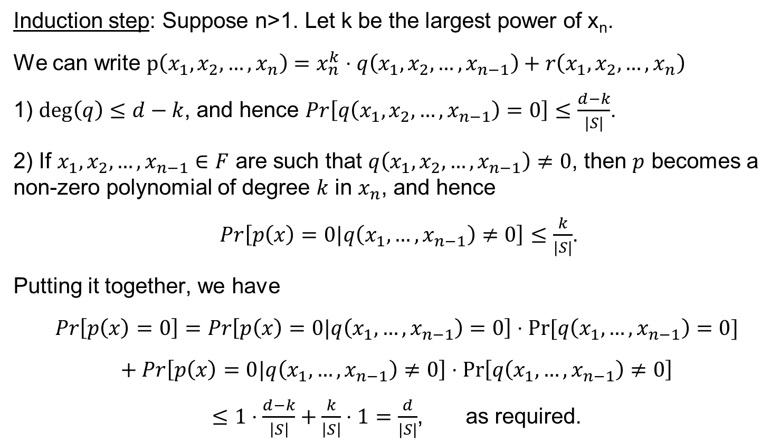
Polynomial Identity Testing
Induction step: Suppose n>1. Let k be the largest power of x_{n}.
We can write $p\left(x_{1},x_{2},…,x_{n}\right)=x_{n}^{k}⋅q\left(x_{1},x_{2},…,x_{n−1}\right)+r\left(x_{1},x_{2},…,x_{n}\right)$
1) $deg\left(q\right)≤d−k$, and hence $Pr\left[q\left(x_{1},x_{2},…,x_{n−1}\right)=0\right]≤\frac{d−k}{|S|}$.
2) If $x_{1},x_{2},…,x_{n−1}∈F$ are such that $q\left(x_{1},x_{2},…,x_{n−1}\right)≠0$, then $p$ becomes a non-zero polynomial of degree $k$ in $x_{n}$, and hence
$Pr\left[p\left(x\right)=0|q\left(x_{1},…,x_{n−1}\right)≠0\right]≤\frac{k}{|S|}$.
Putting it together, we have
$$Pr\left[p\left(x\right)=0\right]=Pr\left[p\left(x\right)=0|q\left(x_{1},…,x_{n−1}\right)=0\right]⋅Pr⁡[q\left(x_{1},…,x_{n−1}\right)=0]$$
$$+ Pr\left[p\left(x\right)=0|q\left(x_{1},…,x_{n−1}\right)≠0\right]⋅\operatorname{Pr}\left[q\left(x_{1},…,x_{n−1}\right)≠0\right]$$
$≤1⋅\frac{d−k}{\left|S\right|}+\frac{k}{\left|S\right|}⋅1=\frac{d}{|S|}$, as required.

Slide 9
Finding a perfect matching in a bipartite graph

Slide 10
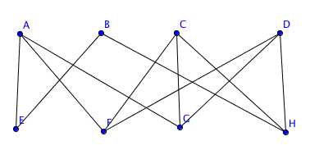
Perfect matching in a bipartite graph
Input: A bipartite graph G = (U,V,E).
Goal: Find a perfect matching in G, or report that there is no perfect matching.
You can solve it using max flow algorithms.
This is done by finding max-flow from S to T.
T
S

Slide 11
Perfect matching in a bipartite graph
Input: A bipartite graph G = (U,V,E).
Goal: Find a perfect matching in G, or report that there is no perfect matching.
Today, we’ll see a different method that uses the polynomial method

Slide 12
Adjacency matrix of a bipartite graph
Given a bipartite graph G = (L, R, E), it is sometimes convenient to thing of its adjacency matrix as follows:
The rows correspond to the vertices on the left
The columns correspond to the vertices on the right
M_{u,v} = 1 if (u,v)∈E for u∈L and v∈R
M_{u,v} = 0 if (u,v) ∉ E
S T U V W
A
B
C
D
E
A
S
B
T
C
U
D
V
E
W

Slide 13
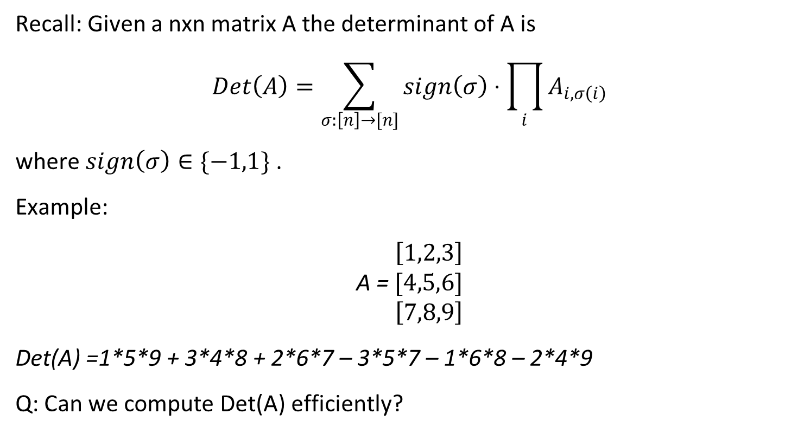
Determinant of a matrix
Recall: Given a nxn matrix A the determinant of A is
$$Det\left(A\right)=\sum_{σ:\left[n\right]→[n]}{sign\left(σ\right)⋅\prod_{i}{A_{i,σ\left(i\right)}}}$$
where $sign\left(σ\right)∈\{−1,1\}$.
Example:
$\left[1,2,3\right]$
A = $[4,5,6]$
$\left[7,8,9\right]$
Det(A) =1*5*9 + 3*4*8 + 2*6*7 – 3*5*7 – 1*6*8 – 2*4*9
Q: Can we compute Det(A) efficiently?

Slide 14
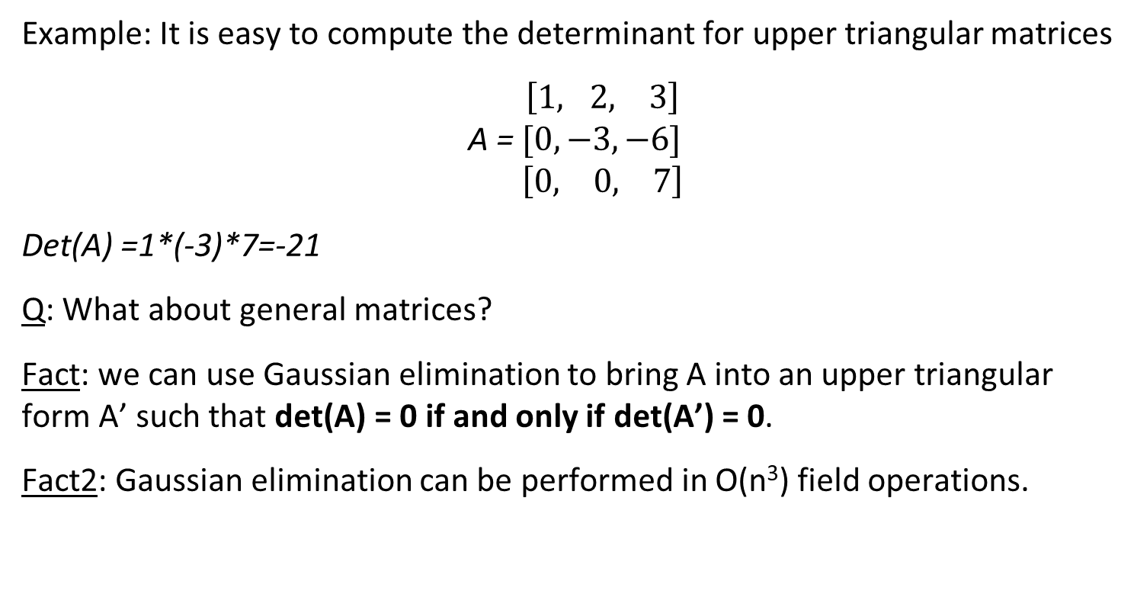
Determinant of a matrix
Example: It is easy to compute the determinant for upper triangular matrices
$\left[1, 2, 3\right]$
A = $[0,−3, −6]$
$\left[0, 0, 7\right]$
Det(A) =1*(-3)*7=-21
Q: What about general matrices?
Fact: we can use Gaussian elimination to bring A into an upper triangular form A’ such that det(A) = 0 if and only if det(A’) = 0.
Fact2: Gaussian elimination can be performed in O(n³) field operations.

Slide 15
Perfect matching in a bipartite graph
Input: A bipartite graph G = (U,V,E) with n vertices on each side.
Goal: Find a perfect matching in G, or report that there is no perfect matching.
A decision version: Decide whether G contains a perfect matching or not.

Slide 16
Perfect matching in a bipartite graph
HW2: Prove that if the decision algorithm outputs the correct answer w.h.p.,
then we can find a PM w.h.p.
Q: How can we solve the search version using the decision version?
Suppose we have a decision version outputs the correct answer w.h.p.
Run the decision algorithm on G.
If G has no perfect matching -> OUTPUT “NO PERFECT MATCHING”
Otherwise, G has a perfect matching. Let’s try to find one edge in it:
  Fix a vertex u, and try to find an edge (u,v) ∈E that belongs to the perfect matching.
  This is done by removing all edges touching u except for one, and running the decision algorithm
  Remove the vertices u and v from G and all edges touching them.
  Find a perfect matching M in G without u and v
  Return M U {(u,v)}

Slide 17
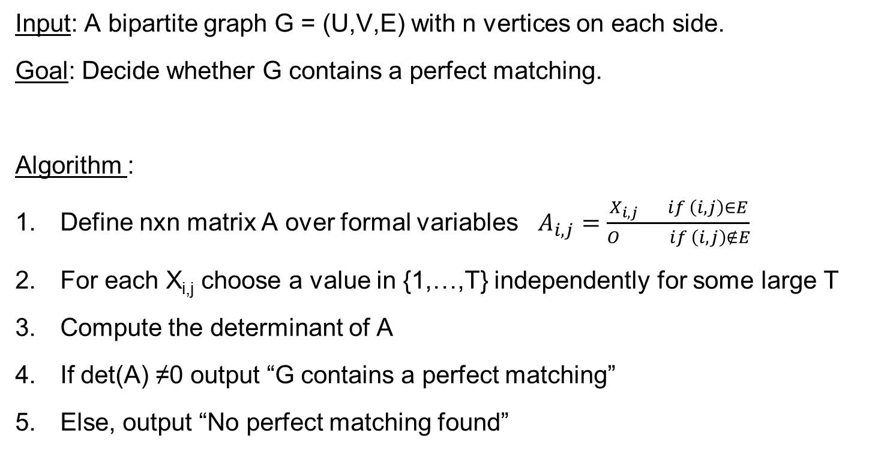
Perfect matching in a bipartite graph
Input: A bipartite graph G = (U,V,E) with n vertices on each side.
Goal: Decide whether G contains a perfect matching.
Algorithm :
Define nxn matrix A over formal variables $A_{i,j}=\frac{X_{i,j} if \left(i,j\right)∈E}{O if \left(i,j\right)∉E}$
For each X_{i,j} choose a value in {1,…,T} independently for some large T
Compute the determinant of A
If det(A) ≠0 output “G contains a perfect matching”
Else, output “No perfect matching found”
We take adjacency matrix of G with random values…
And compute its determinant…
What’s going on here???

Slide 18
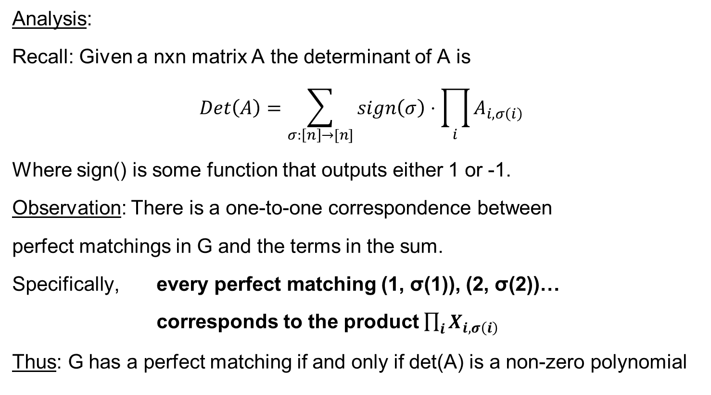
Perfect matching in a bipartite graph
Analysis:
Recall: Given a nxn matrix A the determinant of A is
$$Det\left(A\right)=\sum_{σ:\left[n\right]→[n]}{sign\left(σ\right)⋅\prod_{i}{A_{i,σ\left(i\right)}}}$$
Where sign() is some function that outputs either 1 or -1.
Observation: There is a one-to-one correspondence between
perfect matchings in G and the terms in the sum.
Specifically, every perfect matching (1, σ(1)), (2, σ(2))…
corresponds to the product $\prod_{i}{X_{i,σ\left(i\right)}}$
Thus: G has a perfect matching if and only if det(A) is a non-zero polynomial

Slide 19
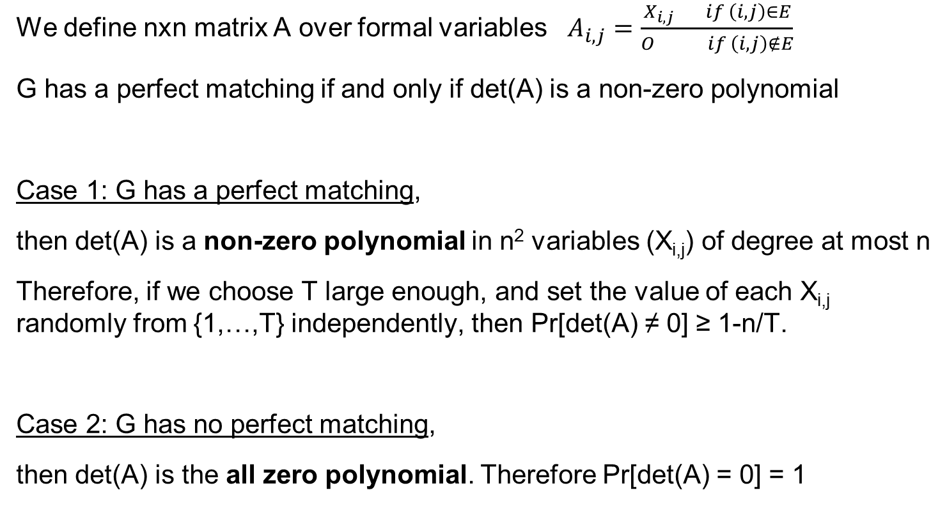
Perfect matching in a bipartite graph
We define nxn matrix A over formal variables $A_{i,j}=\frac{X_{i,j} if \left(i,j\right)∈E}{O if \left(i,j\right)∉E}$
G has a perfect matching if and only if det(A) is a non-zero polynomial
Case 1: G has a perfect matching,
then det(A) is a non-zero polynomial in n² variables (X_{i,j}) of degree at most n
Therefore, if we choose T large enough, and set the value of each X_{i,j} randomly from {1,…,T} independently, then Pr[det(A) ≠ 0] ≥ 1-n/T.
Case 2: G has no perfect matching,
then det(A) is the all zero polynomial. Therefore Pr[det(A) = 0] = 1

Slide 20
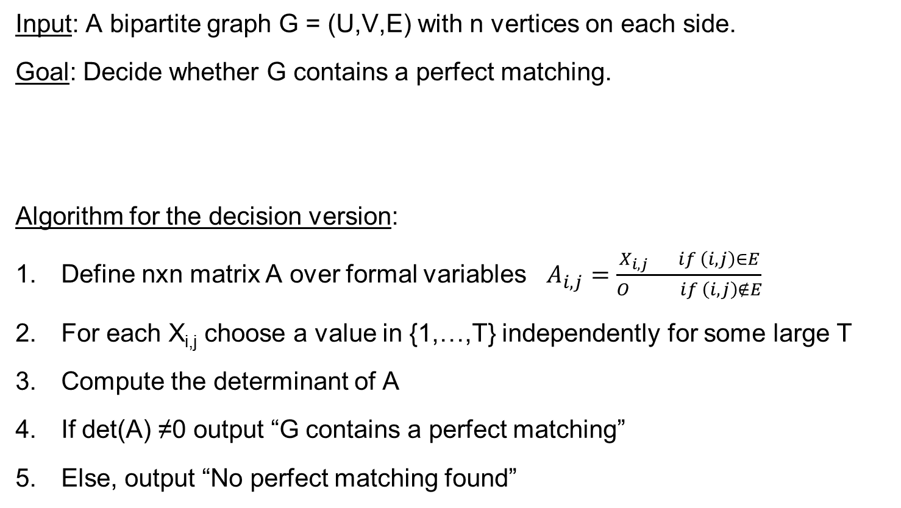
Perfect matching in a bipartite graph
Input: A bipartite graph G = (U,V,E) with n vertices on each side.
Goal: Decide whether G contains a perfect matching.
Algorithm for the decision version:
Define nxn matrix A over formal variables $A_{i,j}=\frac{X_{i,j} if \left(i,j\right)∈E}{O if \left(i,j\right)∉E}$
For each X_{i,j} choose a value in {1,…,T} independently for some large T
Compute the determinant of A
If det(A) ≠0 output “G contains a perfect matching”
Else, output “No perfect matching found”
What is the runtime of this algorithm?

Slide 21
Finding a minimum weight perfect matching in bipartite graphs

Slide 22
Min-weight perfect matchings
Input: A bipartite graph G = (U,V,E) with weights on the edges.
Goal: Find a perfect matching in G of minimal weight.
We may assume that the graph is a complete bipartite graph, and missing edges have some huge weight.

Slide 23
Min-weight perfect matchings
Input: A bipartite graph G = (U,V,E) with |U| = |V| = n and integer weights w_{i,j}>0
Goal (min value version): Output the weight of a min-weight perfect matching.
A simplifying (though weird) assumption: Suppose that G has a unique perfect matching of minimal weight.
Algorithm for the min value version:
Define nxn matrix A over reals as A_{i,j} = 10^{wij}
Compute the determinant of A
Output the largest k such that det(A) is divisible by 10^{k}
Example, if det(A) = 41507000, then we output 3 (because 10³ divides det(A))
What’s going on here???

Slide 24
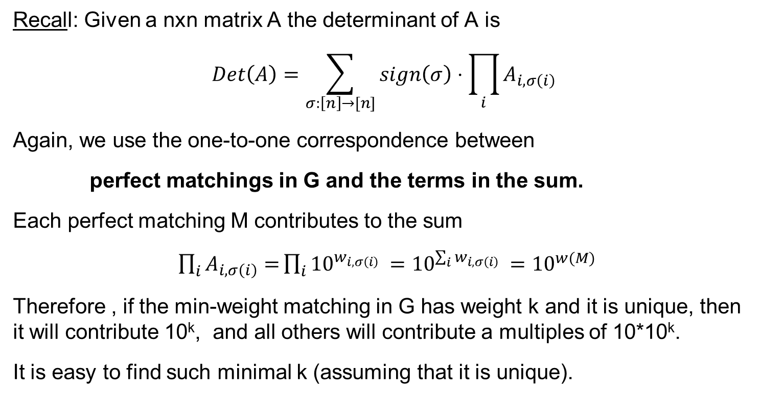
Min-weight perfect matchings
Recall: Given a nxn matrix A the determinant of A is
$$Det\left(A\right)=\sum_{σ:\left[n\right]→[n]}{sign\left(σ\right)⋅\prod_{i}{A_{i,σ\left(i\right)}}}$$
Again, we use the one-to-one correspondence between
perfect matchings in G and the terms in the sum.
Each perfect matching M contributes to the sum
$\prod_{i}{A_{i,σ\left(i\right)}=}\prod_{i}{{10}^{w_{i,σ\left(i\right)} }={10}^{\sum_{i}{w_{i,σ\left(i\right)}} }}={10}^{w(M)}$
Therefore , if the min-weight matching in G has weight k and it is unique, then it will contribute 10^{k}, and all others will contribute a multiples of 10*10^{k}.
It is easy to find such minimal k (assuming that it is unique).

Slide 25
Min-weight perfect matchings
Next time: we’ll see how to get rid of the assumption that the min-weight matching is unique.
We’ll do it by adding to the weight of each edge some O(1/n²) random noise.
Since the weight of each matching is a sum of n integers, the weight of the noisy graph will allow us to recover the weight of the original graph.
Isolation lemma: we’ll see a lemma saying that with high probability we will “isolate” one min-weight perfect matching.
Then we’ll apply the algorithm on this graph with noisy weights

Slide 26
Questions?
Comments?

