Slide 1
CMPT 405
Design & Analysis of Algorithms
January 19, 2022

Slide 2
Today
Kruskal’s algorithm for finding minimum spanning tree
Karger’s algorithm for finding minimum cut

Slide 3
Kruskal’s Algorithm

Slide 4
Kruskal’s Algorithm
Input: an undirected graph connected G = (V,E) with weights {c_{e}>0 : e∈E}
Output: a spanning tree of minimum weight
Set T = empty set
While |T| < |V|-1 do
    Pick an edge e∈E\T with minimum weight
    such that T∪{e} does not contain a cycle.
    Add e to T
Return T

Slide 5
Kruskal’s Algorithm - example
a
a
2
1
MST:
2
1
b
3
c
b
c
1
2
1
3
8
2
5
4
d
e
f
d
e
5
f
2
1
1
g
7
h
g
h

Slide 6
Kruskal’s Algorithm: Correctness
Lemma (the cut property): Suppose that set X of edges is a part of a minimum spanning tree.
Let S be a nonempty subset of vertices, S≠V, such that X does not cross between S and V\S.
Let e be the minimum weight edge connecting S to V\S.
Then X∪{e} is contained in some minimum spanning tree.
Proof: [exchange argument]
Fix a spanning tree T* that contains the edges X,
If e belongs to T*, then X∪{e} is contained in T*, and we are done.
Suppose that e∉T*.
Let’s add e to T*. This will create a cycle in T*
This means that we can remove another edge e’ from T* such that
1) e’ is an edge from S to V\S
2) But c_{e} <= c_{e’} (because e has minimum weight)
3) Removing e’ turns T* into a tree again, and does not increase the weight of the tree

Slide 7
Kruskal’s Algorithm: Correctness
S
e’
y
u
x
e
z
w
r
V\S
q

Slide 8
Kruskal’s Algorithm: Correctness
Theorem: Kruskal’s algorithm produces a minimum spanning tree.
Proof:
1) The output T is a spanning tree because
T contains no cyclces
T has |V|-1 edges
2) T has minimum weight. This is because
Claim: In every step the edges added by the algorithm so far belong to some minimum spanning tree.
Proof of claim: By induction on the steps of the algorithm.
In the beginning T is empty, and the claim holds trivially.
Let T be a tree so far, and consider the next added edge (v,w).
Let S be the vertices reachable in T from v. Clearly v ∈ S, and w ∉ S.
The edge (v,w) is the lightest edge connecting S to V\S.
Therefore, but the cut property T ∪ { (v,w) } belongs to some min spanning tree

Slide 9
Kruskal’s Algorithm: Runtime
Runtime: Suppose G has n=|V| vertices and m=|E| edges.
Straightforward analysis: We add n-1 edges, each time looking for the lightest edge, and then run DFS/BFS to check if the edge closes a cycle.
Kruskal’s algorithm runs in time at most < |V| * |E| * (|V|+|E|) = O(|E|² * |V|)
But we can do better:
We can sort the edges in O(m log(m)) time
Use union-find even with O(log(n)) time per operation.
Hence, good data structure we can construct an MST in time O(m log(n)).
Note that log(m)<2log(n)
because m<n²

Slide 10
Karger’s Min-Cut algorithm

Slide 11
Karger’s Min-Cut algorithm
Input: A graph G=(V,E)
Output: minimum cut in G
A minimum cut in G is a subset of vertices S⊆V such that the number of edges between S and V\S is minimal.
For example, min-cut(G) <= min-degree(G)
Denote the number of edges between S and V\S by E(S,V\S).
You have probably seen the Max-Flow Min-Cut theorem
and a Max-Flow algorithm (Ford-Fulkerson or Edmonds-Karp)
Today we will see a randomized algorithm for the min-cut problem.

Slide 12
Karger’s Min-Cut algorithm
Input: A connected graph G=(V,E)
Output: Min-Cut(G)
Algorithm:
While G has more than 2 vertices do
Choose a random edge e∈E
Contract e
Return the partition corresponding to the two remaining supernodes.

Slide 13
Karger’s Min-Cut algorithm
Example:
The partition is S = {a,b,c} V\S = {e,f}
The cut size is E(S, V\S) = 4
ab
ab
abc
a
(a,b)
(e,f)
(ab,c)
b
c
c
c
f
f
ef
e
e
ef

Slide 14
Karger’s Min-Cut algorithm
Input: A connected graph G=(V,E)
Output: Min-Cut(G)
Algorithm:
While G has more than 2 vertices do
Choose a random edge e∈E
Contract e
Return the partition corresponding to the two remaining supernodes.

Slide 15
Karger’s Min-Cut algorithm
Algorithm:
While G has more than 2 vertices do
Choose a random edge e∈E
Contract e
Return the partition corresponding to the two remaining supernodes.
Theorem: Let (S, V\S) be a partition corresponding to the minimum cut in G.
Then Pr[algorithm returns this partition] >= 2/(n²-n) > 2/n²
Therefore, by repeating the algorithm t = O(n²) times and taking the best solution we can find min-cut(G).
Indeed, Pr[all t repetitions fail to find a good solution] < (1 – 2n⁻²)^{t} < e^{-2t/n2}
What is the total runtime of the algorithm?

Slide 16
Karger’s Min-Cut algorithm
Theorem: Let (S, V\S) be a partition corresponding to the minimum cut in G.
Then Pr[algorithm returns this partition] >= 2/(n²-n) > 2/n²
Conclusion: by repeating the algorithm t = O(n²) times independently,
and taking the best solution we can min-cut(G) with probability 99%.
Indeed, let t = 3n²
Pr[all t repetitions fail to find a good solution] < (1 – 2n⁻²)^{t} < e^{-2t/n2} = e⁻⁶ < 0.01
Fact: (1-x)^{y} < e^{-xy}
Q: What is the total runtime of the algorithm?
A: t * (time of the base algorithm) = poly(n)

Slide 17
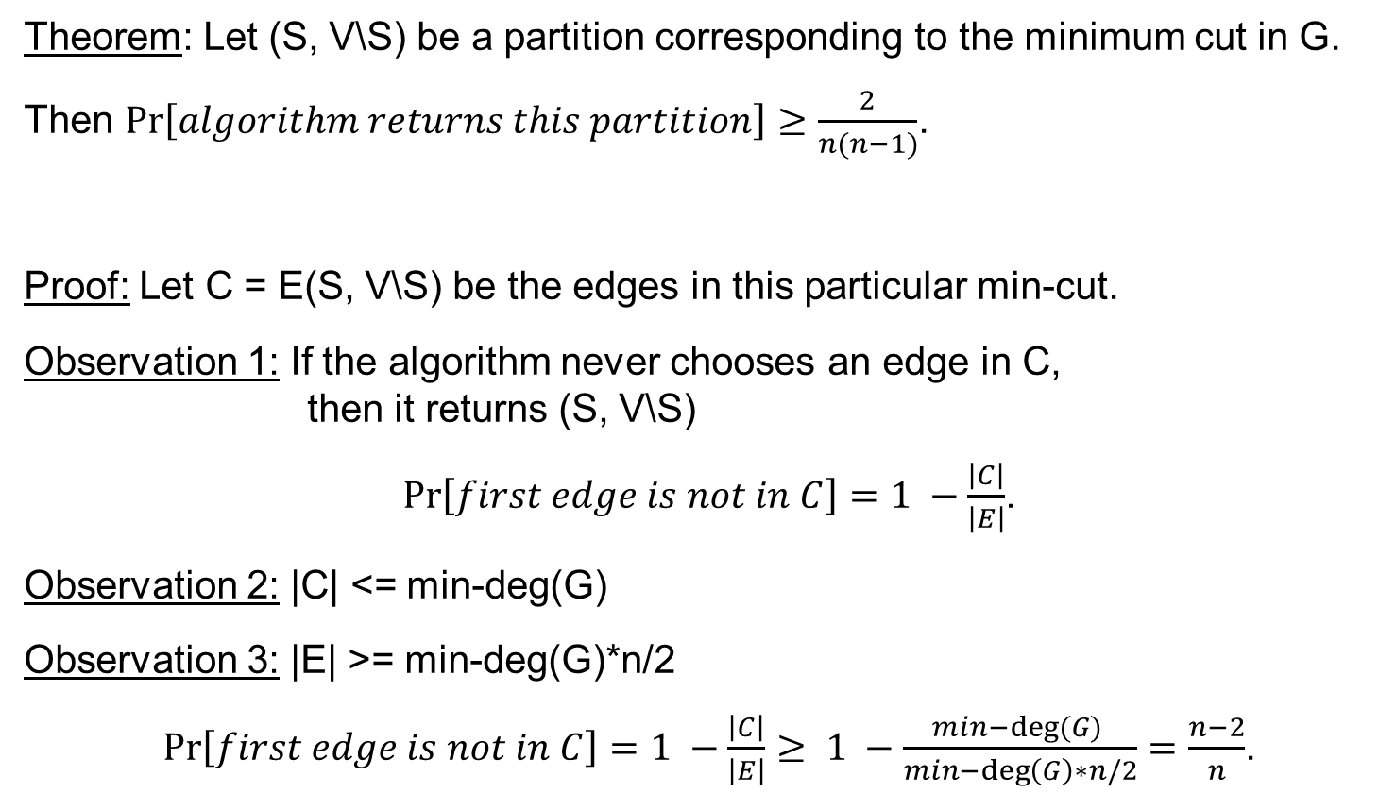
Karger’s Min-Cut algorithm
Theorem: Let (S, V\S) be a partition corresponding to the minimum cut in G.
Then $Pr\left[algorithm returns this partition\right]≥\frac{2}{n(n−1)}$.
Proof: Let C = E(S, V\S) be the edges in this particular min-cut.
Observation 1: If the algorithm never chooses an edge in C,
then it returns (S, V\S)
$Pr\left[first edge is not in C\right]=1 −\frac{\left|C\right|}{\left|E\right|}$.
Observation 2: |C| <= min-deg(G)
Observation 3: |E| >= min-deg(G)*n/2
$Pr\left[first edge is not in C\right]=1 −\frac{\left|C\right|}{\left|E\right|}≥ 1 −\frac{min−deg⁡(G) }{min−\deg\left(G\right)∗n/2}=\frac{n−2}{n}$.

Slide 18
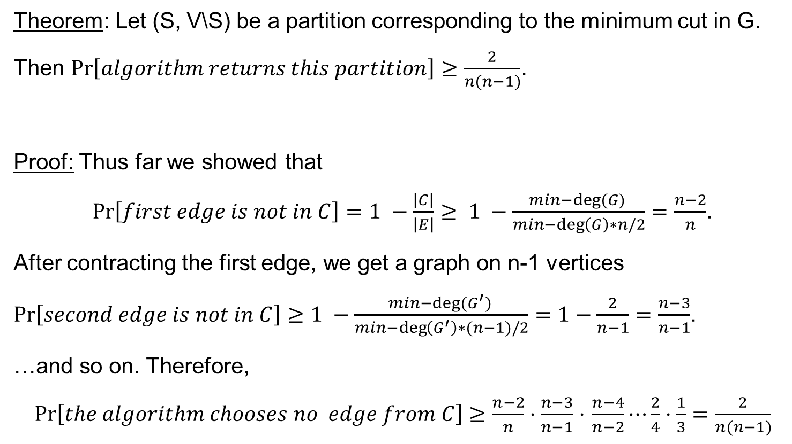
Karger’s Min-Cut algorithm
Theorem: Let (S, V\S) be a partition corresponding to the minimum cut in G.
Then $Pr\left[algorithm returns this partition\right]≥\frac{2}{n(n−1)}$.
Proof: Thus far we showed that
$Pr\left[first edge is not in C\right]=1 −\frac{\left|C\right|}{\left|E\right|}≥ 1 −\frac{min−deg⁡(G) }{min−\deg\left(G\right)∗n/2}=\frac{n−2}{n}$.
After contracting the first edge, we get a graph on n-1 vertices
$Pr\left[second edge is not in C\right]≥1 −\frac{min−deg⁡(G^{′}) }{min−\deg\left(G^{′}\right)∗(n−1)/2}=1−\frac{2}{n−1}=\frac{n−3}{n−1}$.
…and so on. Therefore,
$Pr\left[the algorithm chooses no edge from C\right]≥\frac{n−2}{n}⋅\frac{n−3}{n−1}$ $⋅$ $\frac{n−4}{n−2}⋯\frac{2}{4}⋅\frac{1}{3}=\frac{2}{n(n−1)}$

Slide 19
Questions?
Comments?

