Slide 1
CMPT 409/815
Advanced Algorithms
November 4, 2020

Slide 2
Solving some problems from the midterm

Slide 3
k-Min-Cut algorithm

Slide 4
Karger‘s Min-Cut algorithm
Input: A graph G=(V,E)
Output: minimum k-cut in G
A partition of the vertices into k non-empty parts such that the edges in the k-cut is minimal

Slide 5
Karger‘s Min-Cut algorithm
Input: A connected graph G=(V,E)
Output: Min-Cut(G)
Algorithm:
While G has more than 2 vertices do
Choose a random edge e∈E
Contract e
Return the partition corresponding to the two remaining supernodes.

Slide 6
Karger‘s Min-Cut algorithm
Example:
The partition is S = {a,b,c} V\S = {e,f}
The cut size is E(S, V\S) = 4
ab
ab
abc
a
(a,b)
(e,f)
(ab,c)
b
c
c
c
f
f
ef
e
e
ef

Slide 7
Karger‘s Min-Cut algorithm
Input: A connected graph G=(V,E)
Output: Min-Cut(G)
Algorithm:
While G has more than 2 vertices do
Choose a random edge e∈E
Contract e
Return the partition corresponding to the two remaining supernodes.

Slide 8
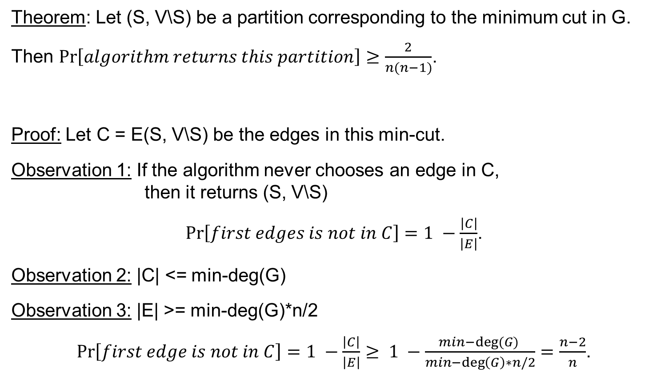
Karger‘s Min-Cut algorithm
Theorem: Let (S, V\S) be a partition corresponding to the minimum cut in G.
Then $Pr\left[algorithm returns this partition\right]≥\frac{2}{n(n−1)}$.
Proof: Let C = E(S, V\S) be the edges in this min-cut.
Observation 1: If the algorithm never chooses an edge in C, then it returns (S, V\S)
$Pr\left[first edges is not in C\right]=1 −\frac{\left|C\right|}{\left|E\right|}$.
Observation 2: |C| <= min-deg(G)
Observation 3: |E| >= min-deg(G)*n/2
$Pr\left[first edge is not in C\right]=1 −\frac{\left|C\right|}{\left|E\right|}≥ 1 −\frac{min−deg⁡(G) }{min−\deg\left(G\right)∗n/2}=\frac{n−2}{n}$.

Slide 9
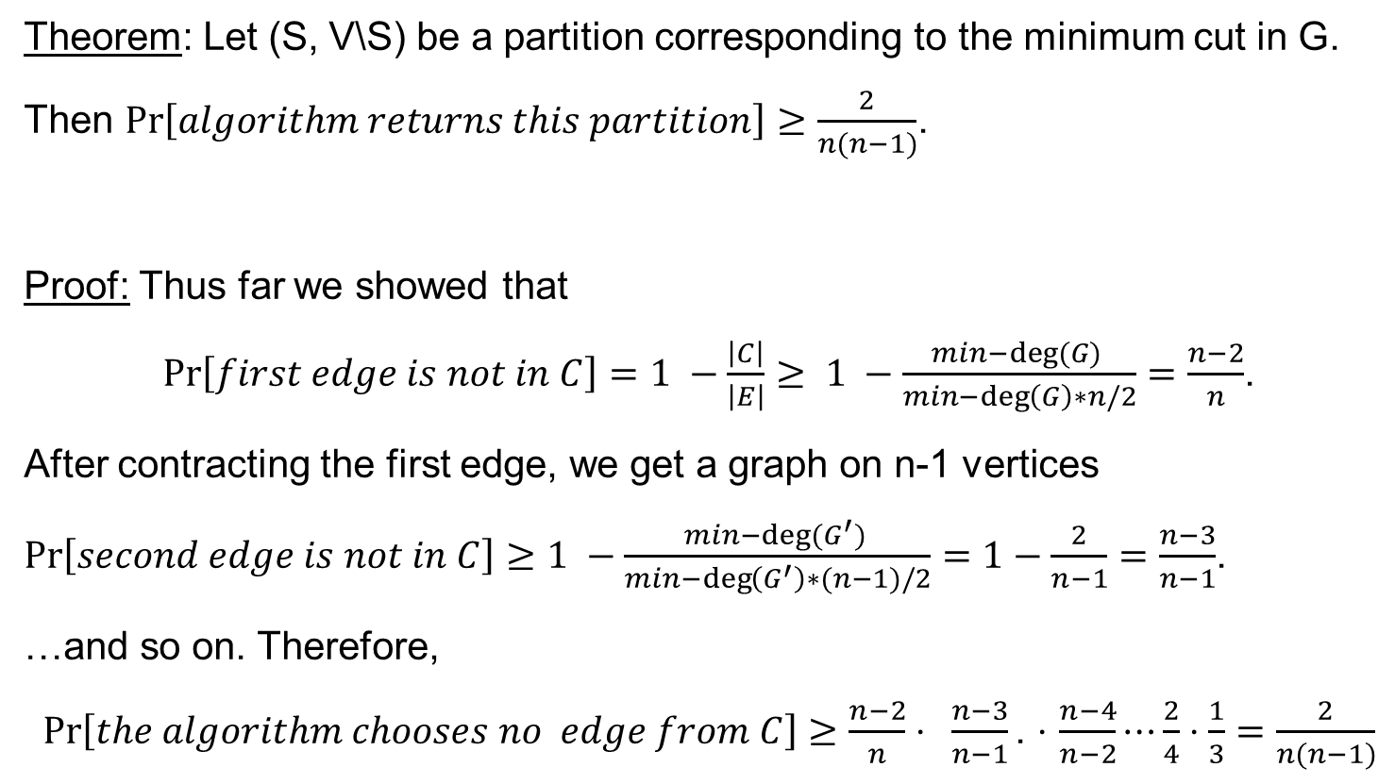
Karger‘s Min-Cut algorithm
Theorem: Let (S, V\S) be a partition corresponding to the minimum cut in G.
Then $Pr\left[algorithm returns this partition\right]≥\frac{2}{n(n−1)}$.
Proof: Thus far we showed that
$Pr\left[first edge is not in C\right]=1 −\frac{\left|C\right|}{\left|E\right|}≥ 1 −\frac{min−deg⁡(G) }{min−\deg\left(G\right)∗n/2}=\frac{n−2}{n}$.
After contracting the first edge, we get a graph on n-1 vertices
$Pr\left[second edge is not in C\right]≥1 −\frac{min−deg⁡(G^{′}) }{min−\deg\left(G^{′}\right)∗(n−1)/2}=1−\frac{2}{n−1}=\frac{n−3}{n−1}$.
…and so on. Therefore,
$Pr\left[the algorithm chooses no edge from C\right]≥\frac{n−2}{n}⋅ \frac{n−3}{n−1}\text{.}$ $⋅$ $\frac{n−4}{n−2}⋯\frac{2}{4}⋅\frac{1}{3}=\frac{2}{n(n−1)}$

Slide 10
Min-k-Cut algorithm
Run Karger’s algorithm, and stop when k supervertices are left
Example k=3:
The partition is V₁ = {a,b} V₂ = {c} V₃ = {e,f}
ab
ab
a
(a,b)
(e,f)
b
c
c
c
f
f
e
e
ef

Slide 11
Min-k-Cut algorithm
Input: A connected graph G=(V,E)
Output: Min-k-Cut(G)
Algorithm:
While G has more than k vertices do
Choose a random edge e∈E
Contract e
Return the partition corresponding to the remaining k supernodes.

Slide 12
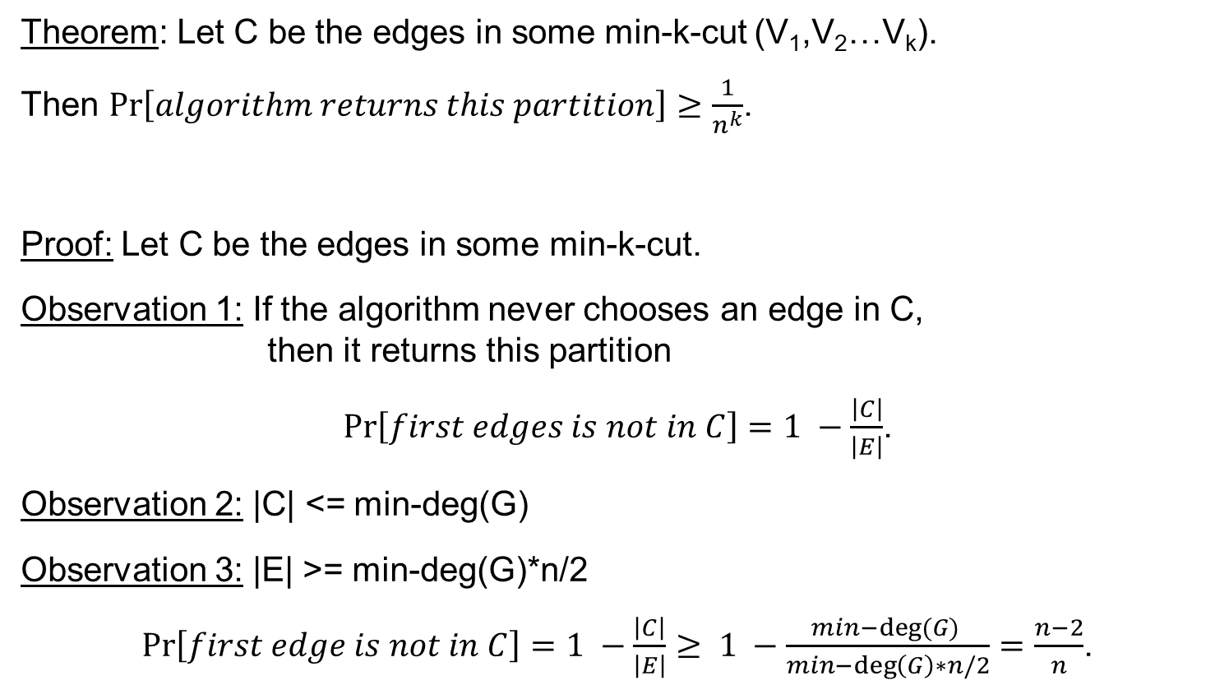
Min-k-Cut algorithm
Theorem: Let C be the edges in some min-k-cut (V₁,V₂…V_{k}).
Then $Pr\left[algorithm returns this partition\right]≥\frac{1}{n^{k}}$.
Proof: Let C be the edges in some min-k-cut.
Observation 1: If the algorithm never chooses an edge in C, then it returns this partition
$Pr\left[first edges is not in C\right]=1 −\frac{\left|C\right|}{\left|E\right|}$.
Observation 2: |C| <= min-deg(G)
Observation 3: |E| >= min-deg(G)*n/2
$Pr\left[first edge is not in C\right]=1 −\frac{\left|C\right|}{\left|E\right|}≥ 1 −\frac{min−deg⁡(G) }{min−\deg\left(G\right)∗n/2}=\frac{n−2}{n}$.
By repeating O(n^{k}) times we will find the optimal k-cut

Slide 13
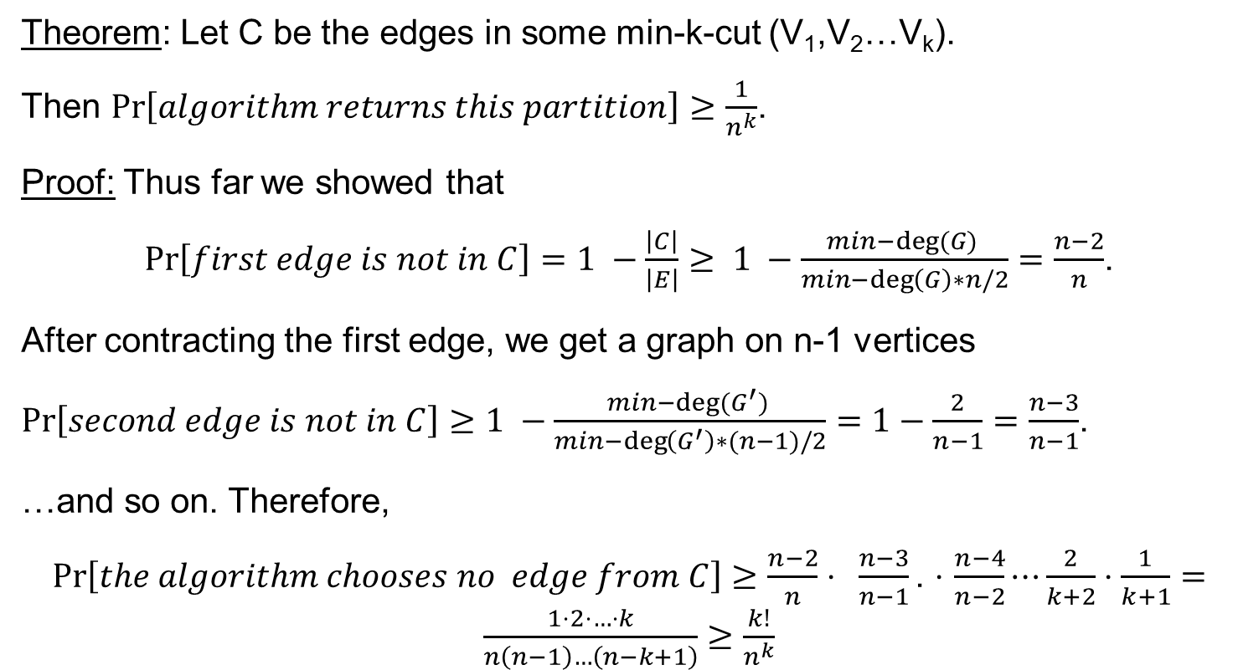
Min-k-Cut algorithm
Theorem: Let C be the edges in some min-k-cut (V₁,V₂…V_{k}).
Then $Pr\left[algorithm returns this partition\right]≥\frac{1}{n^{k}}$.
Proof: Thus far we showed that
$Pr\left[first edge is not in C\right]=1 −\frac{\left|C\right|}{\left|E\right|}≥ 1 −\frac{min−deg⁡(G) }{min−\deg\left(G\right)∗n/2}=\frac{n−2}{n}$.
After contracting the first edge, we get a graph on n-1 vertices
$Pr\left[second edge is not in C\right]≥1 −\frac{min−deg⁡(G^{′}) }{min−\deg\left(G^{′}\right)∗(n−1)/2}=1−\frac{2}{n−1}=\frac{n−3}{n−1}$.
…and so on. Therefore,
$Pr\left[the algorithm chooses no edge from C\right]≥\frac{n−2}{n}⋅ \frac{n−3}{n−1}\text{.}$ $⋅$ $\frac{n−4}{n−2}⋯\frac{2}{k+2}⋅\frac{1}{k+1}=\frac{1⋅2⋅…⋅k}{n\left(n−1\right)…\left(n−k+1\right)}≥\frac{k!}{n^{k}}$

Slide 14
Max-Cut is preserved for random subgraph

Slide 15
Max-Cut is preserved for random subgraph
Given a graph G=(V,E) max-cut is the defined as
max-cut(G) = max_{S,V\S}| E(S,V\S) | / |E|
Let H=(V,E_{H}) be obtained from G be removing each edge with probability ½.
Prove
1) If max-cut(G)=1, then max-cut(H)=1
2) If |E|=|E_{G}|=m, then Pr[| |E_{H}|-m/2 | < eps m] > 1-e^{-n}
3) max-cut(H) is almost equal to max-cut(G).

Slide 16
Max-Cut is preserved for random subgraph
Given a graph G=(V,E) max-cut is the defined as
max-cut(G) = max_{S,V\S}| E(S,V\S) | / |E|
Let H=(V,E_{H}) be obtained from G be removing each edge with probability ½.
Prove If max-cut(G)=1, then max-cut(H)=1
Easy: if max-cut(G)=1, then there is a bi-partition (S,V\S) of V such that all edges of G have one end point in each part.
The same bipartition also works for H.

Slide 17
Max-Cut is preserved for random subgraph
Given a graph G=(V,E) max-cut is the defined as
max-cut(G) = max_{S,V\S}| E(S,V\S) | / |E|
Let H=(V,E_{H}) be obtained from G be removing each edge with probability ½.
Prove
2) If |E|=|E_{G}|=m, then Pr[| |E_{H}|-m/2 | < εm] > 1-2^{-n}
Proof: This is just an application of Chernoff bound.
E_{H} is the sum of all indicator random variables saying that an edge survived
Pr[| |E_{H}|-m/2 | > εm] > 1-e^{-ε2m/6}>1-2^{-n}
(assuming that 𝜀²m>6n, which holds for m>n^{1.5}).

Slide 18
Max-Cut is preserved for random subgraph
Given a graph G=(V,E) max-cut is the defined as
max-cut(G) = max_{S,V\S}| E(S,V\S) | / |E|
Let H=(V,E_{H}) be obtained from G be removing each edge with probability ½.
Prove: max-cut(H) > max-cut(G)-ε with high probability
Proof: This is just another of Chernoff bound.
Fix an optimal cut in G. Let’s say the edges in the cut are some set C. Note that |C|>= m/2.
Denote by C_{H} the edges of C that survive the random removal.
Pr[ |C_{H}|-|C| | > ε |C|] > 1-e^{-ε2|C|/6} > 1-e^{-ε2m/12}>1-2^{-n}
In particular, with this probability |C_{H}| > |C|-ε|C|.
Normalizing by m_{H}, + the previous item ➔ max-cut(H) >= max-cut(G)-2ε

Slide 19
Max-Cut is preserved for random subgraph
Prove: max-cut(H) < max-cut(G)+ε with high probability
Proof: This is yet another of Chernoff bound + union bound
Fix any cut in G. Let’s say the edges in the cut are some set C.
Note that if |C|<m/4, then the corresponding cut mot be max-cut in H anyway.
Denote by C_{H} the edges of C that survive the random removal.
Pr[ |C_{H}|-|C| | > 𝜀|C|] > 1-e^{-ε2|C|/6} > 1-e^{-ε2m/12}>1-2^{-3n}
(again, assuming that
In particular, with this probability |C_{H}| < |C|+ε|C|.
Normalizing by m_{H}, + the previous item ➔ this-cut(H) <= this-cut(G)+2ε
Taking union bound over 2^{n} cuts all cuts give us the result

Slide 20
Questions?
Comments?

