Slide 1
CMPT 409/815
Advanced Algorithms
October 21, 2020

Slide 2
Linear Programming
Duality

Slide 3
LP Duality
Recall canonical form of a minimization LP
Input: A∈R^{MxN}, b∈R^{M}, c∈R^{N},
Goal: find a solution x∈R^{N} that
minimize c^{T}x
subject to Ax >=b
and x>=0.

Slide 4
LP Duality
We said last week that LP can be solved in poly time. But we didn’t prove it
It is easy to see that LP is in NP (the decision version):
Is there x satisfying the following: c^{T}x ≤ k subject to Ax >=b and x>=0.
The NP witness will be x satisfying the constraints and c^{T}x ≤ k.
I’m claiming that LP is in P…
If so, I should be able to prove that LP is in coNP, right?

Slide 5
LP Duality
Today: We prove that the decision version of LP is in coNP
It is easy to see that LP is in NP (the decision version):
Is there x such that c^{T}x <= k subject to Ax >=b and x>=0.
We will see a witness that OPT(LP) ≥ k can be verified in polytime.
We will write another LP that convinces us that OPT(LP) ≥ k.

Slide 6
LP Duality
Convince me that OPT(LP) ≥ 0
2x + 4y + z ≥ 0 because x,y,z>=0
minimize 2x+4y+z
Subject to 2x - y ≥ 2 -x + 2y - z ≥ -1 4y +z ≥ 1
x,y,z ≥0
A feasible solution
(x,y,z) = (12/11, 2/11, 3/11)
LP-value ≤ 35/11 = 3.18181
Convince me that OPT(LP) ≥ 1
Look at the third equation:
2x + 4y + z ≥ (4y + z) ≥ 1
Convince me that OPT(LP) ≥ 3
Convince me that OPT(LP) ≥ 35/11
2x + 4y + z ≥ (2x-y) + (4y+z) ≥ 3
Let k=2/11. Then
2x + 4y + z = 6k(2x-y) + k(-x+2y-z) + (k+1)*(4y+z)
= (12/11)*(2x-y) + (2/11)*(-x+2y-z) + (13/11)*(4y+z) ≥ 35/11

Slide 7
LP Duality
minimize 2x+4y+z
Subject to (1) 2x - y ≥ 2 (2) -x + 2y - z ≥ -1 (3) 4y + z ≥ 1
x,y,z ≥ 0
So what are we doing here?
We are looking for coefficients a,b,c≥0 such that
2x+4y+z ≥a*(1) + b*(2) + c*(3)
If we find such a,b,c≥0, then for any feasible solution the objective function at this solution must be at least 2*a+(-1)*b+1*c.
Convince me that OPT(LP) ≥ 3
2x + 4y + z ≥ (2x-y) + (4y+z) ≥ 3

Slide 8
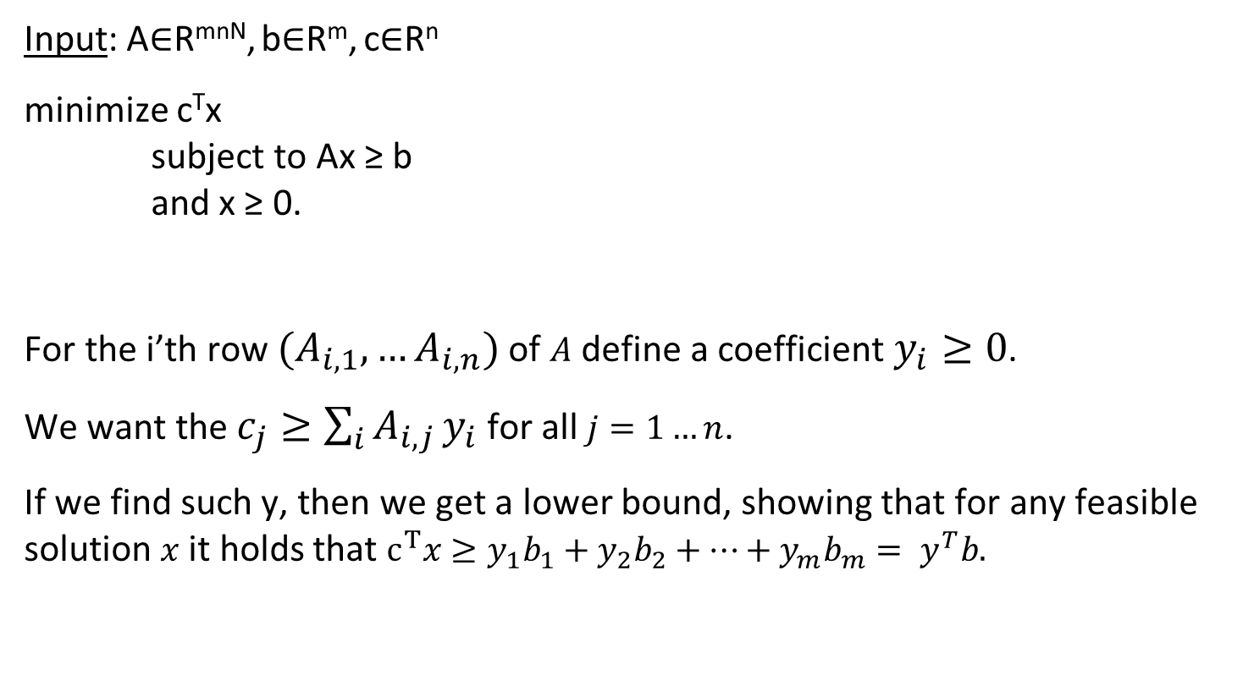
LP Duality
c=
1 | -1 | 0 | 2 | 1 | 3 | 0
Input: A∈R^{mnN}, b∈R^{m}, c∈R^{n}
minimize c^{T}x subject to Ax ≥ b and x ≥ 0.
For the i’th row $(A_{i,1},…A_{i,n})$of $A$ define a coefficient $y_{i}≥0$.
We want the $c_{j}≥\sum_{i}{A_{i,j}}y_{i}$ for all $j=1…n$.
If we find such y, then we get a lower bound, showing that for any feasible solution $x$ it holds that $c^{T}x≥y_{1}b_{1}+y_{2}b_{2}+…+y_{m}b_{m}={ y}^{T}b.$
Y₁
Y₂
y₃
y₄
y₅
1 | -1 | 0 | 2 | 1 | 3 | 0
2 | 1 | 0 | -2 | -4 | 1 | 0
0 | 0 | 2 | 0 | 1 | 6 | 2
2 | 0 | 0 | 2 | 0 | 0 | 0
1 | -3 | 0 | 1 | -1 | 0 | 1
2
1
0
4
-2
y=
A=
b=

Slide 9
LP Duality
c=
1 | -1 | 0 | 2 | 1 | 3 | 0
Input: A∈R^{mnN}, b∈R^{m}, c∈R^{n}
minimize c^{T}x subject to Ax ≥ b and x ≥ 0.
In other words, we are looking for y∈R^{m} such that
1) y_{i}≥ 0 for all i=1…m
2) c ≥ A^{T}y
And our goal is to maximize y₁b₁+ y₂b₂+…y_{m}b_{m}.
Y₁
y₂
y₃
y₄
y₅
1 | -1 | 0 | 2 | 1 | 3 | 0
2 | 1 | 0 | -2 | -4 | 1 | 0
0 | 0 | 2 | 0 | 1 | 6 | 2
2 | 0 | 0 | 2 | 0 | 0 | 0
1 | -3 | 0 | 1 | -1 | 0 | 1
2
1
0
4
-2
y=
A=
b=
Dual LP: Find y∈R^{m}
Maximize b^{T}y
Subject to A^{T}y ≤ c
y ≥ 0

Slide 10
LP Duality
Input: A∈R^{mnN}, b∈R^{m}, c∈R^{n}
Weak duality theorem: Suppose that the primal LP is feasible and finite.
Then OPT(primal LP) ≥ OPT(dual LP).
Strong duality theorem: Suppose that the primal LP is feasible and finite.
Then OPT(primal LP) = OPT(dual LP)
Primal LP: Find x∈R^{n}
minimize c^{T}x subject to Ax ≥ b and x ≥ 0
Dual LP: Find y∈R^{m}
maximize b^{T}y
subject to A^{T}y ≤ c
and y ≥ 0

Slide 11
LP Duality
Primal LP: Find x∈R^{n}
minimize c^{T}x subject to Ax ≥ b and x ≥ 0
Dual LP: Find y∈R^{m}
maximize b^{T}y
subject to A^{t}y ≤ c
and y ≥ 0
Strong duality theorem:
If the primal LP is feasible and finite, then OPT(primal LP) = OPT(dual LP).
If the primal LP is infeasible, the dual LP is unbounded.
If the primal LP is unbounded, the dual LP is infeasible.
Dual of dual is the primal.

Slide 12
LP Duality
Next time: Applications of LP duality.
- A combinatorial algorithm for weighted vertex cover

Slide 13
LP for min-weight vertex cover
Given a graph G=(V,E) we have a variable x_{v} for each v ∈V
minimize ∑_{v∈V} w_{v}x_{v}
subject to x_{u}+x_{v} ≥ 1 for all (u,v) ∈E
x_{v} ≥ 0 for all v∈V
What is the dual of this LP?
If we compute the dual LP, then minVC(G) ≥ OPT(primal-LP) ≥ OPT(dual-LP)
1 | 0 | 0 | 1 | 0 | 0 | 0
1 | 0 | 0 | 0 | 0 | 1 | 0
0 | 1 | 0 | 0 | 1 | 0 | 0
… | … | … | … | … | … | …
0 | 1 | 0 | 1 | 0 | 0 | 0
1
1
1
1
1
A=
b=

Slide 14
Questions?
Comments?

