Slide 1
CMPT 409/815
Advanced Algorithms
October 19, 2020

Slide 2
Linear Programming
Applications

Slide 3
Integrality gaps
Example: vertex cover

Slide 4
Weighted minimum vertex cover
Input: a graph G=(V,E) , and weights w_{v}>=0
Goal: find a vertex cover C⊂V of G such that ∑_{v∈C} w_{v} is minimized.
Algorithm: Consider the following LP:
The variables are x_{v} for each v∈V
minimize ∑_{v∈V} w_{v}x_{v}
subject to x_{u}+x_{v} >=1 for all (u,v) ∈E
0 <= x_{v} <=1 for all v∈V
Intention: if C is a vertex cover, then we can set x_{v}=1 if v∈C and x_{v}=0 if v∈V\C.
Therefore, OPT(LP)<=minVC(G)
Another trivial solution: x_{v}=1/2 for all v∈V (this is not very meaningful)

Slide 5
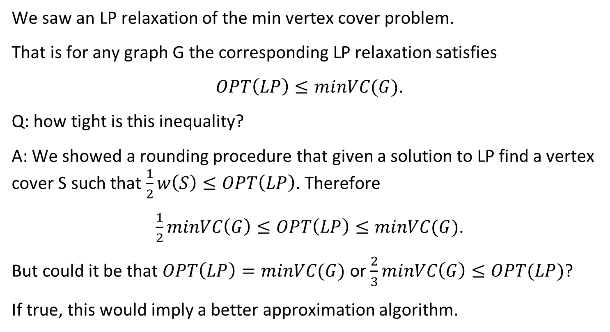
Integrality Gaps
We saw an LP relaxation of the min vertex cover problem.
That is for any graph G the corresponding LP relaxation satisfies
$OPT\left(LP\right)≤minVC(G)$.
Q: how tight is this inequality?
A: We showed a rounding procedure that given a solution to LP find a vertex cover S such that $\frac{1}{2}w\left(S\right)≤OPT\left(LP\right)$. Therefore
$\frac{1}{2}minVC\left(G\right)≤OPT\left(LP\right)≤minVC(G)$.
But could it be that $OPT\left(LP\right)=minVC(G)$ or $\frac{2}{3}minVC\left(G\right)≤OPT(LP)$?
If true, this would imply a better approximation algorithm.

Slide 6
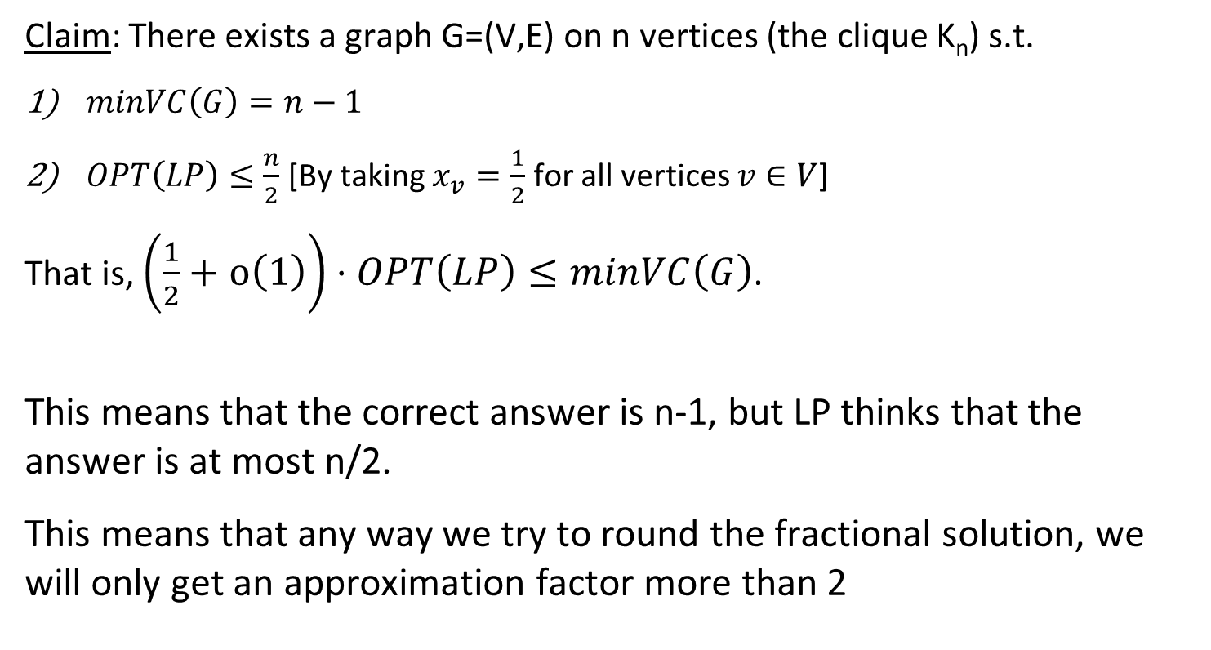
Integrality Gaps
Claim: There exists a graph G=(V,E) on n vertices (the clique K_{n}) s.t.
$minVC\left(G\right)=n−1$
$OPT\left(LP\right)≤\frac{n}{2}$ [By taking $x_{v}=\frac{1}{2}$ for all vertices $v∈V$]
That is, $\left(\frac{1}{2}+o\left(1\right)\right)⋅OPT\left(LP\right)≤minVC\left(G\right)$.
This means that the correct answer is n-1, but LP thinks that the answer is at most n/2.
This means that any way we try to round the fractional solution, we will only get an approximation factor more than 2

Slide 7
Linear Programming
Geometry of Polytopes

Slide 8
Min cost perfect matching in bipartite graphs

Slide 9
Perfect matching in bipartite graphs
Goal: Given an edge weighted bipartite graph G find a perfect matching on minimum weight.
We saw a solution that uses the polynomial method.
Today we’ll see a solution using LPs.

Slide 10
Linear Programming
Goal: find the feasible area of
Subject to:
x+y>=6
y-2x <= 2
x-2y <= 0
0 <= x <= 10
0 <= y <= 10
y-2x<=2
x=0
x=10
Feasible area
y=10
y=0
x+y>=6
x-2y<=0
(4,2)

Slide 11
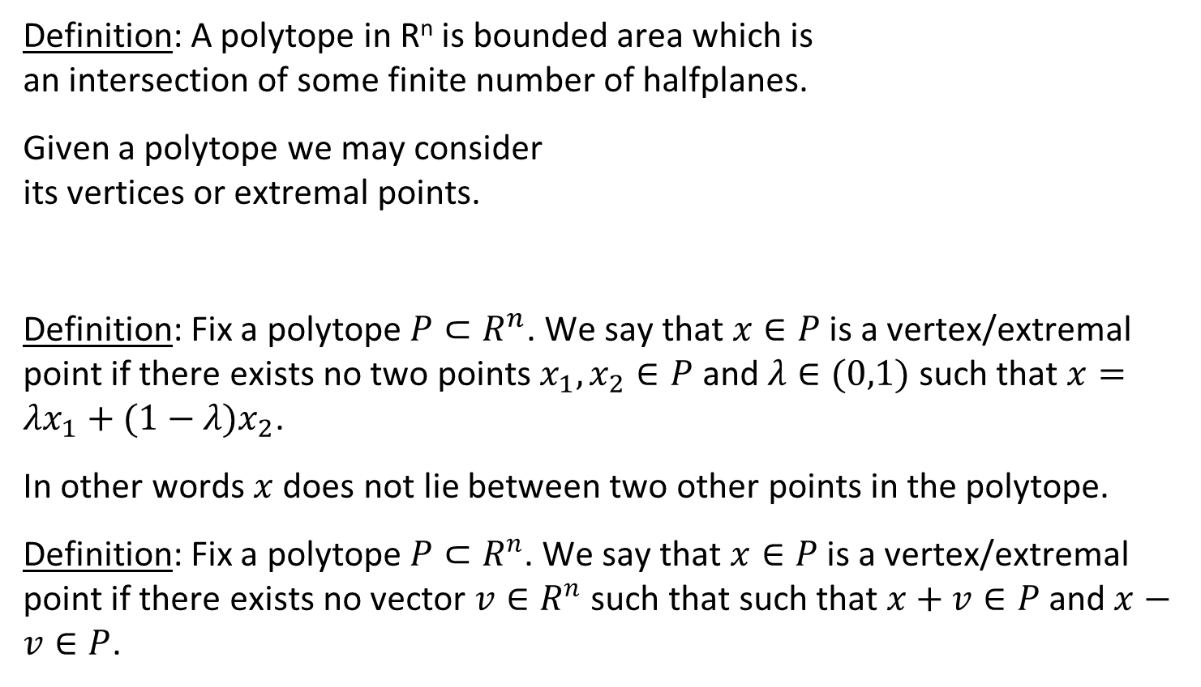
Linear Programming
(4,6)
(10,6)
Definition: A polytope in R^{n} is bounded area which is an intersection of some finite number of halfplanes.
Given a polytope we may consider its vertices or extremal points.
Definition: Fix a polytope $P⊂R^{n}$. We say that $x∈P$ is a vertex/extremal point if there exists no two points $x_{1},x_{2}∈P$ and $λ∈(0,1)$such that $x=λx_{1}+(1−λ)x_{2}$.
In other words $x$ does not lie between two other points in the polytope.
Definition: Fix a polytope $P⊂R^{n}$. We say that $x∈P$ is a vertex/extremal point if there exists no vector $v∈R^{n}$ such that such that $x+v∈P \text{a}\text{nd} x−v∈P$.
(3,4)
(10,4)
(4,2)

Slide 12
Linear Programming
(4,6)
(10,6)
Not an extremal point
(3,4)
(10,4)
(4,2)

Slide 13
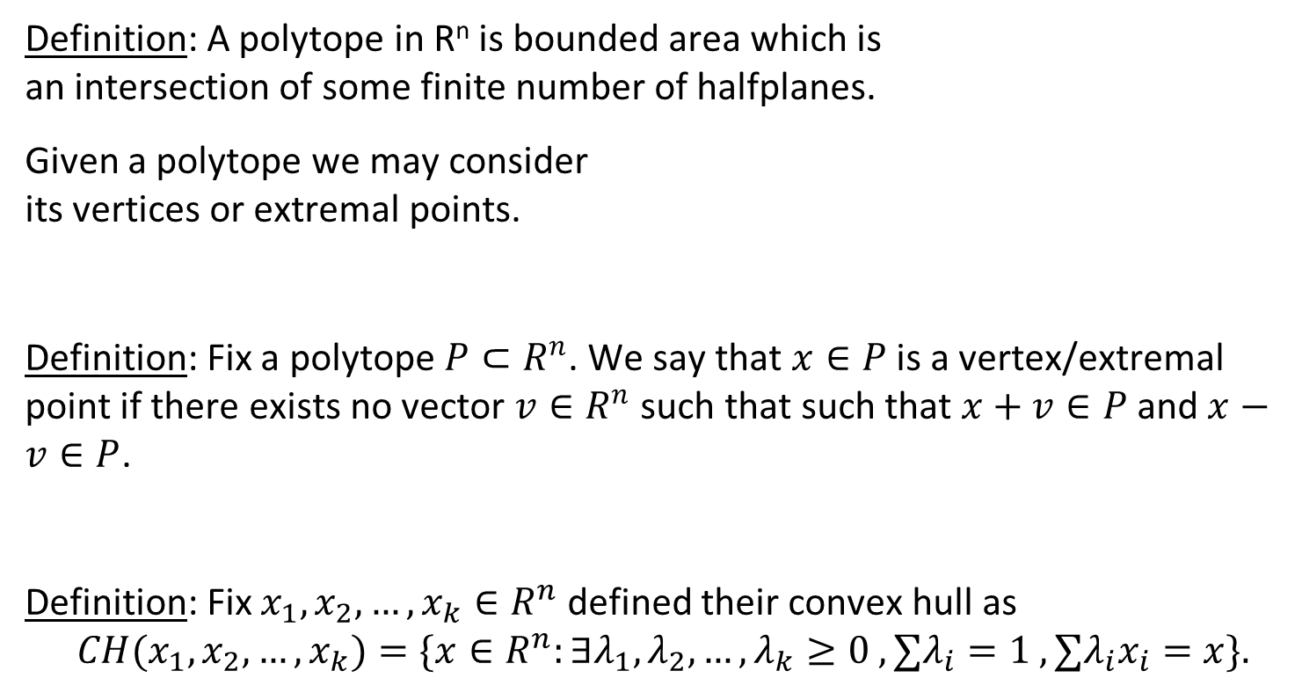
Linear Programming
(4,6)
(10,6)
Definition: A polytope in R^{n} is bounded area which is an intersection of some finite number of halfplanes.
Given a polytope we may consider its vertices or extremal points.
Definition: Fix a polytope $P⊂R^{n}$. We say that $x∈P$ is a vertex/extremal point if there exists no vector $v∈R^{n}$ such that such that $x+v∈P \text{a}\text{nd} x−v∈P$.
Definition: Fix $x_{1},x_{2},…,x_{k}∈R^{n}$ defined their convex hull as $${CH(x}_{1},x_{2},…,x_{k})=\{x∈R^{n}:∃λ_{1},λ_{2},…,λ_{k}≥0 , ∑λ_{i}=1 , ∑λ_{i}x_{i}=x\}.$$
(3,4)
(10,4)
(4,2)

Slide 14
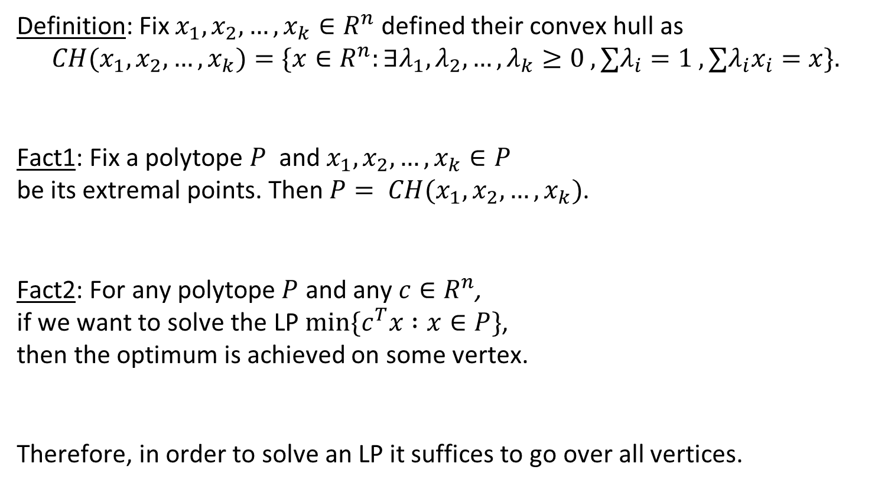
Linear Programming
Definition: Fix $x_{1},x_{2},…,x_{k}∈R^{n}$ defined their convex hull as $${CH(x}_{1},x_{2},…,x_{k})=\{x∈R^{n}:∃λ_{1},λ_{2},…,λ_{k}≥0 , ∑λ_{i}=1 , ∑λ_{i}x_{i}=x\}.$$
Fact1: Fix a polytope $P$ and $x_{1},x_{2},…,x_{k}∈P$ be its extremal points. Then $P= CH(x_{1},x_{2},…,x_{k})$.
Fact2: For any polytope $P$ and any $c∈R^{n}$, if we want to solve the LP $min\{c^{T}x :x∈P\}$, then the optimum is achieved on some vertex.
Therefore, in order to solve an LP it suffices to go over all vertices.
(4,6)
(10,6)
(3,4)
(10,4)
(4,2)
2x+3y=14
2x+3y=7
2x+3y=0

Slide 15
Back to min cost perfect matching in bipartite graphs

Slide 16
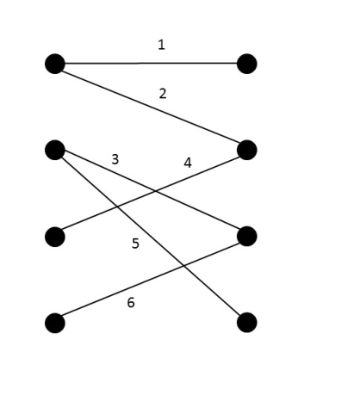
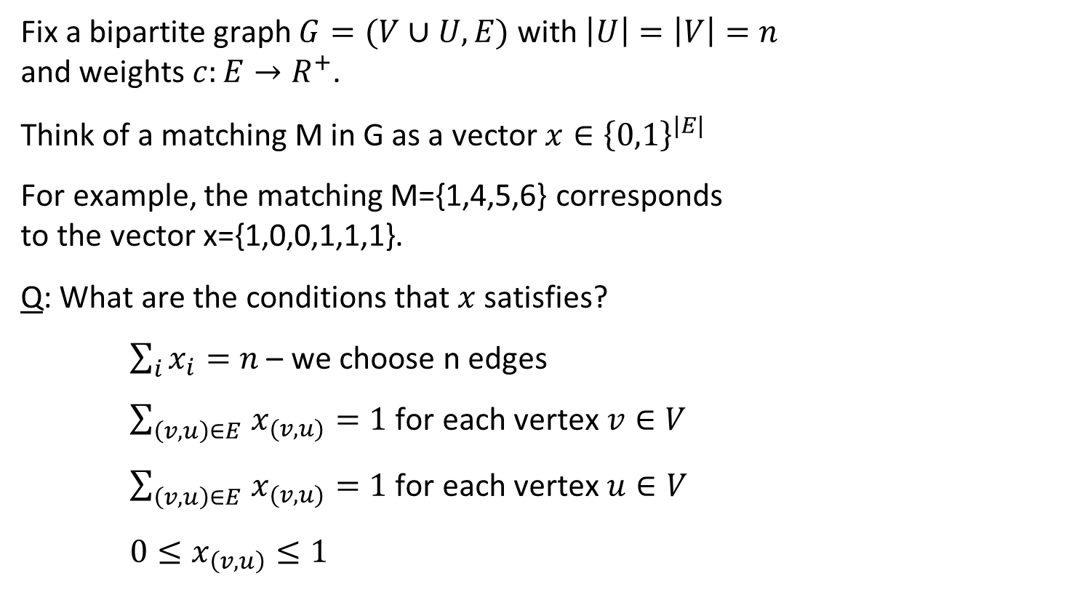
Min-cost perfect matching in bipartite graphs
Fix a bipartite graph $G=(V∪U,E)$ with $\left|U\right|=\left|V\right|=n$ and weights $c:E→R^{+}$.
Think of a matching M in G as a vector $x∈{\left\{0,1\right\}}^{|E|}$
For example, the matching M={1,4,5,6} corresponds to the vector x={1,0,0,1,1,1}.
Q: What are the conditions that $x$ satisfies?
$\sum_{i}{x_{i}}=n$ – we choose n edges
$\sum_{\left(v,u\right)∈E }{x_{(v,u)}}=1$ for each vertex $v∈V$
$\sum_{\left(v,u\right)∈E }{x_{(v,u)}}=1$ for each vertex $u∈V$
$0≤x_{\left(v,u\right)}≤1$

Slide 17
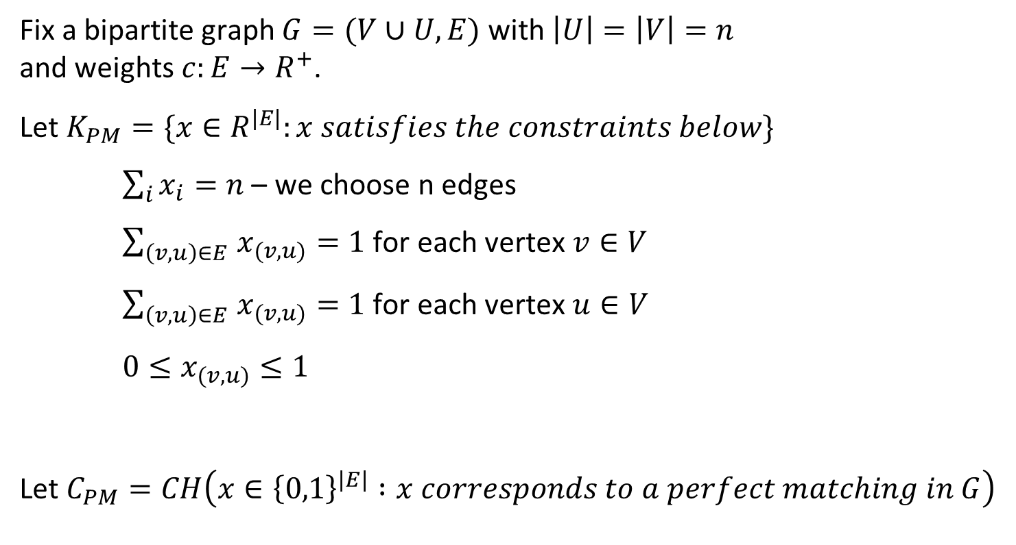
Perfect matching in bipartite graphs
Fix a bipartite graph $G=(V∪U,E)$ with $\left|U\right|=\left|V\right|=n$ and weights $c:E→R^{+}$.
Let $K_{PM}=\{x∈R^{|E|}:x satisfies the constraints below\}$
$\sum_{i}{x_{i}}=n$ – we choose n edges
$\sum_{\left(v,u\right)∈E }{x_{(v,u)}}=1$ for each vertex $v∈V$
$\sum_{\left(v,u\right)∈E }{x_{(v,u)}}=1$ for each vertex $u∈V$
$0≤x_{(v,u)}≤1$
Let $C_{PM}=CH\left(x∈{\left\{0,1\right\}}^{\left|E\right|} :x corresponds to a perfect matching in G\right)$

Slide 18
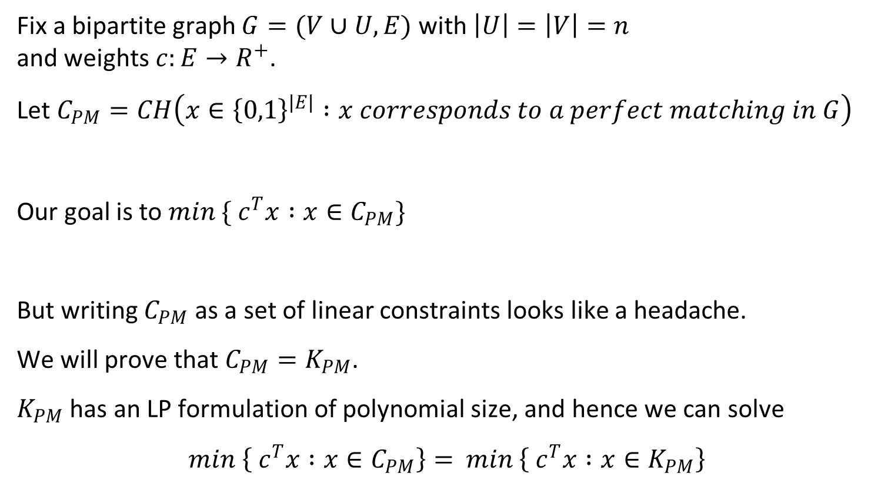
Perfect matching in bipartite graphs
Fix a bipartite graph $G=(V∪U,E)$ with $\left|U\right|=\left|V\right|=n$ and weights $c:E→R^{+}$.
Let $C_{PM}=CH\left(x∈{\left\{0,1\right\}}^{\left|E\right|} :x corresponds to a perfect matching in G\right)$
Our goal is to $min \{ c^{T}x :x∈C_{PM}\}$
But writing $C_{PM}$ as a set of linear constraints looks like a headache.
We will prove that $C_{PM}=K_{PM}$.
$K_{PM}$ has an LP formulation of polynomial size, and hence we can solve
$min \left\{ c^{T}x :x∈C_{PM}\right\}=$ $min \left\{ c^{T}x :x∈K_{PM}\right\}$

Slide 19
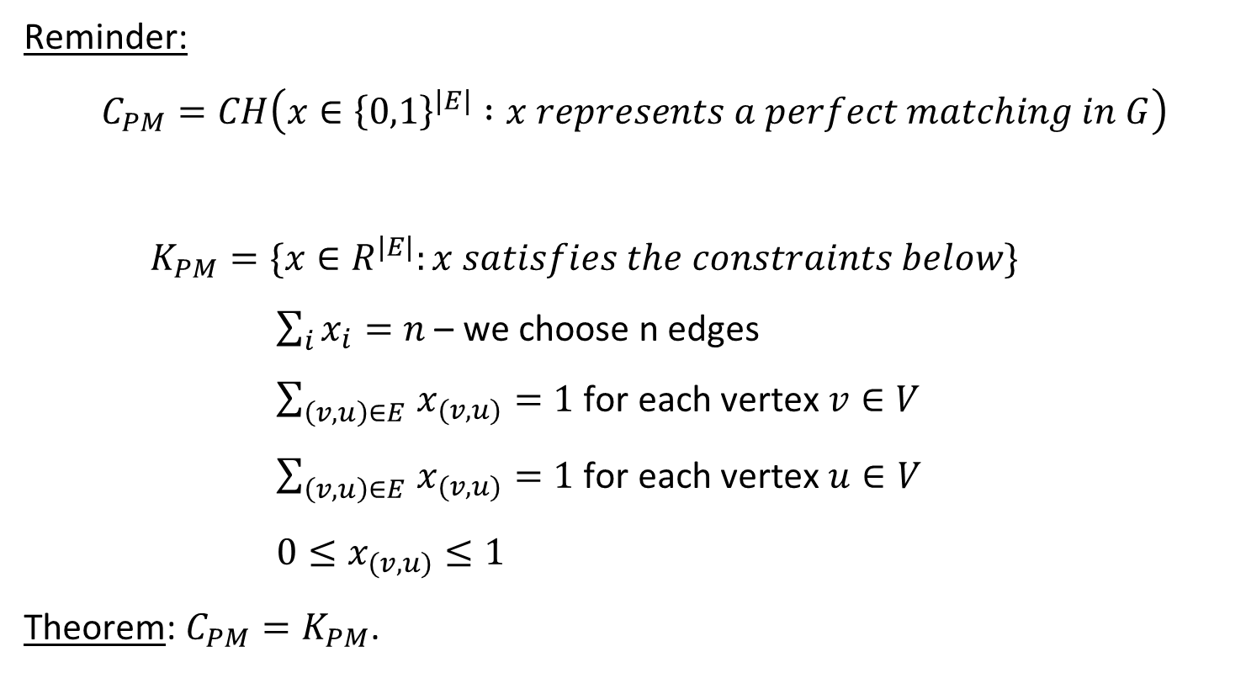
Perfect matching in bipartite graphs
Reminder:
$$C_{PM}=CH\left(x∈{\left\{0,1\right\}}^{\left|E\right|} :x represents a perfect matching in G\right)$$
$K_{PM}=\{x∈R^{|E|}:x satisfies the constraints below\}$
$\sum_{i}{x_{i}}=n$ – we choose n edges
$\sum_{\left(v,u\right)∈E }{x_{(v,u)}}=1$ for each vertex $v∈V$
$\sum_{\left(v,u\right)∈E }{x_{(v,u)}}=1$ for each vertex $u∈V$
$0≤x_{(v,u)}≤1$
Theorem: $C_{PM}=K_{PM}$.

Slide 20
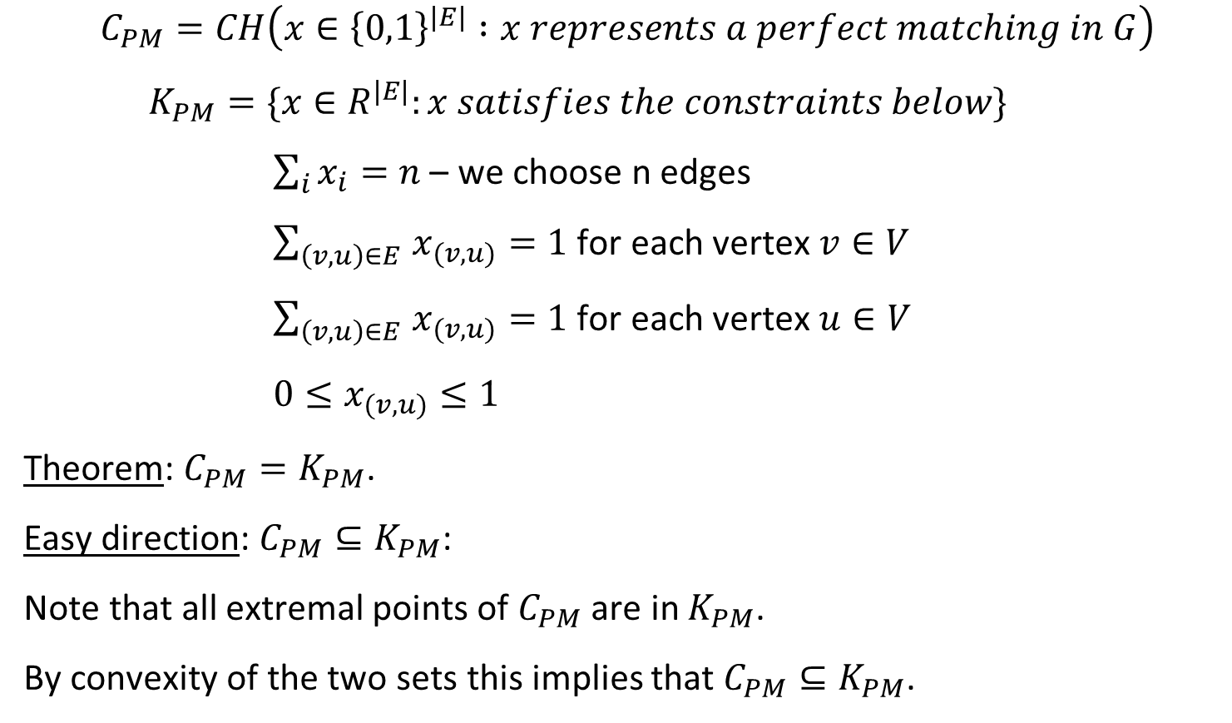
Perfect matching in bipartite graphs
$$C_{PM}=CH\left(x∈{\left\{0,1\right\}}^{\left|E\right|} :x represents a perfect matching in G\right)$$
$K_{PM}=\{x∈R^{|E|}:x satisfies the constraints below\}$
$\sum_{i}{x_{i}}=n$ – we choose n edges
$\sum_{\left(v,u\right)∈E }{x_{(v,u)}}=1$ for each vertex $v∈V$
$\sum_{\left(v,u\right)∈E }{x_{(v,u)}}=1$ for each vertex $u∈V$
$0≤x_{(v,u)}≤1$
Theorem: $C_{PM}=K_{PM}$.
Easy direction: $C_{PM}⊆K_{PM}$:
Note that all extremal points of $C_{PM}$ are in $K_{PM}$.
By convexity of the two sets this implies that $C_{PM}⊆K_{PM}$.

Slide 21
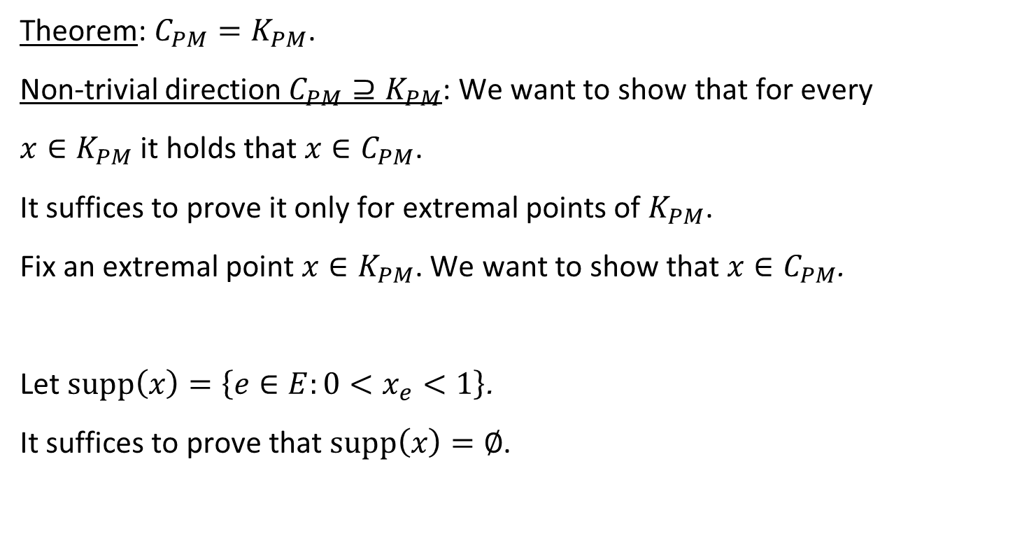
Perfect matching in bipartite graphs
Theorem: $C_{PM}=K_{PM}$.
Non-trivial direction $C_{PM}⊇K_{PM}$: We want to show that for every
$x∈K_{PM}$ it holds that $x∈C_{PM}$.
It suffices to prove it only for extremal points of $K_{PM}$.
Fix an extremal point $x∈K_{PM}$. We want to show that $x∈C_{PM}$.
Let $supp\left(x\right)=\left\{e∈E:0<x_{e}<1\right\}$.
It suffices to prove that $supp\left(x\right)=∅$.

Slide 22

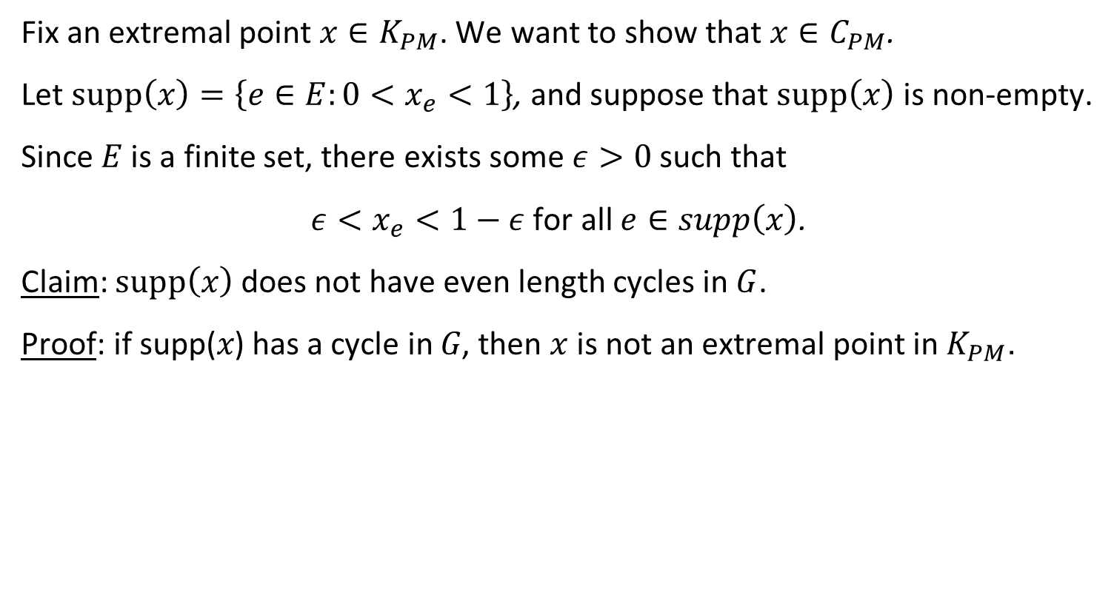







Perfect matching in bipartite graphs
Fix an extremal point $x∈K_{PM}$. We want to show that $x∈C_{PM}$.
Let $supp\left(x\right)=\left\{e∈E:0<x_{e}<1\right\}$, and suppose that $supp\left(x\right)$ is non-empty.
Since $E$ is a finite set, there exists some $ε>0$ such that
$ε<x_{e}<1−ε$ for all $e∈supp\left(x\right)$.
Claim: $supp\left(x\right)$does not have even length cycles in $G$.
Proof: if supp(𝑥) has a cycle in 𝐺, then $x$ is not an extremal point in $K_{PM}$.
x₂
x₂- $ε$
x₂+ $ε$
x₁
x₁+ $ε$
x₁- $ε$
= ½ ½
x₃
x₃+ $ε$
x₃- $ε$
x₄
X₄ - $ε$
X₄ + $ε$

Slide 23
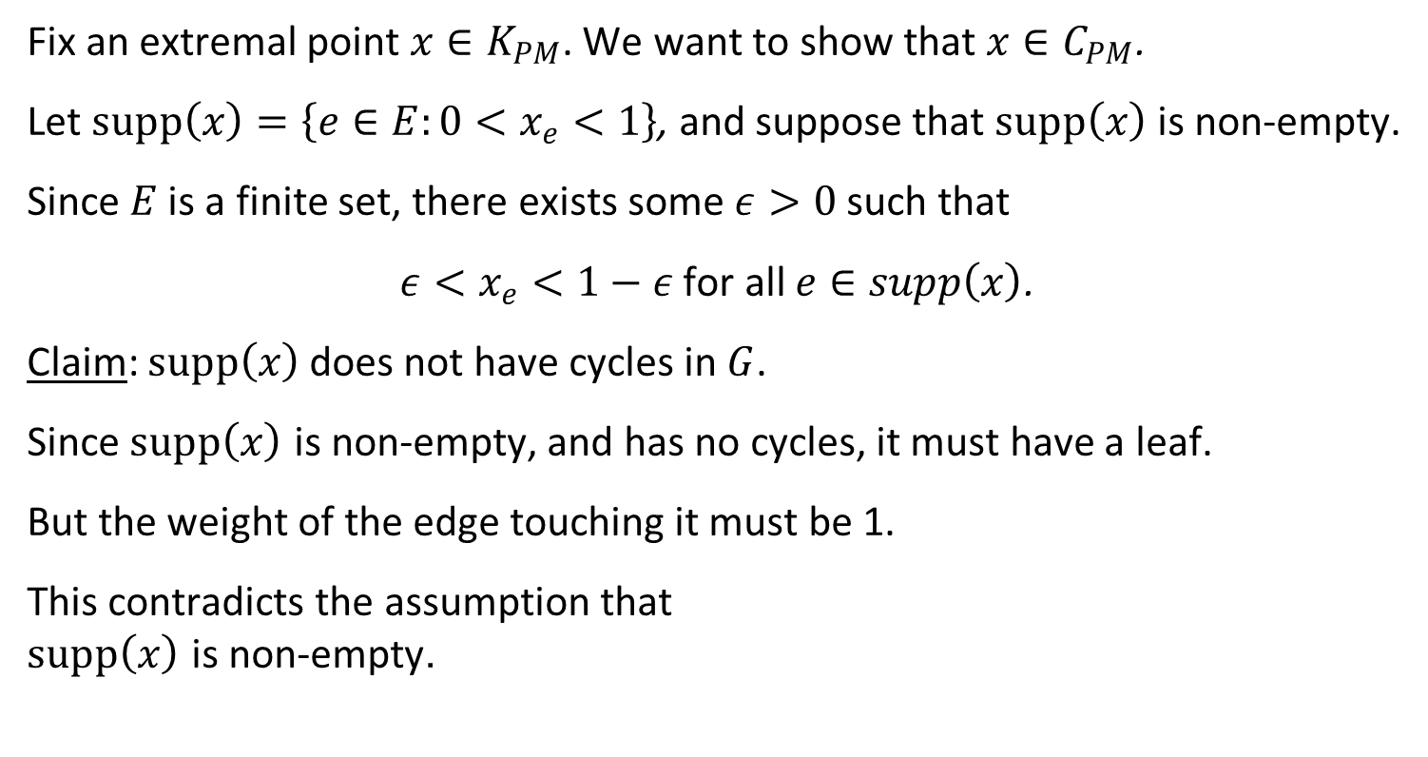
Perfect matching in bipartite graphs
Fix an extremal point $x∈K_{PM}$. We want to show that $x∈C_{PM}$.
Let $supp\left(x\right)=\left\{e∈E:0<x_{e}<1\right\}$, and suppose that $supp\left(x\right)$ is non-empty.
Since $E$ is a finite set, there exists some $ε>0$ such that
$ε<x_{e}<1−ε$ for all $e∈supp\left(x\right)$.
Claim: $supp\left(x\right)$does not have cycles in $G$.
Since $supp\left(x\right)$ is non-empty, and has no cycles, it must have a leaf.
But the weight of the edge touching it must be 1.
This contradicts the assumption that $supp\left(x\right)$ is non-empty.
x_{e}=1

Slide 24

Perfect matching in bipartite graphs
Theorem: $C_{PM}=K_{PM}$.
Easy direction: $C_{PM}⊆K_{PM}$
Non-trivial direction $C_{PM}⊇K_{PM}$: We showed that every extremal point of $K_{PM}$ is integral, and hence is contained in $C_{PM}$.

Slide 25
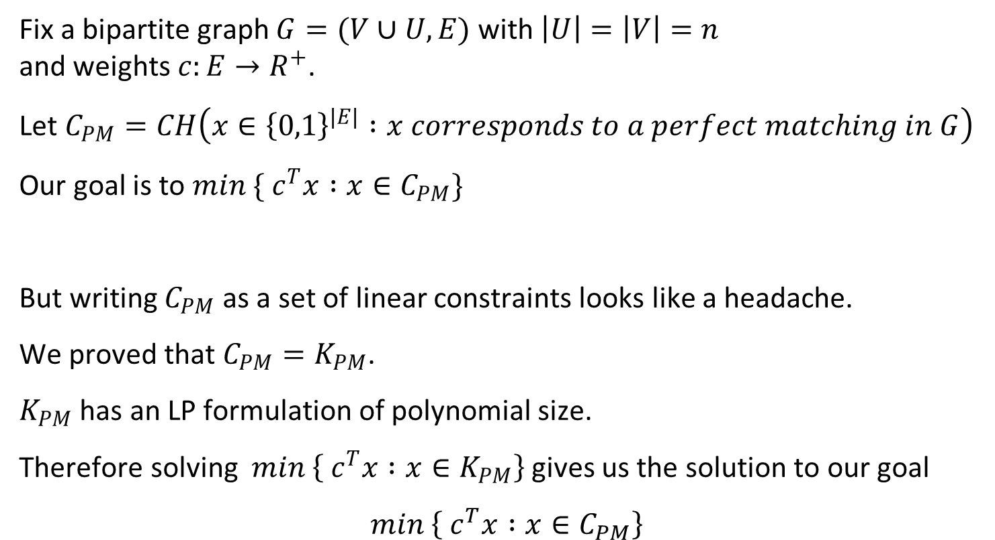
Perfect matching in bipartite graphs
Fix a bipartite graph $G=(V∪U,E)$ with $\left|U\right|=\left|V\right|=n$ and weights $c:E→R^{+}$.
Let $C_{PM}=CH\left(x∈{\left\{0,1\right\}}^{\left|E\right|} :x corresponds to a perfect matching in G\right)$
Our goal is to $min \{ c^{T}x :x∈C_{PM}\}$
But writing $C_{PM}$ as a set of linear constraints looks like a headache.
We proved that $C_{PM}=K_{PM}$.
$K_{PM}$ has an LP formulation of polynomial size.
Therefore solving $min \left\{ c^{T}x :x∈K_{PM}\right\}$ gives us the solution to our goal
$$min \left\{ c^{T}x :x∈C_{PM}\right\}$$

Slide 26
Discrepancy
Beck-Fiala Theorem

Slide 27
Discrepancy
Input: A hypergraph H = (V, E)
Goal: color the vertices of the hypergraph using two colors so that the edges of H are as “balanced” as possible.

Slide 28
Discrepancy
Fix a coloring X:V → {-1,1}
Define the discrepancy of the edge e∈E using X as disc_{X}(e) =| ∑_{v∈e}X(v) |
Discrepancy of H with X is disc_{X}(H) = max_{e∈E} disc_{X}(e)
Discrepancy of H is defined
Disc(H) = min_{X:V→{-1,1}}disc_{X}(H)
Disc(H)=d means that for some coloring all edges have discrepancy <= d.

Slide 29
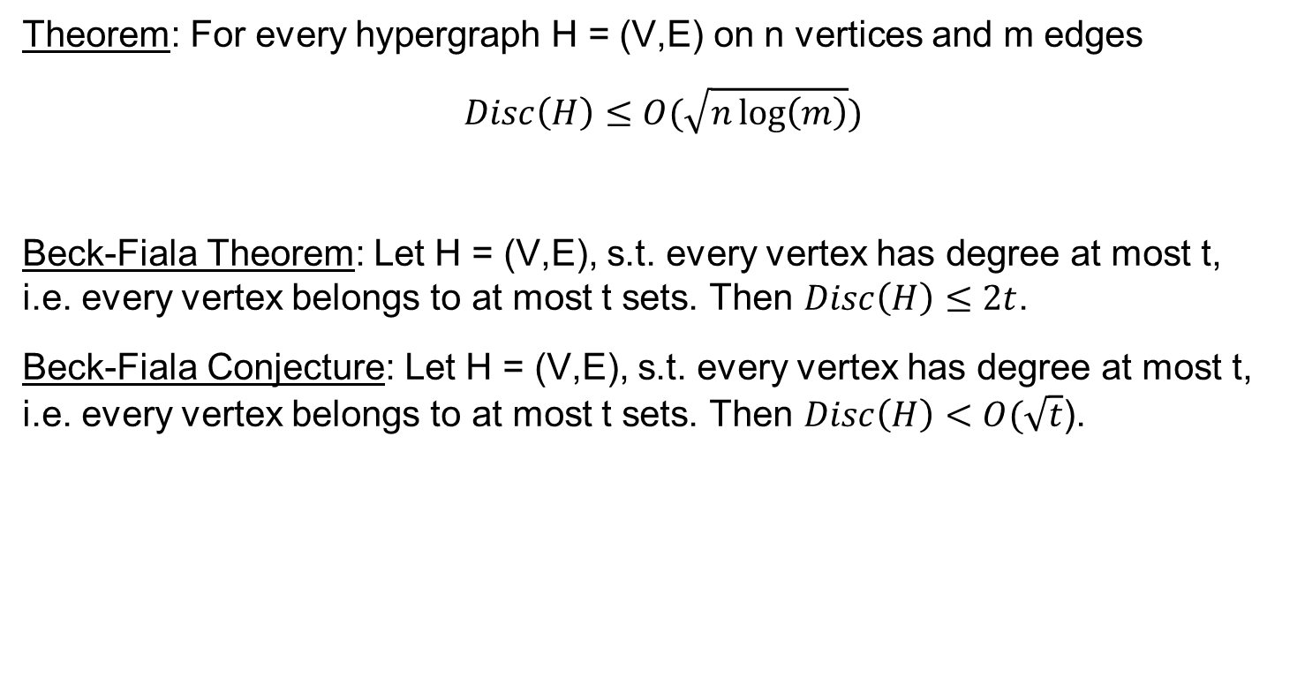
Discrepancy
Theorem: For every hypergraph H = (V,E) on n vertices and m edges
$$Disc\left(H\right)≤O(\sqrt{n\log\left(m\right)})$$
Beck-Fiala Theorem: Let H = (V,E), s.t. every vertex has degree at most t, i.e. every vertex belongs to at most t sets. Then $Disc\left(H\right)≤2t$.
Beck-Fiala Conjecture: Let H = (V,E), s.t. every vertex has degree at most t, i.e. every vertex belongs to at most t sets. Then $Disc\left(H\right)<O(\sqrt{t}$).

Slide 30

Discrepancy
Theorem [Beck-Fiala ‘81]: Let H = (V,E) be a hypergraph , such that every vertex has degree at most t, i.e. every vertex belongs to at most t sets. Then
$Disc\left(H\right)<2t$.
Proof: We need a notion of basic feasible solution of LPs.

Slide 31
Basic Feasible Solution of LPs

Slide 32
Linear Programming (minimization version)
Recall canonical form of a minimization LP
Input: A∈R^{MxN}, b∈R^{M}, c∈R^{N},
Goal: find a solution x∈R^{N} that
minimizes c^{T}x
subject to Ax >=b
and x>=0.
Observation: we may assume that rows of A are linearly independent
Therefore, we will assume that n>=m

Slide 33
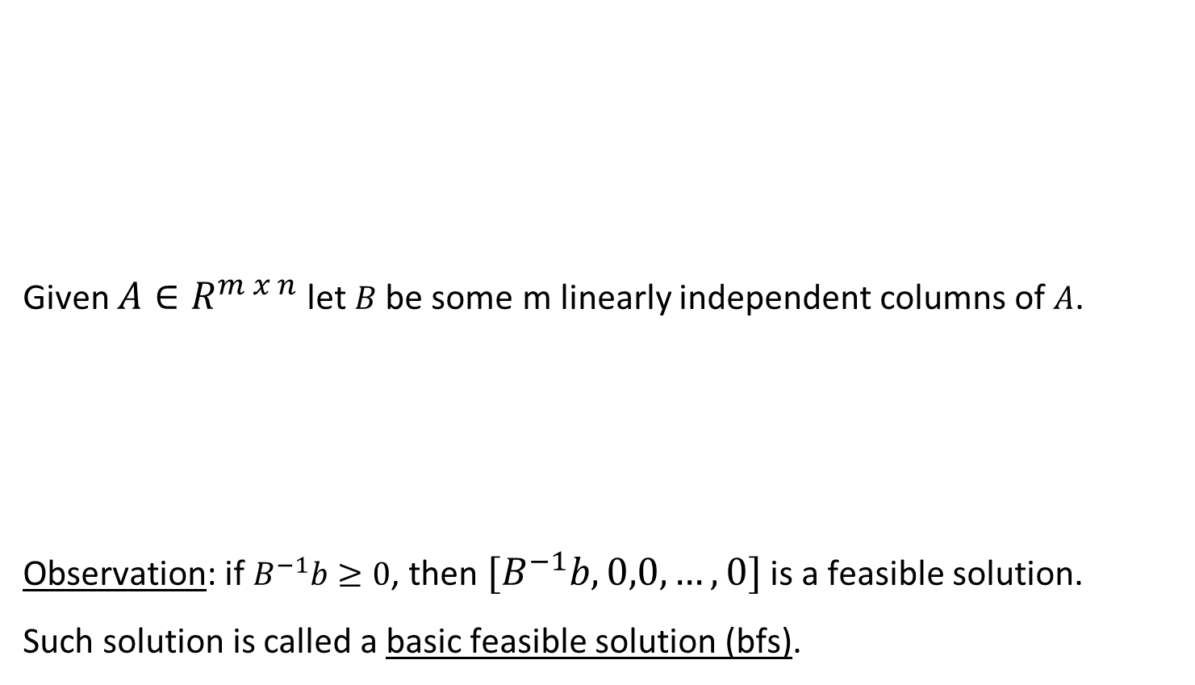
Linear Programming (minimization version)
1 | -1 | 0 | 2 | 1 | 3 | 0
2 | 1 | 0 | -2 | -4 | 1 | 0
0 | 0 | 2 | 0 | 1 | 6 | 2
2 | 0 | 0 | 2 | 0 | 0 | 0
1 | -3 | 0 | 1 | -1 | 0 | 1
2
1
0
4
-2
Minimize c^{T}x
Subject to: Ax >=b x >=0
Given $A∈R^{m x n}$ let $B$ be some m linearly independent columns of $A$.
Observation: if $B^{−1}b≥0$, then $[B^{−1}b,0,0,…,0]$ is a feasible solution.
Such solution is called a basic feasible solution (bfs).
A=
b=
1 | -1 | 0 | 2 | 1
2 | 1 | 0 | -2 | -4
0 | 0 | 2 | 0 | 1
2 | 0 | 0 | 2 | 0
1 | -3 | 0 | 1 | -1
B=

Slide 34
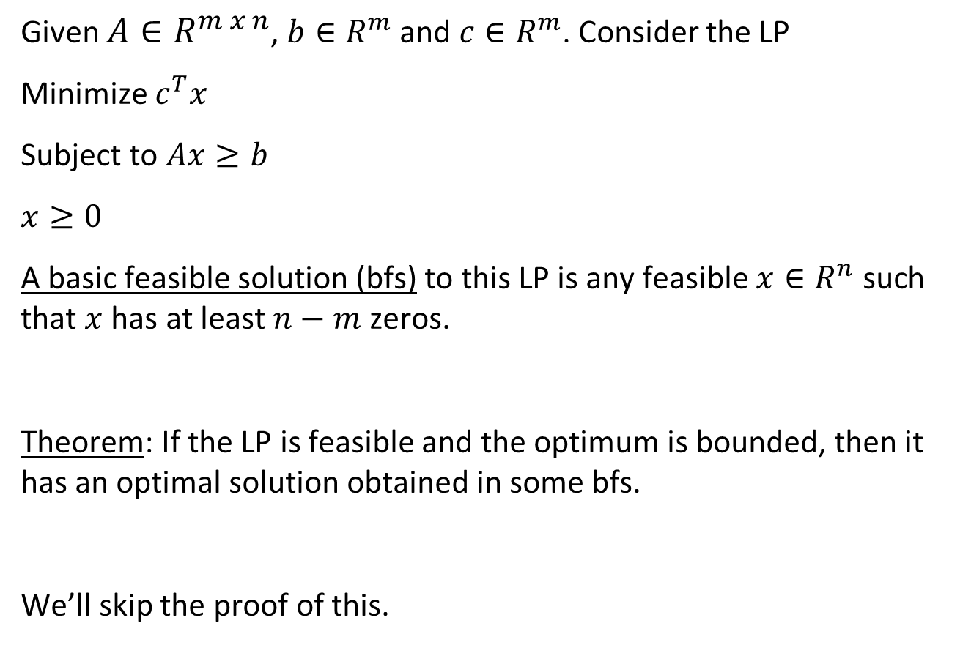
Linear Programming (minimization version)
Given $A∈R^{m x n}$, $b∈R^{m}$ and $c∈R^{m}$. Consider the LP
Minimize $c^{T}x$
Subject to $Ax≥b$
$$x≥0$$
A basic feasible solution (bfs) to this LP is any feasible $x∈R^{n}$ such that $x$ has at least $n−m$ zeros.
Theorem: If the LP is feasible and the optimum is bounded, then it has an optimal solution obtained in some bfs.
We’ll skip the proof of this.

Slide 35
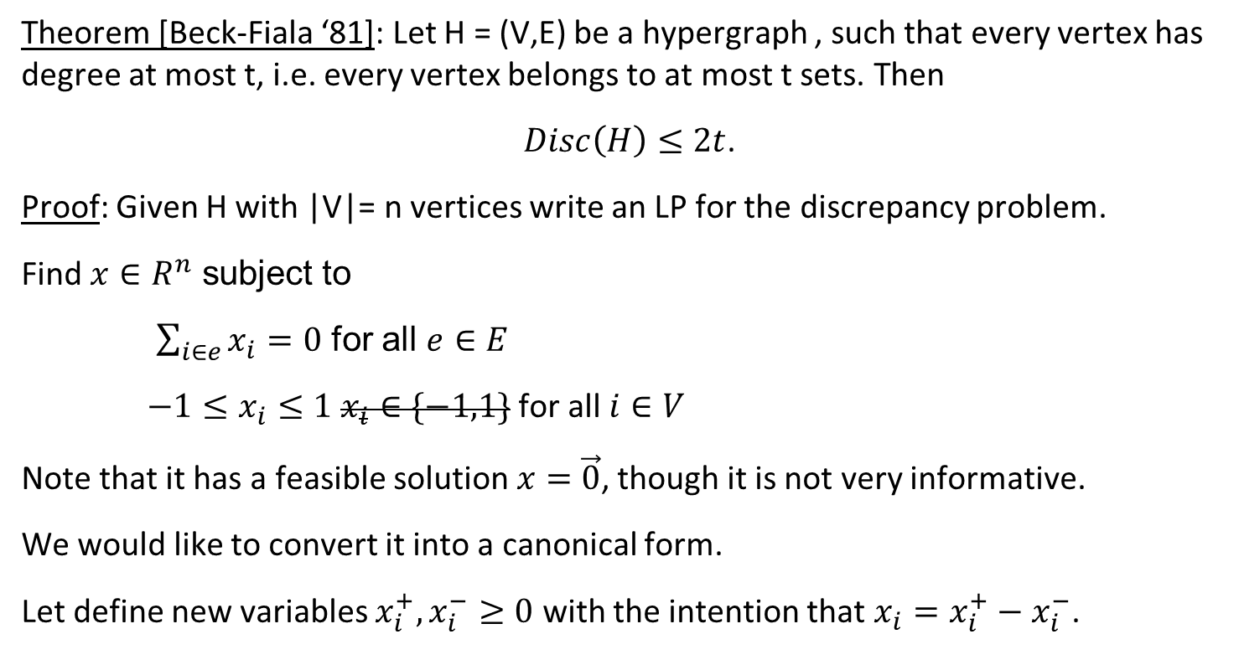
Discrepancy
Theorem [Beck-Fiala ‘81]: Let H = (V,E) be a hypergraph , such that every vertex has degree at most t, i.e. every vertex belongs to at most t sets. Then
$Disc\left(H\right)≤2t$.
Proof: Given H with |V|= n vertices write an LP for the discrepancy problem.
Find $x∈R^{n}$ subject to
$\sum_{i∈e}{x_{i}}=0$ for all $e∈E$
$−1≤x_{i}≤1$ $x_{i}∈\{−1,1\}$for all $i∈V$
Note that it has a feasible solution $x=\vec{0}$, though it is not very informative.
We would like to convert it into a canonical form.
Let define new variables $x_{i}^{+},x_{i}^{−}≥0$ with the intention that $x_{i}=x_{i}^{+}−x_{i}^{−}$.

Slide 36
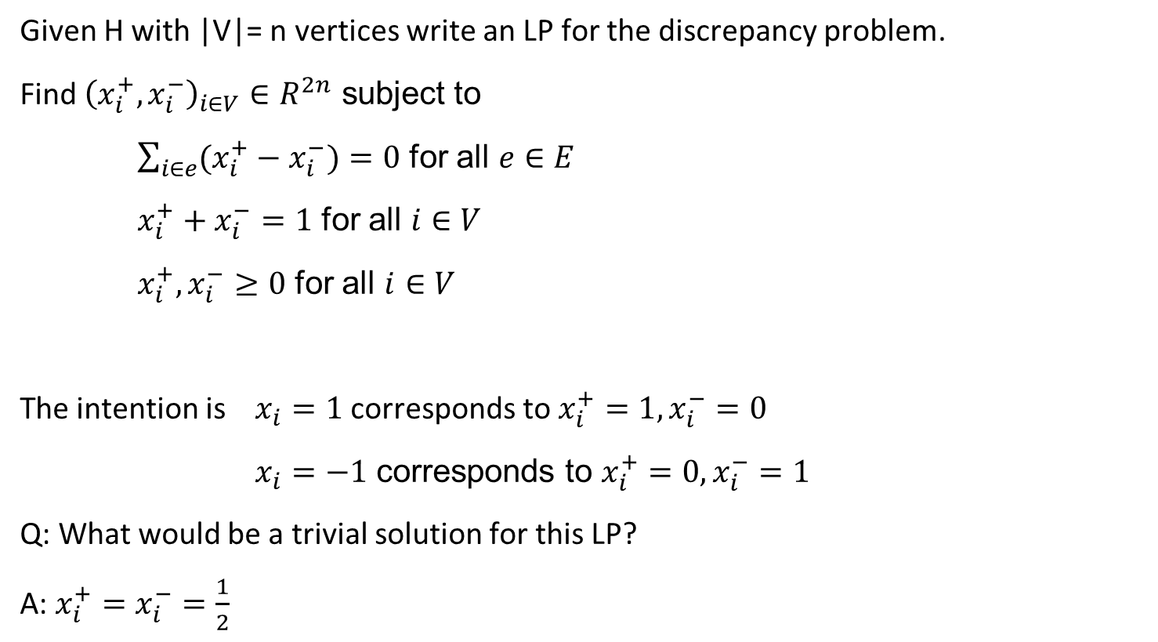
Discrepancy
Given H with |V|= n vertices write an LP for the discrepancy problem.
Find ${\left(x_{i}^{+},x_{i}^{−}\right)}_{i∈V}∈R^{2n}$ subject to
$\sum_{i∈e}{(x_{i}^{+}−x_{i}^{−}})=0$ for all $e∈E$
$x_{i}^{+}+x_{i}^{−}=1$ for all $i∈V$
$x_{i}^{+},x_{i}^{−}≥0$ for all $i∈V$
The intention is $x_{i}=1$ corresponds to $x_{i}^{+}=1,x_{i}^{−}=0$
$x_{i}=−1$ corresponds to $x_{i}^{+}=0,x_{i}^{−}=1$
Q: What would be a trivial solution for this LP?
A: $x_{i}^{+}=x_{i}^{−}=\frac{1}{2}$

Slide 37
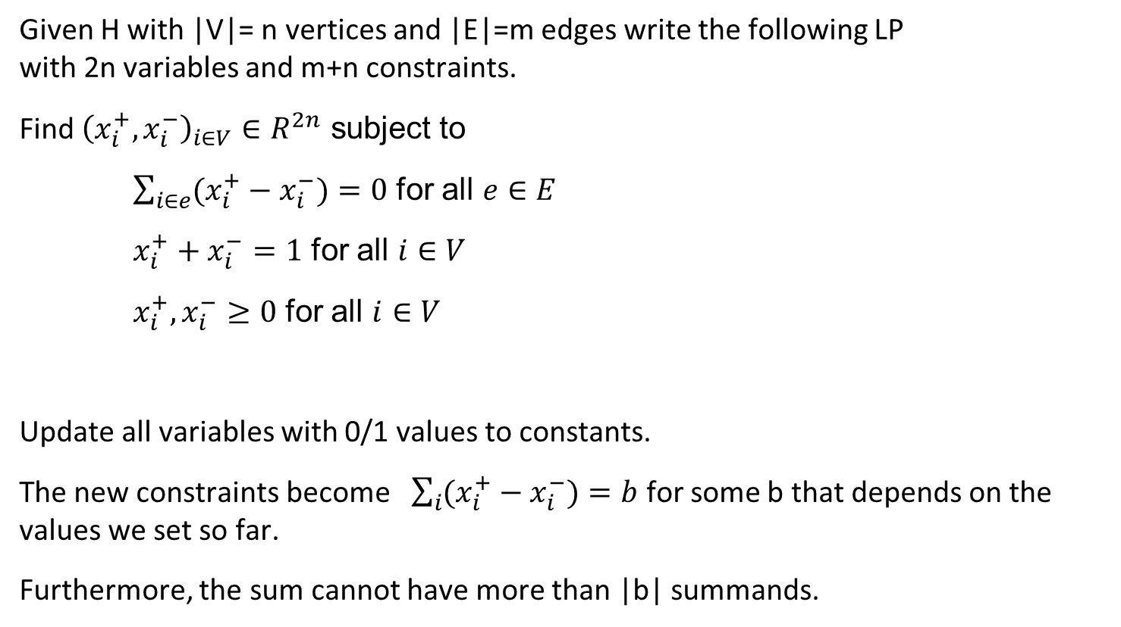
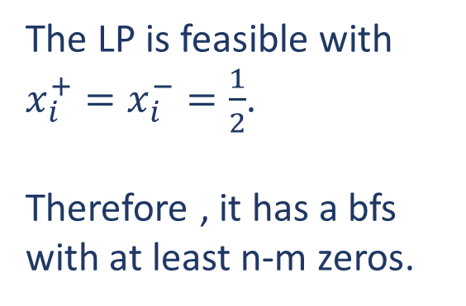
Discrepancy
Given H with |V|= n vertices and |E|=m edges write the following LP with 2n variables and m+n constraints.
Find ${\left(x_{i}^{+},x_{i}^{−}\right)}_{i∈V}∈R^{2n}$ subject to
$\sum_{i∈e}{(x_{i}^{+}−x_{i}^{−}})=0$ for all $e∈E$
$x_{i}^{+}+x_{i}^{−}=1$ for all $i∈V$
$x_{i}^{+},x_{i}^{−}≥0$ for all $i∈V$
Update all variables with 0/1 values to constants.
The new constraints become $\sum_{i}{(x_{i}^{+}−x_{i}^{−}})=b$ for some b that depends on the values we set so far.
Furthermore, the sum cannot have more than |b| summands.
The LP is feasible with $x_{i}^{+}=x_{i}^{−}=\frac{1}{2}$.
Therefore , it has a bfs with at least n-m zeros.

Slide 38
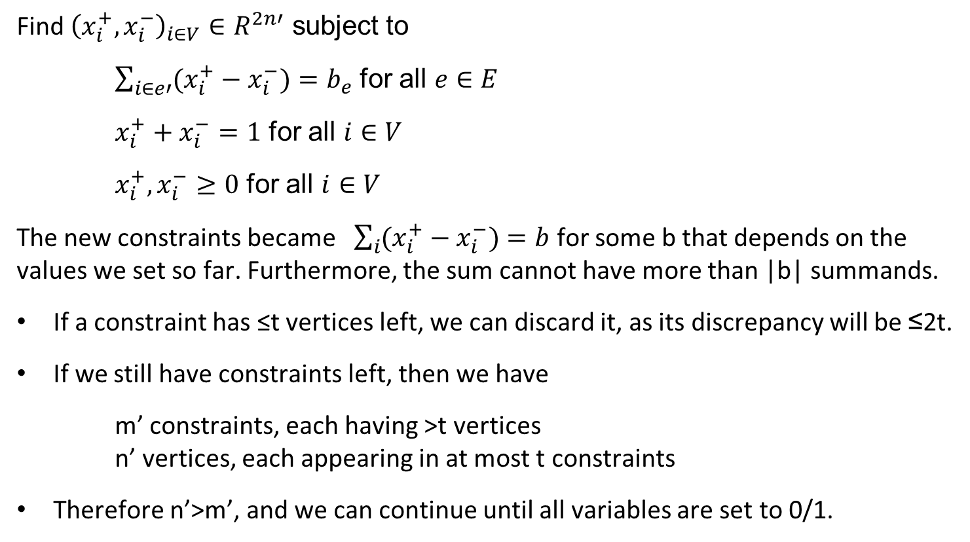
Discrepancy
The LP is still feasible
Therefore , it has a bfs with at least n’-m’>0 zeros.
Find ${\left(x_{i}^{+},x_{i}^{−}\right)}_{i∈V}∈R^{2n′}$ subject to
$\sum_{i∈e′}{(x_{i}^{+}−x_{i}^{−}})=b_{e}$ for all $e∈E$
$x_{i}^{+}+x_{i}^{−}=1$ for all $i∈V$
$x_{i}^{+},x_{i}^{−}≥0$ for all $i∈V$
The new constraints became $\sum_{i}{(x_{i}^{+}−x_{i}^{−}})=b$ for some b that depends on the values we set so far. Furthermore, the sum cannot have more than |b| summands.
If a constraint has ≤t vertices left, we can discard it, as its discrepancy will be ≤2t.
If we still have constraints left, then we have
m’ constraints, each having >t vertices n’ vertices, each appearing in at most t constraints
Therefore n’>m’, and we can continue until all variables are set to 0/1.

Slide 39

Discrepancy
Beck-Fiala Theorem: Let H = (V,E), s.t. every vertex has degree at most t, i.e. every vertex belongs to at most t sets. Then $Disc\left(H\right)≤2t$.
Beck-Fiala Conjecture: Let H = (V,E), s.t. every vertex has degree at most t, i.e. every vertex belongs to at most t sets. Then $Disc\left(H\right)<O(\sqrt{t}$).

Slide 40
Questions?
Comments?

