Slide 1
CMPT 409/815
Advanced Algorithms
October 14, 2020

Slide 2
Linear Programming
Applications

Slide 3
2-approximation for weighted min vertex cover

Slide 4
Weighted minimum vertex cover
We saw a combinatorial algorithm for 2-approximation for vertex cover.
Let’s consider the weighted version of the min vertex cover problem.
Input: a graph G=(V,E) , and weights w_{v}>=0
Goal: find a vertex cover C⊂V of G such that ∑_{v∈C} w_{v} is minimized.
It is not clear how to solve it combinatorially.
1
1
1
1
1
1
1
1
100
8
1
1
1
1
1
1
1
1
1

Slide 5
Weighted minimum vertex cover
Input: a graph G=(V,E) , and weights w_{v}>=0
Goal: find a vertex cover C⊂V of G such that ∑_{v∈C} w_{v} is minimized.
Algorithm: Consider the following LP:
The variables are x_{v} for each v∈V
minimize ∑_{v∈V} w_{v}x_{v}
subject to x_{u}+x_{v} >=1 for all (u,v) ∈E
0 <= x_{v} <=1 for all v∈V
Intention: if C is a vertex cover, then we can set x_{v}=1 if v∈C and x_{v}=0 if v∈V\C.
Therefore, OPT(LP)<=minVC(G)
Another trivial solution: x_{v}=1/2 for all v∈V (this is not very meaningful)

Slide 6
Weighted minimum vertex cover
Input: a graph G=(V,E) , and weights w_{v}>=0
Goal: find a vertex cover C⊂V of G such that ∑_{v∈C} w_{v} is minimized.
Algorithm: Consider the following LP:
The variables are x_{v} for each v∈V
minimize ∑_{v∈V} w_{v}x_{v}
subject to x_{u}+x_{v} >=1 for all (u,v) ∈E
0 <= x_{v} <=1 for all v∈V
Solve the LP.
Let S = {v∈V : x_{v}>=0.5}.
Output S

Slide 7
Weighted minimum vertex cover
Algorithm: Consider the following LP:
The variables are x_{v} for each v∈V
minimize ∑_{v∈V} w_{v}x_{v}
subject to x_{u}+x_{v} >=1 for all (u,v) ∈E
0 <= x_{v} <=1 for all v∈V
Before we continue let’s make the following observation:
Observation: OPT(LP) <= minVC(G).
Proof: let x* be the optimal solution to LP, and let C be a min vertex cover of G.
Then we can set x_{v}=1 if v∈C and x_{v}=0 if v∈V\C (be an integer solution)
Therefore, OPT(LP) = ∑_{v∈V} w_{v}x*_{v} <= ∑_{v∈V} w_{v}x_{v} = minVC(G)

Slide 8
Weighted minimum vertex cover
minimize ∑_{v∈V} w_{v}x_{v}
subject to x_{u}+x_{v} >=1 for all (u,v) ∈E 0 <= x_{v} <=1 for all v∈V
Solve the LP. Let S = {v∈V : x_{v}>=0.5}. Output S
Claim1: S is vertex cover.
Proof: Let x be any feasible solution. Then for any (u,v) ∈E we have x_{u}+x_{v} >=1.
Therefore, either x_{u} or x_{v} are at least ½, and hence one of them is in S.

Slide 9
Weighted minimum vertex cover
minimize ∑_{v∈V} w_{v}x_{v}
subject to x_{u}+x_{v} >=1 for all (u,v) ∈E 0 <= x_{v} <=1 for all v∈V
Solve the LP. Let S = {v∈V : x_{v}>=0.5}. Output S
Claim2: w(S) <= 2OPT(LP) <= 2minVC(G).
Proof: Let x* be the optimal solution
OPT(LP) = ∑_{v∈V} w_{v}x*_{v} >= ∑_{v∈S} w_{v}x*_{v} >= 0.5*∑_{v∈S} w_{v} = 0.5*w(S)
Therefore, w(S) <= 2OPT(LP),
And by the observation from before we have 2OPT(LP)<=2minVC(G).

Slide 10
Weighted minimum vertex cover
Algorithm: Consider the following LP:
minimize ∑_{v∈V} w_{v}x_{v}
subject to x_{u}+x_{v} >=1 for all (u,v) ∈E 0 <= x_{v} <=1 for all v∈V
Solve the LP. Let S = {v∈V : x_{v}>=0.5}. Output S
We proved: (1) S is a vertex cover of G and (2) w(S) <= 2OPT(G).
Therefore, the algorithm is a 2-approximation for the weighted minVC problem.

Slide 11
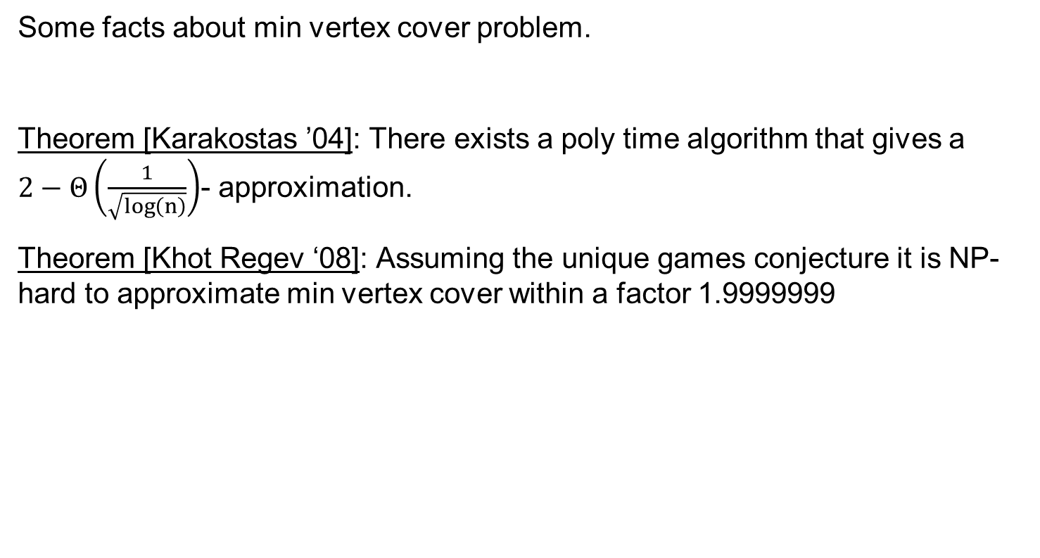
Weighted minimum vertex cover
Some facts about min vertex cover problem.
Theorem [Karakostas ’04]: There exists a poly time algorithm that gives a $2−Θ\left(\frac{1}{\sqrt{\log\left(n\right)}}\right)$- approximation.
Theorem [Khot Regev ‘08]: Assuming the unique games conjecture it is NP-hard to approximate min vertex cover within a factor 1.9999999

Slide 12
O(ln(n))-approximation for weighted set-cover

Slide 13
O(ln(n)) approximation for weighted Set Cover
Input: A universe U = {a₁…a_{n}}, and S₁…S_{m} - m subsets of U with costs w_{i}>0
Output: Find a cheapest collection of sets that cover all elements {a₁…a_{n}}

Slide 14
O(ln(n)) approximation for weighted Set Cover
We saw a ln(n)-approximation for the min Set Cover problem.
Next, we will see an O(ln(n))-approximation for the weighted min Set Cover.
In your homework you will improve it to 1.001 ln(n) approximation

Slide 15
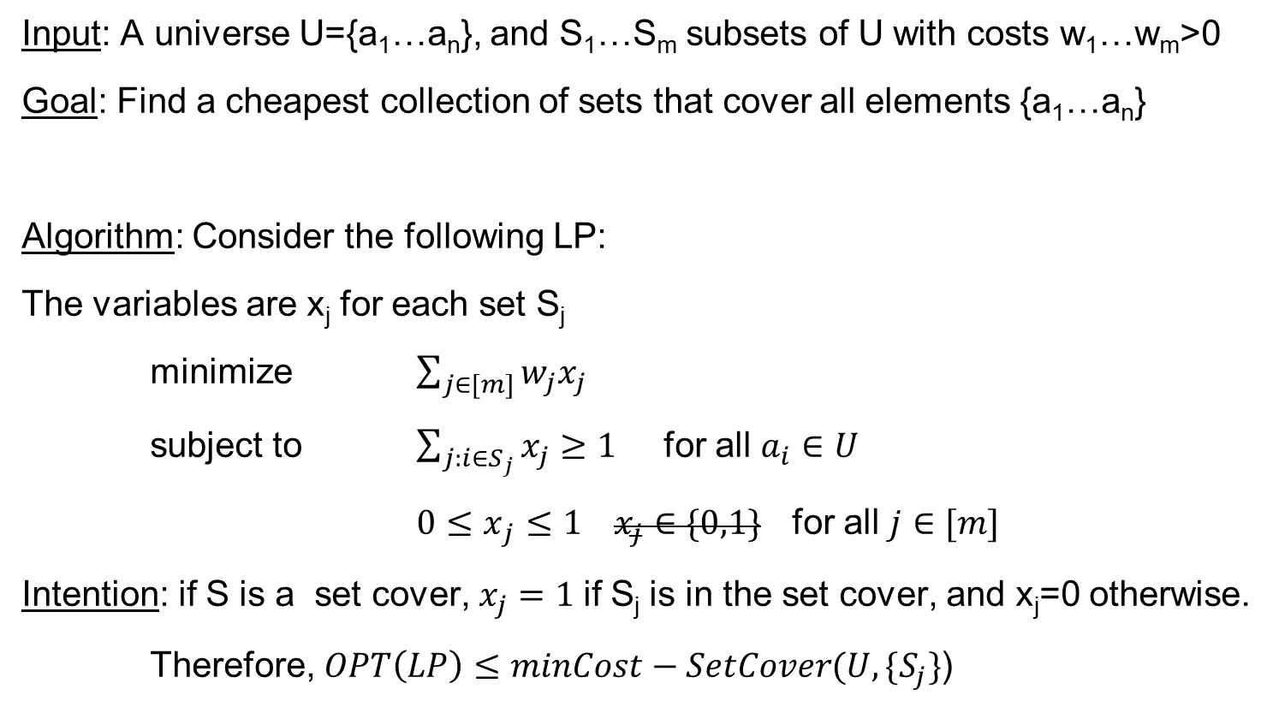
O(ln(n)) approximation for weighted Set Cover
Input: A universe U={a₁…a_{n}}, and S₁…S_{m} subsets of U with costs w₁…w_{m}>0
Goal: Find a cheapest collection of sets that cover all elements {a₁…a_{n}}
Algorithm: Consider the following LP:
The variables are x_{j} for each set S_{j}
minimize $\sum_{j∈[m]}{w_{j}x_{j}}$
subject to $\sum_{j:i∈S_{j}}{x_{j}}≥1$ for all $a_{i}∈U$
${0≤x}_{j}≤1 x_{j}∈\{0,1\}$ for all $j∈[m]$
Intention: if S is a set cover, $x_{j}=1$if S_{j} is in the set cover, and x_{j}=0 otherwise.
Therefore, $OPT\left(LP\right)≤minCost−SetCover(U,\{S_{j}\}$)

Slide 16
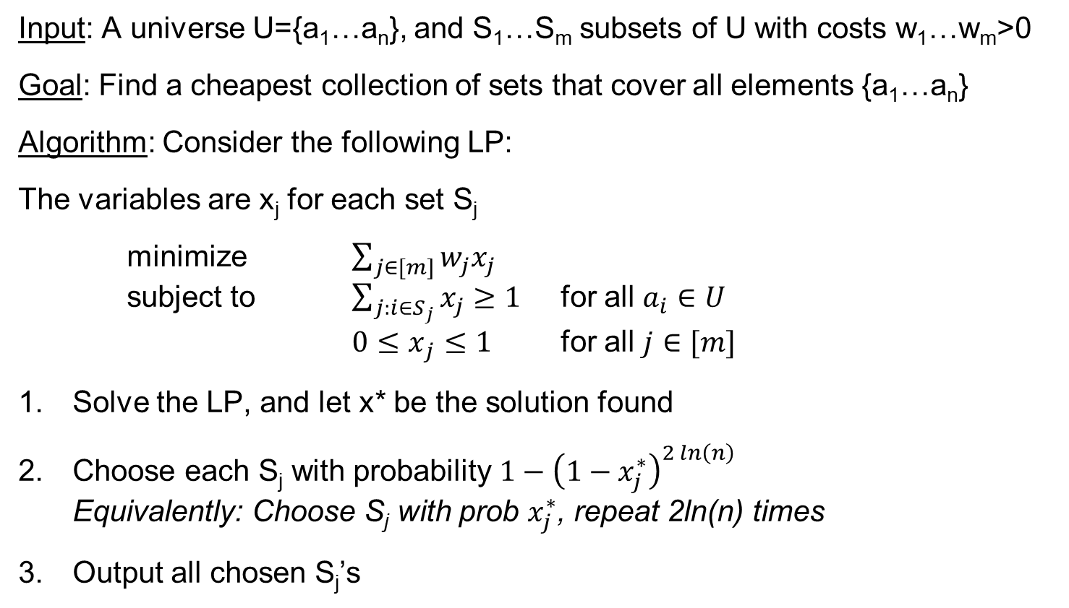
O(ln(n)) approximation for weighted Set Cover
Input: A universe U={a₁…a_{n}}, and S₁…S_{m} subsets of U with costs w₁…w_{m}>0
Goal: Find a cheapest collection of sets that cover all elements {a₁…a_{n}}
Algorithm: Consider the following LP:
The variables are x_{j} for each set S_{j}
minimize $\sum_{j∈[m]}{w_{j}x_{j}}$ subject to $\sum_{j:i∈S_{j}}{x_{j}}≥1$ for all $a_{i}∈U$ ${0≤x}_{j}≤1$ for all $j∈[m]$
Solve the LP, and let x* be the solution found
Choose each S_{j} with probability $1−{\left(1−x_{j}^{∗}\right)}^{2\ln\left(n\right)}$ Equivalently: Choose S_{j} with prob $x_{j}^{∗}$, repeat 2ln(n) times
Output all chosen S_{j}’s

Slide 17
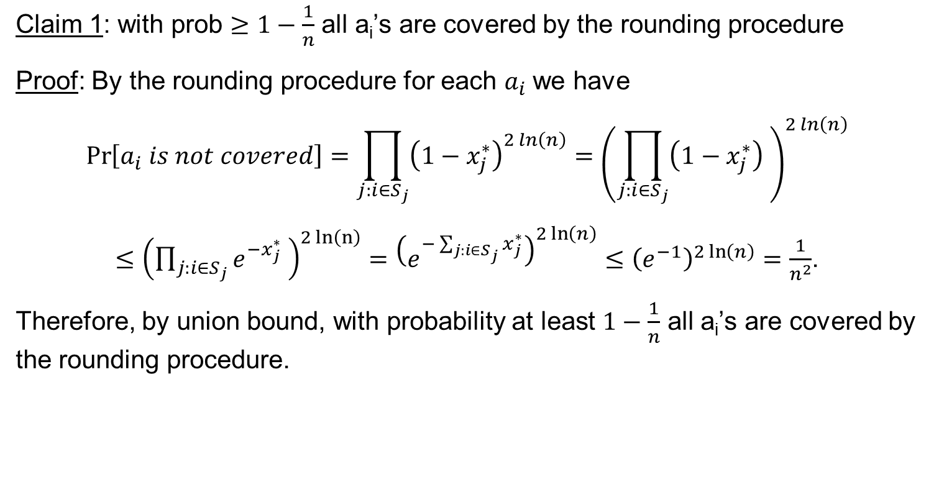
O(ln(n)) approximation for weighted Set Cover
Claim 1: with prob $≥1−\frac{1}{n}$ all a_{i}’s are covered by the rounding procedure
Proof: By the rounding procedure for each $a_{i}$we have
$$\operatorname{Pr}\left[a_{i} is not covered\right]=\prod_{j:i∈S_{j}}{{\left(1−x_{j}^{∗}\right)}^{2\ln\left(n\right)}}={\left(\prod_{j:i∈S_{j}}{\left(1−x_{j}^{∗}\right)} \right)}^{2\ln\left(n\right)}$$
$≤{\left(\prod_{j:i∈S_{j}}{e^{{−x}_{j}^{∗}}} \right)}^{2\ln\left(n\right)}={\left(e^{−\sum_{j:i∈S_{j}}{x_{j}^{∗}}}\right)}^{2\ln\left(n\right)}≤{\left(e^{−1}\right)}^{2\ln\left(n\right)}=\frac{1}{n^{2}}$.
Therefore, by union bound, with probability at least $1−\frac{1}{n}$ all a_{i}’s are covered by the rounding procedure.

Slide 18
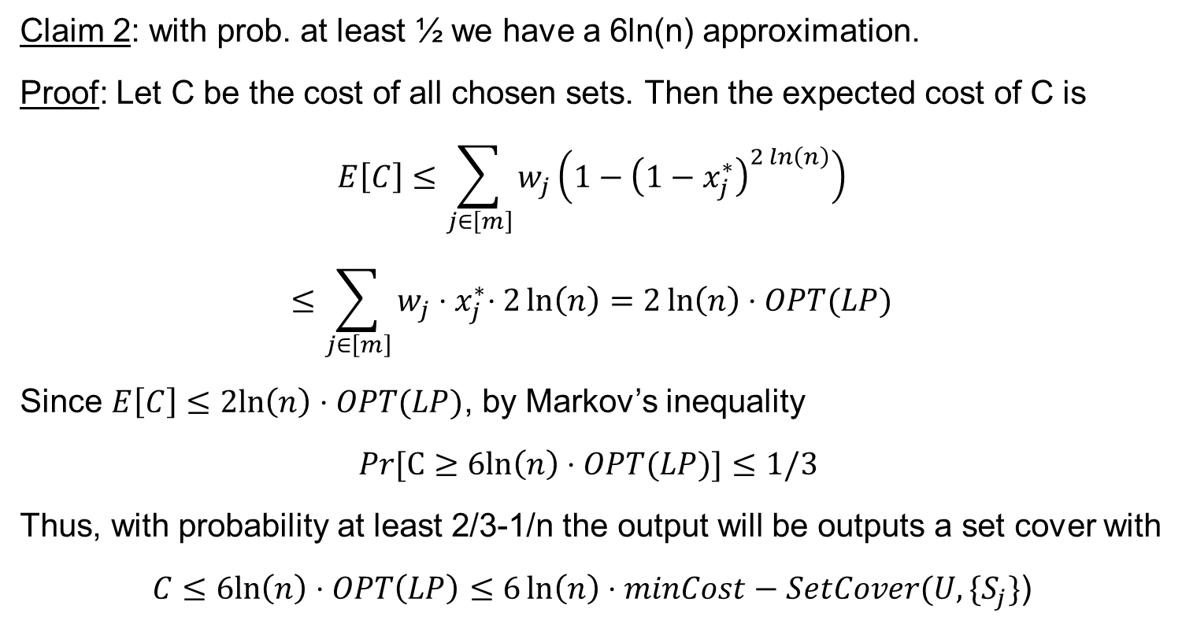
O(ln(n)) approximation for weighted Set Cover
Claim 2: with prob. at least ½ we have a 6ln(n) approximation.
Proof: Let C be the cost of all chosen sets. Then the expected cost of C is
$$E\left[C\right]≤\sum_{j∈\left[m\right]}{w_{j}}\left(1−{\left(1−x_{j}^{∗}\right)}^{2\ln\left(n\right)}\right)$$
$$≤\sum_{j∈\left[m\right]}{w_{j}{⋅x}_{j}^{∗}⋅2\ln\left(n\right)}=2\ln\left(n\right)⋅OPT(LP)$$
Since $E\left[C\right]≤2ln\left(n\right)⋅OPT(LP)$, by Markov’s inequality
$$Pr[C≥6ln\left(n\right)⋅OPT(LP)]≤1/3$$
Thus, with probability at least 2/3-1/n the output will be outputs a set cover with
$$C≤6ln\left(n\right)⋅OPT\left(LP\right)≤6\ln\left(n\right)⋅minCost−SetCover(U,\{S_{j}\}\text{)}$$

Slide 19
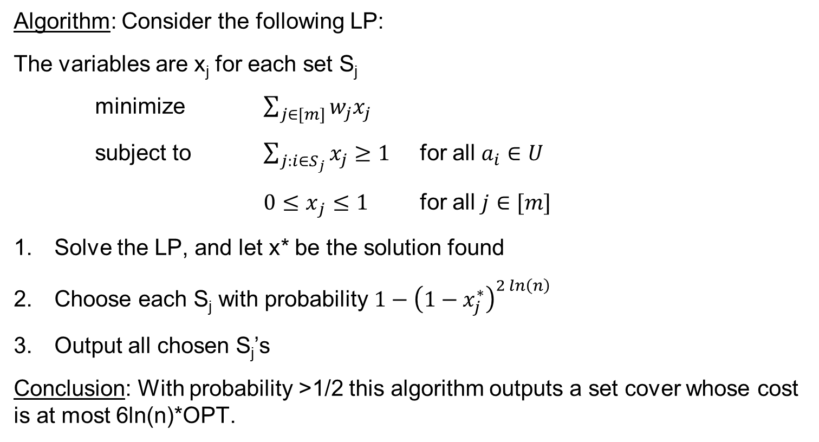
O(ln(n)) approximation for weighted Set Cover
Algorithm: Consider the following LP:
The variables are x_{j} for each set S_{j}
minimize $\sum_{j∈[m]}{w_{j}x_{j}}$
subject to $\sum_{j:i∈S_{j}}{x_{j}}≥1$ for all $a_{i}∈U$
${0≤x}_{j}≤1$ for all $j∈[m]$
Solve the LP, and let x* be the solution found
Choose each S_{j} with probability $1−{\left(1−x_{j}^{∗}\right)}^{2\ln\left(n\right)}$
Output all chosen S_{j}’s
Conclusion: With probability >1/2 this algorithm outputs a set cover whose cost is at most 6ln(n)*OPT.

Slide 20
Questions?
Comments?

