Slide 1
CMPT 409/815
Advanced Algorithms
September 30, 2020

Slide 2
Announcements
First assignment is online.
Submit your solutions to Coursys by October 7, 2020
Office hours: Wednesdays 11:30, after the lecture.
Link to zoom on course homepage

Slide 3
Plan for today
Isolation Lemma
Min weight perfect matching in bipartite graphs

Slide 4
Finding a minimum weight perfect matching in bipartite graphs

Slide 5
Min-weight perfect matchings
Input: A bipartite graph G = (U,V,E) with weights on the edges.
Goal: Find a perfect matching in G of minimal weight.
We may assume that the graph is a complete bipartite graph, and missing edges have some huge weight.

Slide 6
Min-weight perfect matchings
Input: A bipartite graph G = (U,V,E) with |U| = |V| = n and integer weights w_{i,j}>0
Goal (min value version): Output the weight of a min-weight perfect matching.
A simplifying (though weird) assumption: Suppose that G has a unique perfect matching of minimal weight.
Algorithm for the min value version:
Define nxn matrix A over reals as A_{i,j} = 10^{wij}
Compute the determinant of A
Output the largest k such that det(A) is divisible by 10^{k}
Example, if det(A) = 4150100, then we output 2 (because 10² divides det(A))
What’s going on here???

Slide 7
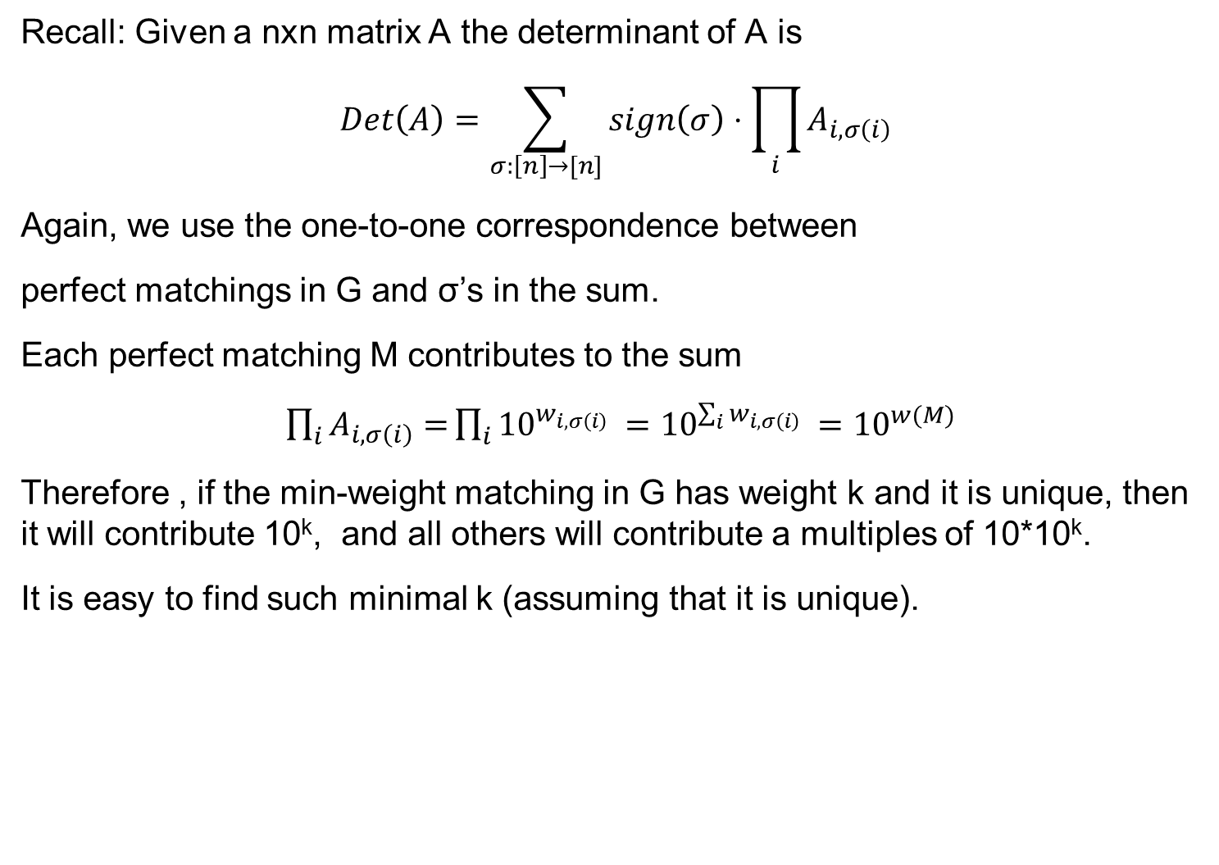
Min-weight perfect matchings
Recall: Given a nxn matrix A the determinant of A is
$$Det\left(A\right)=\sum_{σ:\left[n\right]→[n]}{sign\left(σ\right)⋅\prod_{i}{A_{i,σ\left(i\right)}}}$$
Again, we use the one-to-one correspondence between
perfect matchings in G and σ’s in the sum.
Each perfect matching M contributes to the sum
$\prod_{i}{A_{i,σ\left(i\right)}=}\prod_{i}{{10}^{w_{i,σ\left(i\right)} }={10}^{\sum_{i}{w_{i,σ\left(i\right)}} }}={10}^{w(M)}$
Therefore , if the min-weight matching in G has weight k and it is unique, then it will contribute 10^{k}, and all others will contribute a multiples of 10*10^{k}.
It is easy to find such minimal k (assuming that it is unique).
Why can we assume that the min-weight PM is unique?

Slide 8
Isolation Lemma

Slide 9
Isolation Lemma
Isolation Lemma: Fix a set U, let T₁, T₂…⊆U. Fix an integer S.
For each x∈U choose w_{x} ∈{1,2,…S} uniformly independently.
For each T define w(T) = 𝛴_{x ∈T}w_{x}.
Then Pr[there is a unique T_{i} of minimum weight] > 1 – U/S
Note that the probability is independent of the number of sets
(which is pretty surprising)
For our applications, the edges of G will be associated with the set U,
and each T_{i} will correspond to some perfect matching in G.

Slide 10
Isolation Lemma
Isolation Lemma: Fix a set U, let T₁, T₂…⊆U. Fix an integer S.
For each x∈U choose w_{x} ∈{1,2,…S} uniformly independently.
For each T define w(T) = 𝛴_{x ∈T}w_{x}.
Then Pr[there is a unique T_{i} of minimum weight] > 1 – U/S
Proof: Let E_{x} be the event that min{w(T_{i}) : x∈T_{i}} = min{w(T_{i}) : x ∉T_{i}}
Claim1: Pr[E_{x}] <= 1/S for all x∈U
Claim2: If none of the E_{x} holds, then there is a unique T_{i} of min weight.
Therefore, Pr[there is a unique T_{i} of minimum weight] > 1-𝛴_{x ∈U}Pr[E_{x}]>1-U/S.

Slide 11
Isolation Lemma
Let E_{x} be the event that min{w(T_{i}) : x∈T_{i}} = min{w(T_{i}) : x ∉T_{i}}
Claim1: Pr[E_{x}] <= 1/S for all x∈U
Proof: Fix all random choices of w’s except for w_{x}.
So we are only left with sampling the value of w_{x}.
Then A = min{w(T_{i}) : x ∉T_{i}} is defined, and it is independent of w_{x}.
Also, denoted B = min{w(T_{i}\{x}) : x∈T_{i}} is defined and independent of w_{x}.
Furthermore, min{w(T_{i}) : x∈T_{i}} = B + w_{x}.
Hence, for min{w(T_{i}) : x∈T_{i}} = min{w(T_{i}) : x ∉T_{i}} to happen, we need w_{x} = A-B.
Therefore, Pr[E_{x}] = Pr[w_{x} = A-B] <= 1/S.

Slide 12
Isolation Lemma
Let E_{x} be the event that min{w(T_{i}) : x∈T_{i}} = min{w(T_{i}) : x ∉T_{i}}
Claim2: If none of the E_{x} holds, then there is a unique T_{i} of min weight.
Proof: We prove the contrapositive. Namely, we show that if the minimum is not unique, then E_{x} holds for some x∈U.
Suppose toward contradiction that w(T_{i}) = w(T_{j}) for some i≠j have both minimum weight.
In particular, there exists some x in one of the sets but not in the other.
Let’s say x ∈T_{i} but x ∉T_{j}.
Since both are of min weight, it follows that min{w(T_{i}) : x∈T_{i}}=min{w(T_{i}) : x ∉T_{i}}.
Therefore, E_{x} holds.

Slide 13
Isolation Lemma
Isolation Lemma: Fix a set U, let T₁, T₂…⊆U. Fix an integer S.
For each x∈U choose w_{x} ∈{1,2,…S} uniformly independently.
For each T define w(T) = 𝛴_{x ∈T}w_{x}.
Then Pr[there is a unique T_{i} of minimum weight] > 1 – U/S
Proof: Let E_{x} be the event that min{w(T_{i}) : x∈T_{i}} = min{w(T_{i}) : x ∉T_{i}}
Claim1: Pr[E_{x}] <= 1/S for all x∈U.
Claim2: If none of the E_{x} holds, then there is a unique T_{i} of min weight.
Therefore, Pr[there is a unique T_{i} of minimum weight] > 1-𝛴_{x ∈M}Pr[E_{x}]>1-U/S.

Slide 14
Finding a minimum weight perfect matching in bipartite graphs

Slide 15
Min-weight perfect matchings
Input: A bipartite graph G = (U,V,E) with |U| = |V| = n and integer weights w_{e}>0
Goal (min value version): Output the weight of a min-weight perfect matching.
Algorithm:
For each edge e∈E choose a random r_{e}∈{1…S}
Define w*_{e} = w_{e}⋅(Sn+1) + r_{e}
Define nxn matrix A over reals as A_{i,j} = 10^{w*ij}
Compute the determinant of A
Let k be maximal such that such that det(A) is divisible by 10^{k}
Output round-down[ k/(Sn+1) ]

Slide 16
Min-weight perfect matchings
Analysis:
For each perfect matching M in G we have
w*(M) = 𝛴_{e∈M}w*_{e} = (nS+1)𝛴_{e∈M}w_{e} + 𝛴_{e∈M}r_{e}= (nS+1)w(M) + 𝛴_{e∈M}r_{e}
Note that 𝛴_{e∈M}r_{e}<nS, and hence if we know w*(M), then
w(M) = round-down[w*(M)/(nS+1)]
Furthermore, by Isolation Lemma, if S=n³, then
Pr[there is a unique PM w.r.t. w*] > 1 – |E|/S>1-1/n.
Therefore, with probability at least 1-|E|/S the algorithm will output the weight of the min-weight perfect matching in G.

Slide 17
Perfect matching in general graphs
So far, we have discussed perfect matchings in bipartite graphs.
In HW2 you will design an algorithm that finds a perfect matching in general (non-bipartite) graphs.

Slide 18
Questions?
Comments?

