Slide 1
CMPT 409/815
Advanced Algorithms
September 28, 2020

Slide 2
Announcements
First assignment is online.
Submit your solutions to Coursys by October 7, 2020
Office hours: Wednesdays 11:30, after the lecture.
Link to zoom on course homepage

Slide 3
Plan for today
Polynomial identity testing
Applications: Finding perfect matching in bipartite graphs

Slide 4
Polynomial Identity Testing

Slide 5
Polynomial Identity Testing
Easy Fact: Let p:F→ F be a non-zero polynomial of degree at most d.
Then, p has at most d zeros.
For example: p(x) = x³+ 4x+1 has at most 3 zeros.
Stated differently:
For any set S⊆F if we choose x∈S uniformly, then Pr[p(x) = 0] <= d/|S|
Schwartz-Zippel Lemma: Let p(x₁,x₂,…x_{n}) be a non-zero polynomial of total degree at most d. Let S⊆F be a subset of the field F.
If we choose x₁,x₂,…x_{n}∈S uniformly, independently, then
Pr[p(x₁,x₂,…x_{n}) = 0] < d/|S|
Examples:
p(x,y) = x⁴ + y² + 4xy² has degree 4
q(x,y,z) = x²y + x²yz³ + 7y² - 4x²z² has degree 6
r(x,y,z) = x + y + xy + xz has degree 2

Slide 6
Polynomial Identity Testing
Schwartz-Zippel Lemma: Let p(x₁,x₂,…x_{n}) be a non-zero polynomial of total degree at most d. Let S⊆F be a subset of the field F.
If we choose x₁,x₂,…x_{n}∈S uniformly, independently, then
Pr[p(x₁,x₂,…x_{n}) = 0] < d/|S|
This looks very useful:
If we can phrase a problem as a checking if a polynomial is identically zero, then we can check by choosing a large enough S, and checking p(x) at a random point x∈S^{n}.
If p is not identically zero, then it is highly unlikely that p(x) will be zero.

Slide 7
Polynomial Identity Testing
Schwartz-Zippel Lemma: Let p(x₁,x₂,…x_{n}) be a non-zero polynomial of total degree at most d. Let S⊆F be a subset of the field F.
If we choose x₁,x₂,…x_{n}∈S uniformly, independently, then
Pr[p(x₁,x₂,…x_{n}) = 0] < d/|S|
Equivalently: Let p(x₁,x₂,…x_{n}) and q(x₁,x₂,…x_{n}) be two distinct polynomials of total degree at most d. Let S⊆F be a subset of the field F.
If we choose x₁,x₂,…x_{n}∈S uniformly, independently, then
Pr[p(x₁,x₂,…x_{n}) = q(x₁,x₂,…x_{n})] < d/|S|

Slide 8
Polynomial Identity Testing
Schwartz-Zippel Lemma: Let p(x₁,x₂,…x_{n}) be a non-zero polynomial of total degree at most d. Let S⊆F be a subset of the field F.
If we choose x₁,x₂,…x_{n}∈S uniformly, independently, then
Pr[p(x₁,x₂,…x_{n}) = 0] < d/|S|
Proof: Induction on the number of variables.
Base case: n=1 – follows from the discussion before.
Induction step: Suppose n>1. Let k be the largest power of x_{n}.
Then we can write p(x₁,x₂,…x_{n}) =(x_{n})^{k} q(x₁,x₂,…x_{n-1})+r(x₁,x₂,…x_{n}).

Slide 9
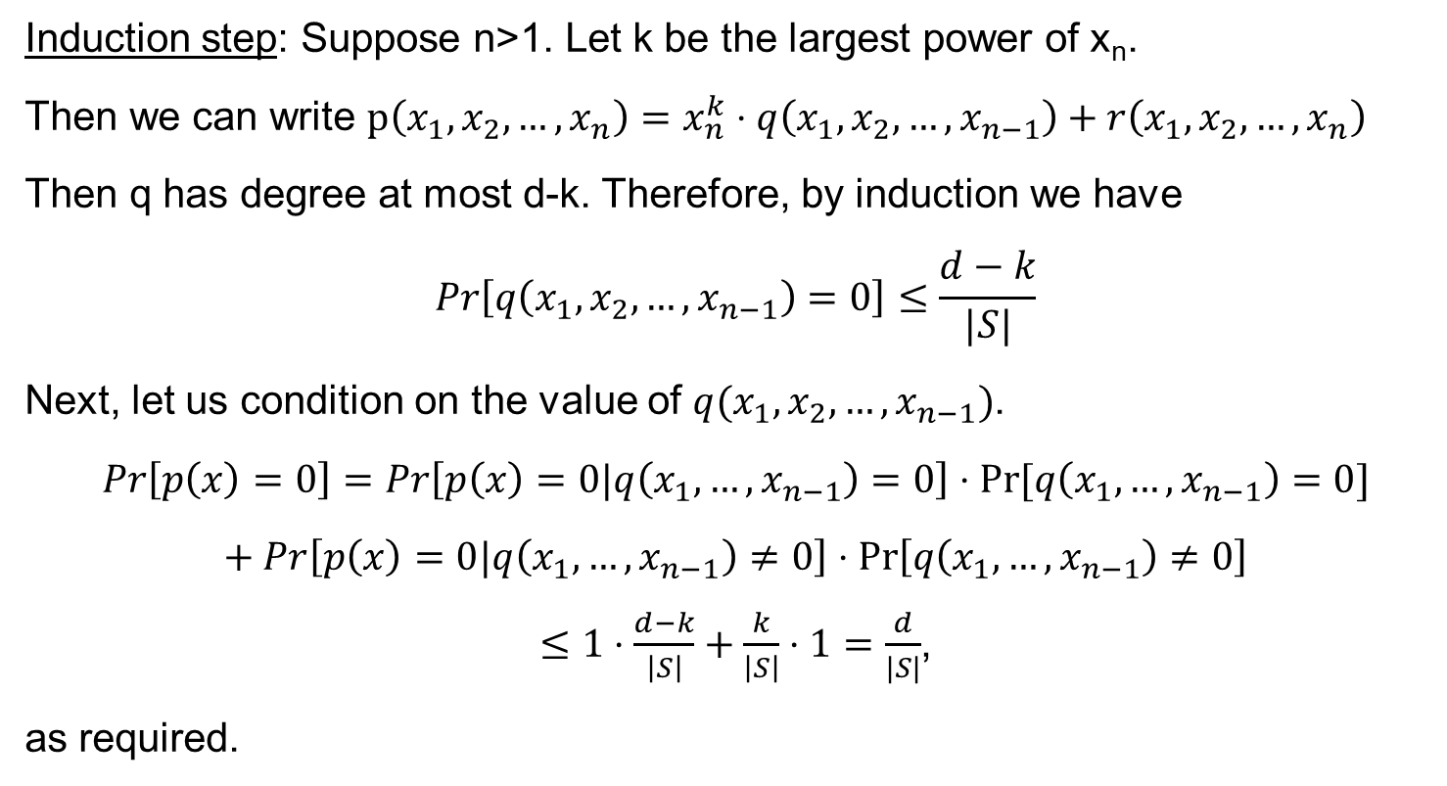
Polynomial Identity Testing
Induction step: Suppose n>1. Let k be the largest power of x_{n}.
Then we can write $p\left(x_{1},x_{2},…,x_{n}\right)=x_{n}^{k}⋅q\left(x_{1},x_{2},…,x_{n−1}\right)+r\left(x_{1},x_{2},…,x_{n}\right)$
Then q has degree at most d-k. Therefore, by induction we have
$$Pr\left[q\left(x_{1},x_{2},…,x_{n−1}\right)=0\right]≤\frac{d−k}{|S|}$$
Next, let us condition on the value of $q(x_{1},x_{2},…,x_{n−1})$.
$$Pr\left[p\left(x\right)=0\right]=Pr\left[p\left(x\right)=0|q\left(x_{1},…,x_{n−1}\right)=0\right]⋅Pr⁡[q\left(x_{1},…,x_{n−1}\right)=0]$$
$$+ Pr\left[p\left(x\right)=0|q\left(x_{1},…,x_{n−1}\right)≠0\right]⋅\operatorname{Pr}\left[q\left(x_{1},…,x_{n−1}\right)≠0\right]$$
$≤1⋅\frac{d−k}{\left|S\right|}+\frac{k}{\left|S\right|}⋅1=\frac{d}{|S|}$,
as required.

Slide 10
Verifying matrix multiplication - revisited

Slide 11
Verifying matrix multiplication - revisited
Input: Three NxN (real/integer) matrices A,B,C
Goal: check if A*B = C
Theorem: There exists an algorithm that runs in O(N²) time and returns the correct answer with probability > 0.999.
Freivalds' algorithm: On input A,B,C
Repeat 10 times
  Sample v∈{0,1}^{N} by picking each v_{i} to be 0/1 w.p. ½ independently
  Compute z = A*B*v (in O(N²) time)
  Compute z’ = C*v (in O(N²) time)
  If z≠z’ return “NOT EQUAL”
If reached here, return “EQUAL”

Slide 12
Verifying matrix multiplication - revisited
Goal: Given three NxN (real/integer) matrices A,B,C, check if A*B = C
Theorem: There exists an algorithm that runs in O(N²) time and returns the correct answer with probability > 0.999.
Recall: The analysis boils down to checking if a given matrix D∈R^{NxN} is identically zero or not.
We do it by picking a random v∈S^{N} and checking if Dv is the all-zero vector.
Equivalently, we can phrase the problem as polynomial identity testing:
Let p_{i}(v₁,v₂,…v_{n}) = D_{i,1}v₁ + D_{i,2}v₂ + … D_{i,n}v_{n} be the inner product with the i'th row.
If one of the p_{i}’s is not zero, then Pr[p_{i}(v₁,v₂,…v_{n}) = 0] < 1/|S|

Slide 13
Finding a perfect matching in a bipartite graph

Slide 14
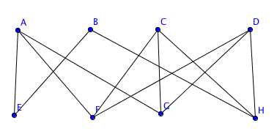
Perfect matching in a bipartite graph
Input: A bipartite graph G = (U,V,E).
Goal: Find a perfect matching in G, or report that there is no perfect matching.
You can probably solve it using max flow algorithms.
Today, we’ll see a different method that uses the polynomial method

Slide 15
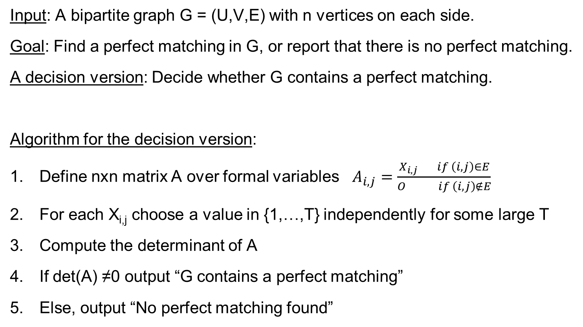
Perfect matching in a bipartite graph
Input: A bipartite graph G = (U,V,E) with n vertices on each side.
Goal: Find a perfect matching in G, or report that there is no perfect matching.
A decision version: Decide whether G contains a perfect matching.
Algorithm for the decision version:
Define nxn matrix A over formal variables $A_{i,j}=\frac{X_{i,j} if \left(i,j\right)∈E}{O if \left(i,j\right)∉E}$
For each X_{i,j} choose a value in {1,…,T} independently for some large T
Compute the determinant of A
If det(A) ≠0 output “G contains a perfect matching”
Else, output “No perfect matching found”
What is the runtime of this algorithm?

Slide 16
Perfect matching in a bipartite graph
HW2: Prove that if the decision algorithm outputs the correct answer w.h.p.,
then the decision algorithm succeeds w.h.p.
Q: How can we solve the search version using the decision version?
Suppose we have a decision version outputs the correct answer w.h.p.
Run the decision algorithm on G.
If G has no perfect matching -> OUTPUT “NO PERFECT MATCHING”
Choose an edge (u,v) ∈E, and let G’ be the graph obtained from G by removing u,v and all edges touching them.
Run the decision algorithm on G’.
If G’ has a perfect matching
Find a perfect matching M’ in G’, and output M’ augmented with (u,v)
Otherwise
Remove (u,v) from G, and recurse on G without the edge (u,v)

Slide 17
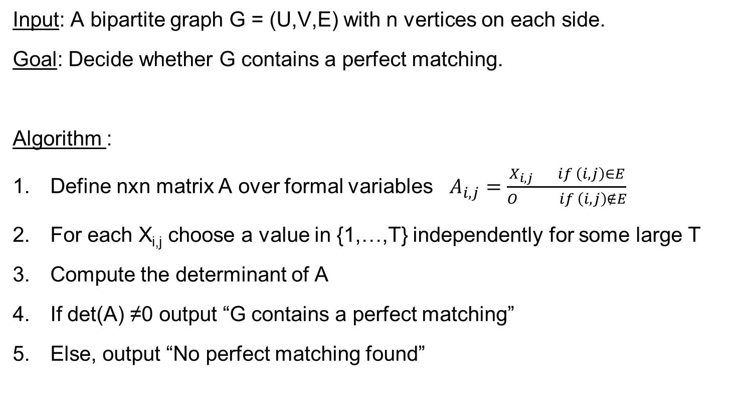
Perfect matching in a bipartite graph
Input: A bipartite graph G = (U,V,E) with n vertices on each side.
Goal: Decide whether G contains a perfect matching.
Algorithm :
Define nxn matrix A over formal variables $A_{i,j}=\frac{X_{i,j} if \left(i,j\right)∈E}{O if \left(i,j\right)∉E}$
For each X_{i,j} choose a value in {1,…,T} independently for some large T
Compute the determinant of A
If det(A) ≠0 output “G contains a perfect matching”
Else, output “No perfect matching found”
What’s going on here???

Slide 18
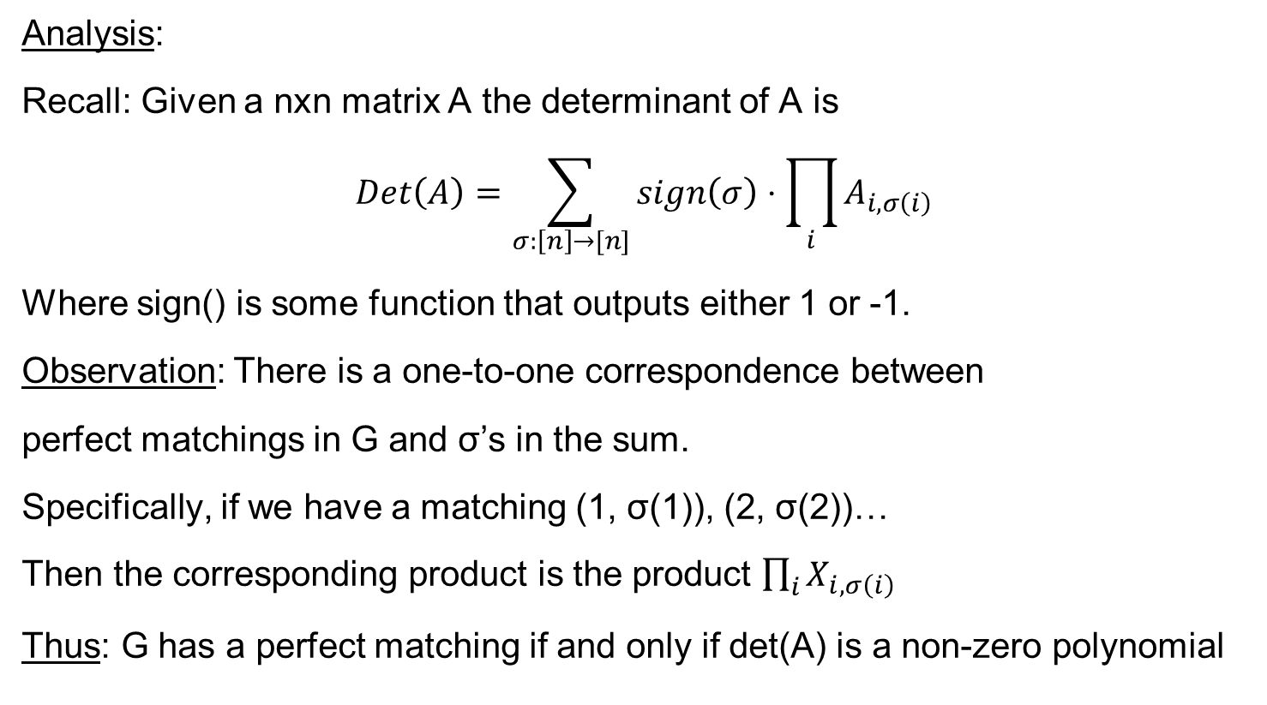
Perfect matching in a bipartite graph
Still, computing det(A) can be done in O(n³) time.
Analysis:
Recall: Given a nxn matrix A the determinant of A is
$$Det\left(A\right)=\sum_{σ:\left[n\right]→[n]}{sign\left(σ\right)⋅\prod_{i}{A_{i,σ\left(i\right)}}}$$
Where sign() is some function that outputs either 1 or -1.
Observation: There is a one-to-one correspondence between
perfect matchings in G and σ’s in the sum.
Specifically, if we have a matching (1, σ(1)), (2, σ(2))…
Then the corresponding product is the product $\prod_{i}{X_{i,σ\left(i\right)}}$
Thus: G has a perfect matching if and only if det(A) is a non-zero polynomial

Slide 19
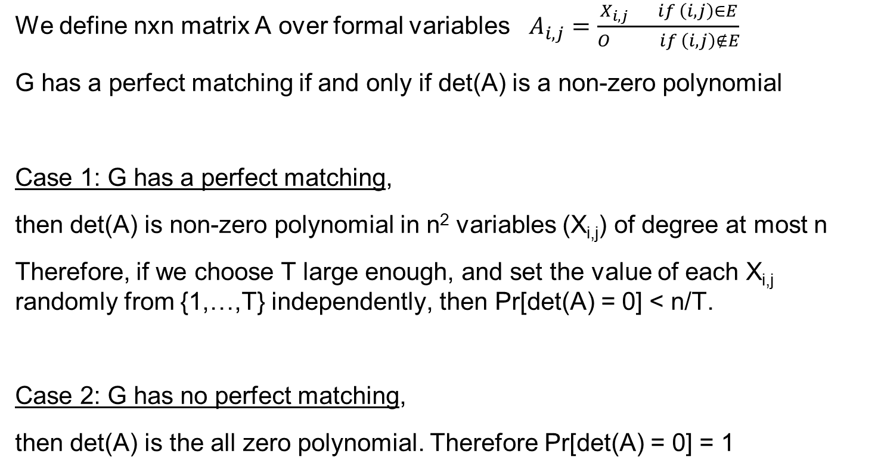
Perfect matching in a bipartite graph
We define nxn matrix A over formal variables $A_{i,j}=\frac{X_{i,j} if \left(i,j\right)∈E}{O if \left(i,j\right)∉E}$
G has a perfect matching if and only if det(A) is a non-zero polynomial
Case 1: G has a perfect matching,
then det(A) is non-zero polynomial in n² variables (X_{i,j}) of degree at most n
Therefore, if we choose T large enough, and set the value of each X_{i,j} randomly from {1,…,T} independently, then Pr[det(A) = 0] < n/T.
Case 2: G has no perfect matching,
then det(A) is the all zero polynomial. Therefore Pr[det(A) = 0] = 1

Slide 20
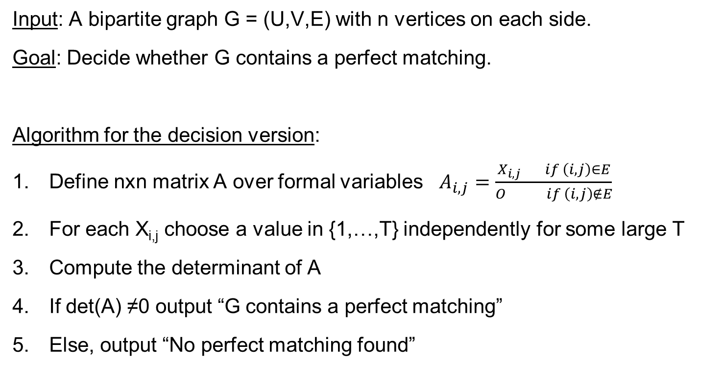
Perfect matching in a bipartite graph
Input: A bipartite graph G = (U,V,E) with n vertices on each side.
Goal: Decide whether G contains a perfect matching.
Algorithm for the decision version:
Define nxn matrix A over formal variables $A_{i,j}=\frac{X_{i,j} if \left(i,j\right)∈E}{O if \left(i,j\right)∉E}$
For each X_{i,j} choose a value in {1,…,T} independently for some large T
Compute the determinant of A
If det(A) ≠0 output “G contains a perfect matching”
Else, output “No perfect matching found”

Slide 21
Finding a minimum weight perfect matching in bipartite graphs

Slide 22
Min-weight perfect matchings
Input: A bipartite graph G = (U,V,E) with weights on the edges.
Goal: Find a perfect matching in G of minimal weight.
We may assume that the graph is a complete bipartite graph, and missing edges have some huge weight.

Slide 23
Min-weight perfect matchings
Input: A bipartite graph G = (U,V,E) with |U| = |V| = n and integer weights w_{i,j}>0
Goal (min value version): Output the weight of a min-weight perfect matching.
A simplifying (though weird) assumption: Suppose that G has a unique perfect matching of minimal weight.
Algorithm for the min value version:
Define nxn matrix A over reals as A_{i,j} = 10^{wij}
Compute the determinant of A
Output the largest k such that det(A) is divisible by 10^{k}
Example, if det(A) = 41507000, then we output 3 (because 10³ divides det(A))
What’s going on here???

Slide 24
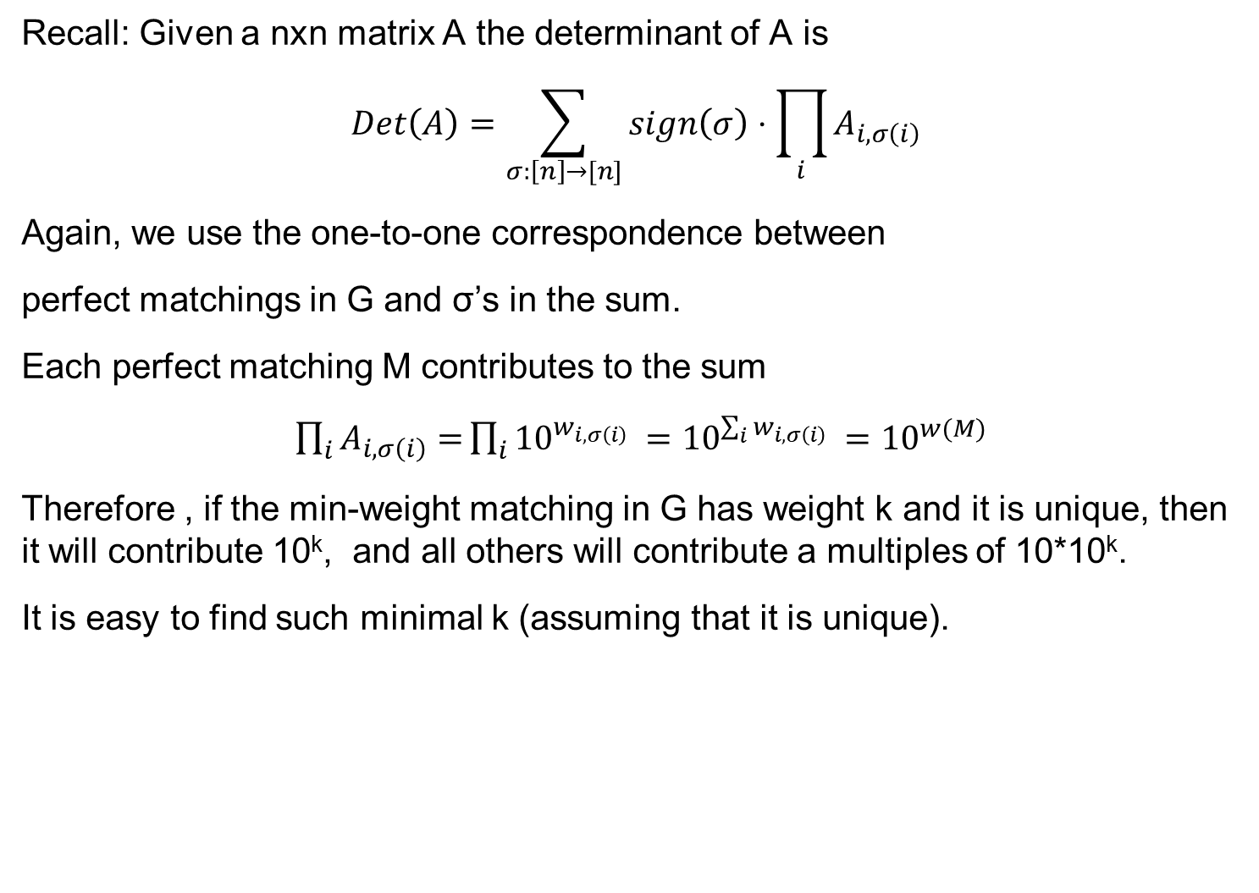
Min-weight perfect matchings
Recall: Given a nxn matrix A the determinant of A is
$$Det\left(A\right)=\sum_{σ:\left[n\right]→[n]}{sign\left(σ\right)⋅\prod_{i}{A_{i,σ\left(i\right)}}}$$
Again, we use the one-to-one correspondence between
perfect matchings in G and σ’s in the sum.
Each perfect matching M contributes to the sum
$\prod_{i}{A_{i,σ\left(i\right)}=}\prod_{i}{{10}^{w_{i,σ\left(i\right)} }={10}^{\sum_{i}{w_{i,σ\left(i\right)}} }}={10}^{w(M)}$
Therefore , if the min-weight matching in G has weight k and it is unique, then it will contribute 10^{k}, and all others will contribute a multiples of 10*10^{k}.
It is easy to find such minimal k (assuming that it is unique).

Slide 25
Min-weight perfect matchings
Next time: we’ll see how to get rid of the assumption that the min-weight matching is unique.
We’ll do it by adding to the weight of each edge some O(1/n²) random noise.
Since the weight of each matching is a sum of n integers, the weight of the noisy graph will allow us to recover the weight of the original graph.
Isolation lemma: we’ll see a lemma saying that with high probability we will “isolate” one min-weight perfect matching.
Then we’ll apply the algorithm on this graph with noisy weights

Slide 26
Questions?
Comments?

