Slide 1
CMPT 409/815
Advanced Algorithms
September 14, 2020

Slide 2
Announcements
Midterm: November 2, during the regular Monday class
Final: TBA
The exams will be take home exams, to be submitted within 3 hours.
Please let me know if you have conflicts with other courses.

Slide 3
Plan for today
A sample of (simple) randomized algorithms
Approximating π [Markov chain Monte Carlo method]
Verifying matrix multiplication [Freivalds’ algorithm]
A randomized algorithm for Min-cut [Karger’s algorithm]

Slide 4
A randomized algorithm for computing π

Slide 5
A randomized algorithm for computing π
Goal: Write an algorithm that prints π up to 10 decimal digits
Equivalently: Compute the area of a unit disk up to 10 decimal digits.
Fact: the area of a unit disc = π
Idea: Estimate p₀ = Pr_{x,y in [-1,1]}[(x,y) is in the disc]
Since the area of the square is 4,
it follows that area of the disc is 4*p₀
Q: How can we compute p₀?
A: Sample many random points in [-1,1], and check how many are in the disc.

Slide 6
A randomized algorithm for computing π
Goal: Write an algorithm that prints π up to 10 decimal digits
Equivalently: Compute the area of a unit disk up to 10 decimal digits.
Fact: the area of a unit disc = π
Algorithm:
Sample n random points (x_{i},y_{i}) ∈[-1,1] x [-1,1]
Let t be the number of point such that
x_{i}²+ y_{i}² ≤1
Let p_{est} = t/n, and output 4*p_{est}.

Slide 7
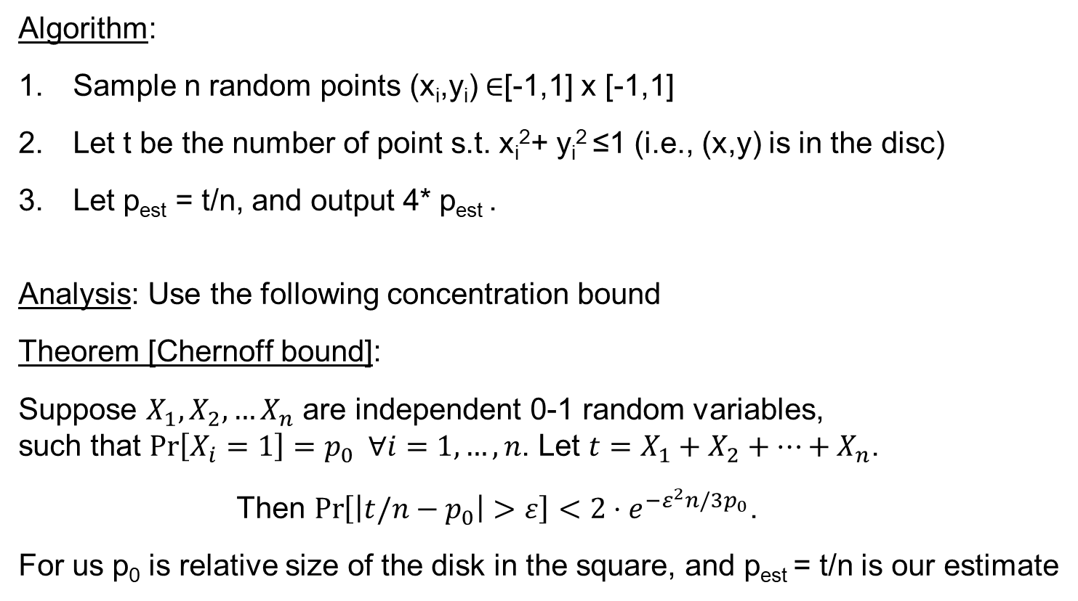
A randomized algorithm for computing π
Algorithm:
Sample n random points (x_{i},y_{i}) ∈[-1,1] x [-1,1]
Let t be the number of point s.t. x_{i}²+ y_{i}² ≤1 (i.e., (x,y) is in the disc)
Let p_{est} = t/n, and output 4* p_{est} .
Analysis: Use the following concentration bound
Theorem [Chernoff bound]:
Suppose $X_{1},X_{2},…X_{n}$ are independent 0-1 random variables,
such that $\operatorname{Pr}\left[X_{i}=1\right]=p_{0} ∀i=1,…, n$. Let $t=X_{1}+X_{2}+…+X_{n}$.
Then $\operatorname{Pr}\left[\left|t/n−p_{0}\right|>ε\right]<2⋅e^{{−ε}^{2}n/3p_{0}}$.
For us p₀ is relative size of the disk in the square, and p_{est} = t/n is our estimate
Intuitively, p_{est} should roughly be equal to the relative size of the disc in the square.

Slide 8
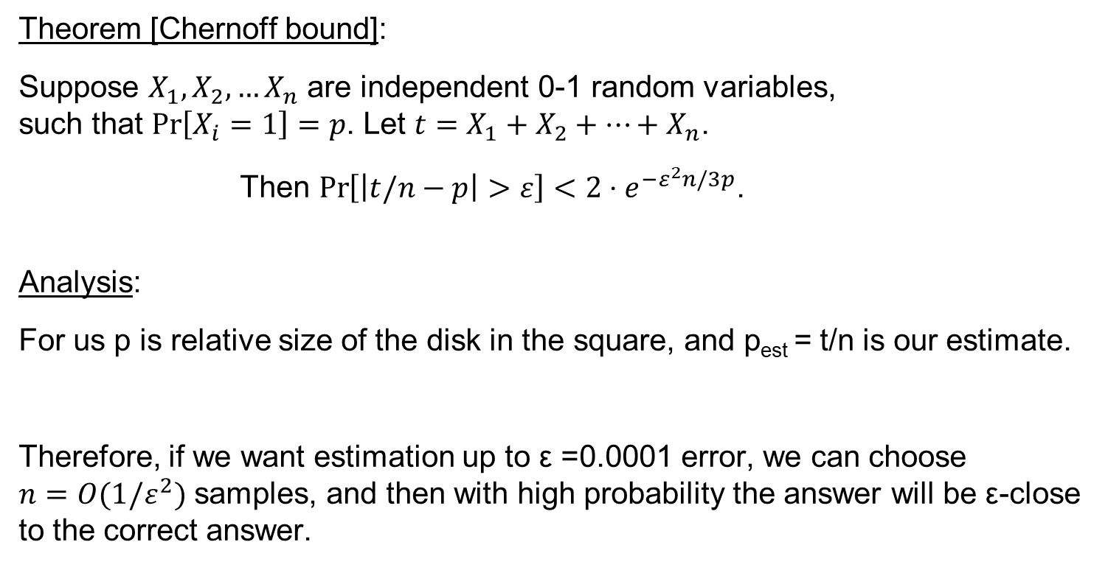
A randomized algorithm for computing π
Theorem [Chernoff bound]:
Suppose $X_{1},X_{2},…X_{n}$ are independent 0-1 random variables,
such that $\operatorname{Pr}\left[X_{i}=1\right]=p$. Let $t=X_{1}+X_{2}+…+X_{n}$.
Then $\operatorname{Pr}\left[\left|t/n−p\right|>ε\right]<2⋅e^{{−ε}^{2}n/3p}$.
Analysis:
For us p is relative size of the disk in the square, and p_{est} = t/n is our estimate.
Therefore, if we want estimation up to ε =0.0001 error, we can choose
$n=O(1/ε^{2})$ samples, and then with high probability the answer will be ε-close to the correct answer.

Slide 9
Questions?
Comments?

Slide 10
Freivalds' algorithm for verifying matrix multiplication

Slide 11
Verifying matrix multiplication
Input: Three NxN (real/integer) matrices A,B,C
Goal: check if A*B = C
Trivial solution: Compute A*B and compare the solution to C.
Runtime:
Naively, the runtime is O(N³) for multiplying two matrices
+ O(N²) for checking equality of two matrices.
Fact: Matrix multiplication can be solved in time O(N^{2.3728639}).
Therefore the total runtime is O(N^{2.3728639}).
Can we do faster?

Slide 12
Verifying matrix multiplication
Input: Three NxN (real/integer) matrices A,B,C
Goal: check if A*B = C
Theorem: There exists an algorithm that runs in O(N²) time and returns the correct answer with probability > 0.999.
Freivalds' algorithm: On input A,B,C
Repeat 10 times
  Sample v∈{0,1}^{N} by picking each v_{i} to be 0/1 w.p. ½ independently
  Compute z = A*B*v (in O(N²) time)
  Compute z’ = C*v (in O(N²) time)
  If z≠z’ return “NOT EQUAL”
If reached here, return “EQUAL”
How can we compute A*B*z in O(N²) time?

Slide 13
Verifying matrix multiplication
  Sample v∈{0,1}^{N} by picking each v_{i} to be 0/1 w.p. ½ independently
  Compute z = A*B*v (in O(N²) time)
  Compute z’ = C*v (in O(N²) time)
  If z≠z’ return “NOT EQUAL”
Analysis: Let’s analyze only one iteration of the algorithm.
If A*B = C, then clearly Pr_{v}[z=z’]=1.
Therefore, if A*B = C, then the algorithm outputs “EQUAL” with probability 1.

Slide 14
Verifying matrix multiplication
Claim: If A*B ≠ C, then Pr_{v}[z=z’] <= 1/2.
This implies that Pr[all 10 iterations have z=z’] <= 1/2¹⁰< 1/1000.
Proof of claim:
Let D=A*B-C. Then D is a non-zero matrix and
Pr_{v}[z=z’] = Pr_{v}[z-z’=0] = Pr[(A*B-C)v ≡ 0] = Pr[Dv ≡ 0].
Since D is a non-zero matrix, there is some i,j∈[N] such that D_{i,j} ≠0.
Focus only on the i’th row of D. We prove that Pr_{v}[<D_{i},v> = 0] <= ½.
0 | 0 | 0 | 0 | 0
0 | 0 | 0 | 0 | 0
1 | 0 | 2 | 0 | 0
0 | 0 | 0 | 0 | 0
0 | 4 | 0 | 0 | 1
v₁
v₂
v₃
v₄
v₅
x =

Slide 15
Verifying matrix multiplication
Claim: Let r = (r₁…r_{N}) be a non-zero row of N integers/reals
Sample v∈{0,1}^{N} by picking each v_{i} to be 0/1 w.p. ½ independently
Then Pr[∑_{j} r_{j} v_{j} = 0] <= ½.
Proof: Suppose for concreteness that r_{N}≠0.
Sample first v₁,v₂,…v_{N-1}. Then there is at most one possible value for v_{N} so that ∑_{j} r_{j} v_{j} = 0.
Example1: if ∑_{j<=N-1} r_{j} v_{j} = 0, then only v_{N}=0 will make the entire sum 0.
Example2: if ∑_{j<=N-1} r_{j} v_{j} = -r_{N}, then only v_{N}=1 will make the entire sum 0.
Therefore, for any fixing of v₁,v₂,…v_{N-1} we have
Pr[∑_{j} r_{j} v_{j} = 0] <= ½.

Slide 16
Verifying matrix multiplication
Back to our claim
Claim: If A*B ≠ C, then Pr_{v}[z=z’] <= 1/2.
Proof of claim:
Let D=A*B-C. Then D is a non-zero matrix and
Pr_{v}[z=z’] = Pr_{v}[z-z’=0] = Pr[(A*B-C)v ≡ 0] = Pr[Dv ≡ 0].
Focus only on the i’th row of D.
We have Pr[Dv ≡ 0] <= Pr_{v}[<D_{i},v> = 0] <= ½, as required.
0 | 0 | 0 | 0 | 0
0 | 0 | 0 | 0 | 0
1 | 0 | 2 | 0 | 0
0 | 0 | 0 | 0 | 0
0 | 4 | 0 | 0 | 1
v₁
v₂
v₃
v₄
v₅
x =

Slide 17
Verifying matrix multiplication
Freivalds' algorithm: On input A,B,C
Repeat 10 times
  Sample v∈{0,1}^{N} by picking each v_{i} to be 0/1 w.p. ½ independently
  Compute z = A*B*v (in O(N²) time)
  Compute z’ = C*v (in O(N²) time)
  If z≠z’ return “NOT EQUAL”
If reached here, return “EQUAL”
Theorem:
If AB = C, then Pr[Algorithm returns “EQUAL] = 1
If AB ≠ C, then Pr[Algorithm returns “”NOT EQUAL”] >0.999

Slide 18
Questions?
Comments?

Slide 19
Karger‘s Min-Cut algorithm

Slide 20
Karger‘s Min-Cut algorithm
Input: A graph G=(V,E)
Output: minimum cut in G
A minimum cut in G is a subset of vertices S⊆V such that the number of edges between S and V\S is minimal.
Denote the number of edges between S and V\S by E(S,V\S).
You have probably seen the Max-Flow Min-Cut theorem
and a Max-Flow algorithm.
Today we’ll see a randomized algorithm for this problem.

Slide 21
Karger‘s Min-Cut algorithm
Input: A connected graph G=(V,E)
Output: Min-Cut(G)
Algorithm:
While G has more than 2 vertices do
Choose a random edge e∈E
Contract e
Return the partition corresponding to the two remaining supernodes.

Slide 22
Karger‘s Min-Cut algorithm
Example:
The partition is S = {a,b,c} V\S = {e,f}
The cut size is E(S, V\S) = 4
ab
ab
abc
a
(a,b)
(e,f)
(ab,c)
b
c
c
c
f
f
ef
e
e
ef

Slide 23
Karger‘s Min-Cut algorithm
Input: A connected graph G=(V,E)
Output: Min-Cut(G)
Algorithm:
While G has more than 2 vertices do
Choose a random edge e∈E
Contract e
Return the partition corresponding to the two remaining supernodes.

Slide 24
Karger‘s Min-Cut algorithm
Algorithm:
While G has more than 2 vertices do
Choose a random edge e∈E
Contract e
Return the partition corresponding to the two remaining supernodes.
Theorem: Let (S, V\S) be a partition corresponding to the minimum cut in G.
Then Pr[algorithm returns this partition] >= 2/(n²-n)
Therefore, by repeating the algorithm O(n²) times and taking the best solution we can find min-cut(G)
What is the total runtime of the algorithm?

Slide 25
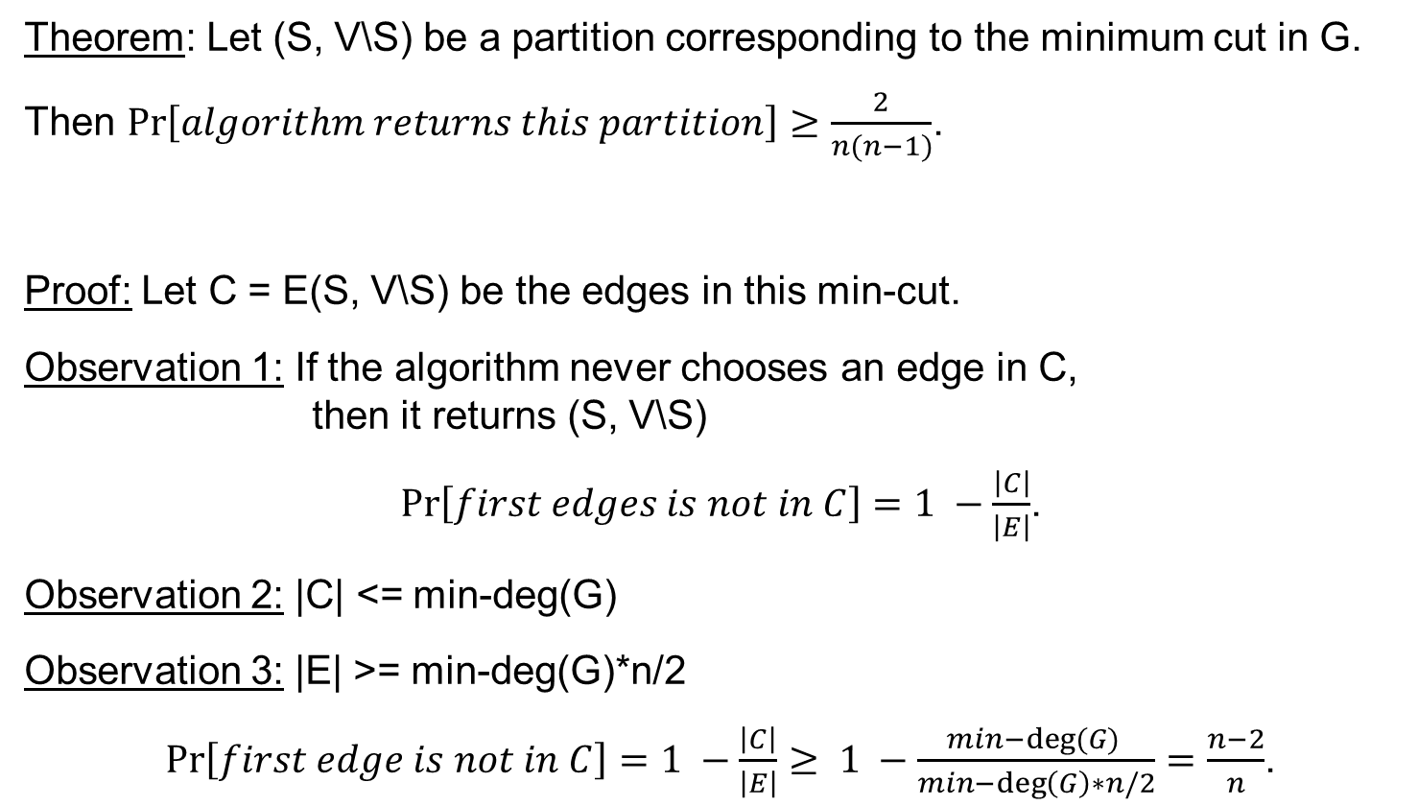
Karger‘s Min-Cut algorithm
Theorem: Let (S, V\S) be a partition corresponding to the minimum cut in G.
Then $Pr\left[algorithm returns this partition\right]≥\frac{2}{n(n−1)}$.
Proof: Let C = E(S, V\S) be the edges in this min-cut.
Observation 1: If the algorithm never chooses an edge in C,
then it returns (S, V\S)
$Pr\left[first edges is not in C\right]=1 −\frac{\left|C\right|}{\left|E\right|}$.
Observation 2: |C| <= min-deg(G)
Observation 3: |E| >= min-deg(G)*n/2
$Pr\left[first edge is not in C\right]=1 −\frac{\left|C\right|}{\left|E\right|}≥ 1 −\frac{min−deg⁡(G) }{min−\deg\left(G\right)∗n/2}=\frac{n−2}{n}$.

Slide 26
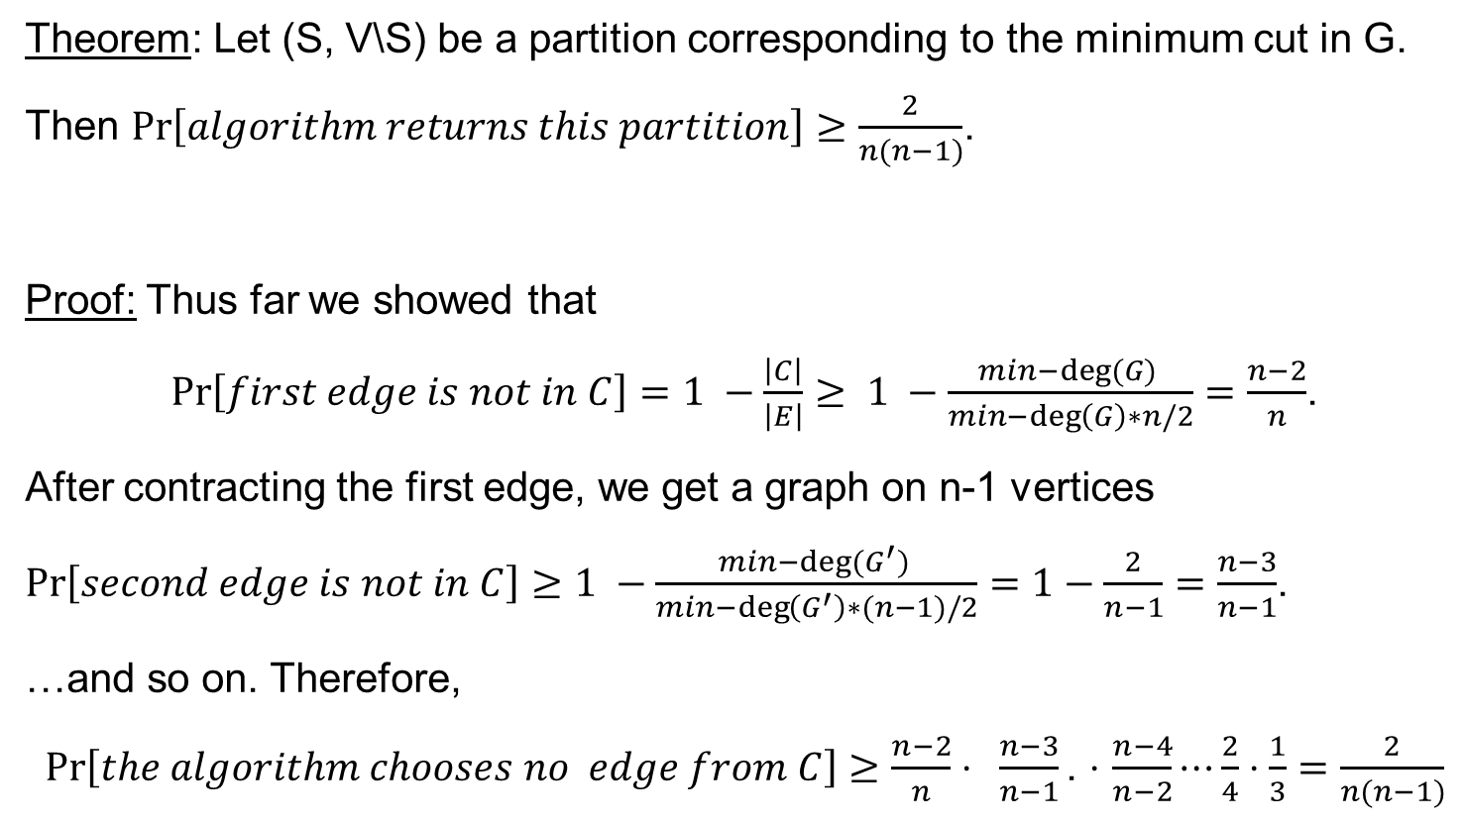
Karger‘s Min-Cut algorithm
Theorem: Let (S, V\S) be a partition corresponding to the minimum cut in G.
Then $Pr\left[algorithm returns this partition\right]≥\frac{2}{n(n−1)}$.
Proof: Thus far we showed that
$Pr\left[first edge is not in C\right]=1 −\frac{\left|C\right|}{\left|E\right|}≥ 1 −\frac{min−deg⁡(G) }{min−\deg\left(G\right)∗n/2}=\frac{n−2}{n}$.
After contracting the first edge, we get a graph on n-1 vertices
$Pr\left[second edge is not in C\right]≥1 −\frac{min−deg⁡(G^{′}) }{min−\deg\left(G^{′}\right)∗(n−1)/2}=1−\frac{2}{n−1}=\frac{n−3}{n−1}$.
…and so on. Therefore,
$Pr\left[the algorithm chooses no edge from C\right]≥\frac{n−2}{n}⋅ \frac{n−3}{n−1}\text{.}$ $⋅$ $\frac{n−4}{n−2}⋯\frac{2}{4}⋅\frac{1}{3}=\frac{2}{n(n−1)}$

Slide 27
Questions?
Comments?

